Slide 1
iSER update
Eyal Salomon
Mellanox Technologies
2014 OFA Developer Workshop
Sunday, March 30 - Wednesday, April 2, 2014
Monterey CA

Slide 2
Agenda
iSER Advantages and Status
Support for new targets
LIO, SCST, TGT enhancements
Initiator features and updates
Linux, VMware
Performance acceleration: iSER-BD and Block MultiQ
iSER in OpenStack (Cinder)

Slide 3
iSER Advantages and Status
Advantages
Enterprise Storage Solution (Security, HA, Discovery, ..)
OS tools and integration based on iSCSI
Ethernet (RoCE, iWarp) + InfiniBand
faster than SRP (on IOPs & Latency)
Status and Adoption
In the kernel for few years, and constantly improving
Seamless integration into OpenStack (from Havana)
Adopted by many cloud providers
Will be available from multiple Tier1-2 storage vendors in the coming months

Slide 4
Storage Targets Support
 | SRP | iSER | FCoE (Mlnx)
SCST (Kernel, external) | Yes | Yes | No
TGTD (User) | No | Yes | No
LIO (Kernel, inbox) | Yes | Yes | In-progress
GPL free, standalone reference (for storage OEMs and other OSes) | No, can base on SCST | Yes (can be obtained from Mellanox) | No, can base on LIO

Slide 5
LIO iSER
iSER available from kernel 3.10
T10-DIF
Implemented T10-DIF framework in target core
Implemented for iSER – fully offloading transport
Can do ADD/STRIP/PASS and verify of T10-DIF info
Implemented for File backing store
Can keep DIF interleaved in the data file (so one file has it all)
Can keep DIF in separate file (so data file stays clean with data only)
Good for development & debug (can inject errors…)
working on performance optimizations

Slide 6
SCST
SCST: A leading Linux target implementation
iSCSI in SCST extended to support RDMA transport as well as TCP
Transport API to abstract away from transport implementation
High IOPs and bandwidth
Supports Infiniband, RoCE and iWARP
Available at http://scst.sourceforge.net/target_iser.html

Slide 7
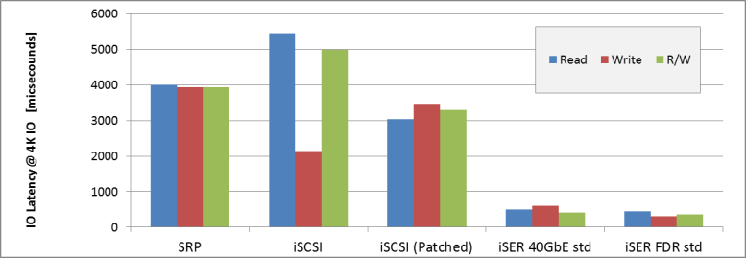
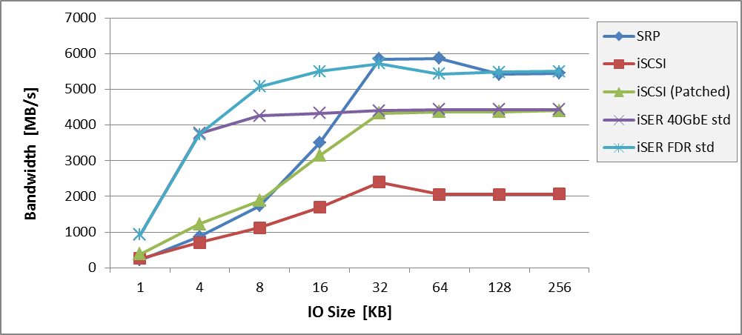
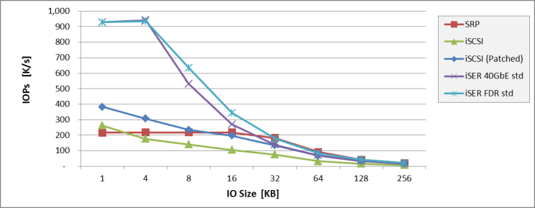
Example Linux SCST Target Transport Comparison
Single Initiator to Single Target
Using HP DL380 with 2 x Intel 2650 CPUs
ConnectX-3 Adapter (40GbE or IB FDR)

Slide 8
TGT iSER features
sophisticated polling strategies to maximize IOPS
support iSCSI Discovery over iser
usage of Huge pages to minimize HCA cache misses
support multiple instances for IOPS scalability
support larger IO queue depth
Configurable memory buffer
Configurable CQ affinity

Slide 9
Initiator recent features
Linux
ability to work in a VM over SRIOV VF
support fast registration (FRWR)
support iSCSI Discovery over iser
optimized fast-path locking scheme in libiscsi
support larger IO queue depth
support SCSI T10 signature/protection
misc stability fixes
VMware ESX
iSER integrated into ESX 5.1/5.5 as an iSCSI HW offload
Work on native port to ESX 6 kernel

Slide 10
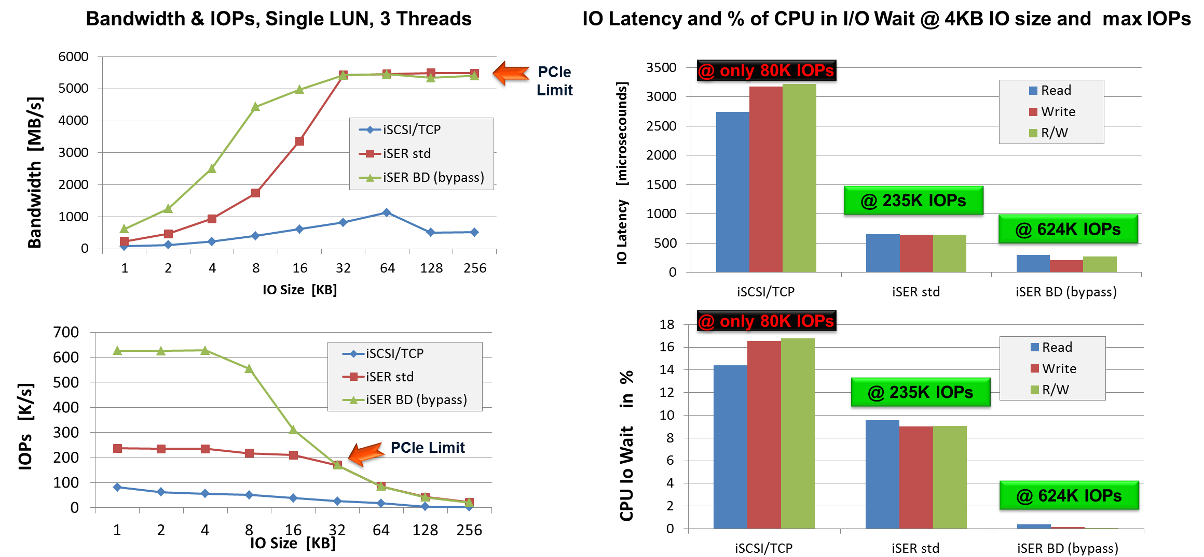
Accelerating IO Performance (Accessing a Single LUN)

Slide 11
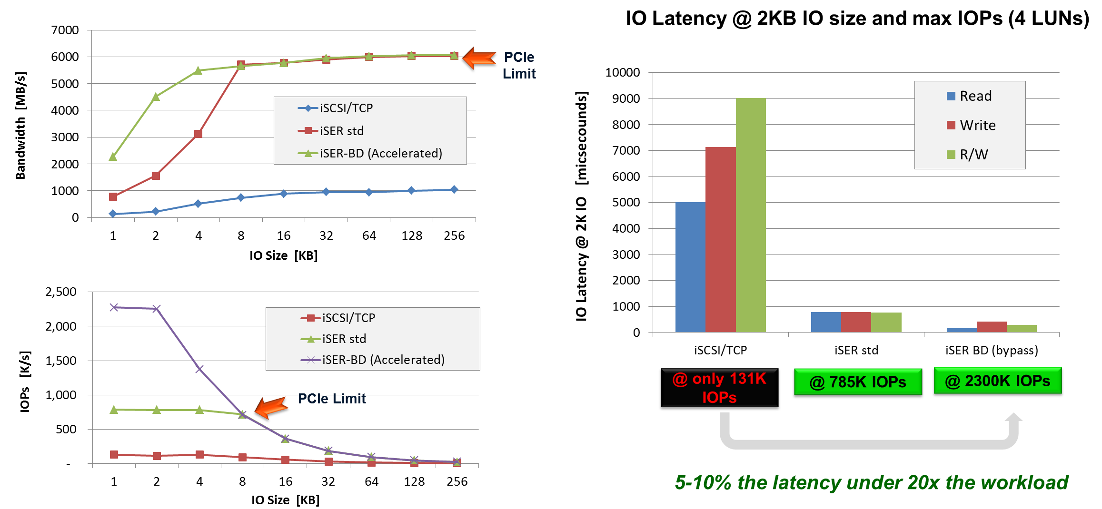
Accelerating IO Performance (Accessing 4 LUN in parallel)

Slide 12
MultiQ
The iSER initiator exposes a SCSI Block device to the OS
Both the Block and SCSI layers are performance bottlenecks e.g. for IOPS scalability
in Linux 3.13 BLK-MQ was introduced to the block layer for generic block devices
SCSI MQ is under the works by the community and iSER is planned to leverage on that
The results in the previous slides were obtained by a prototype that emulated BLK/SCSI MQ

Slide 13
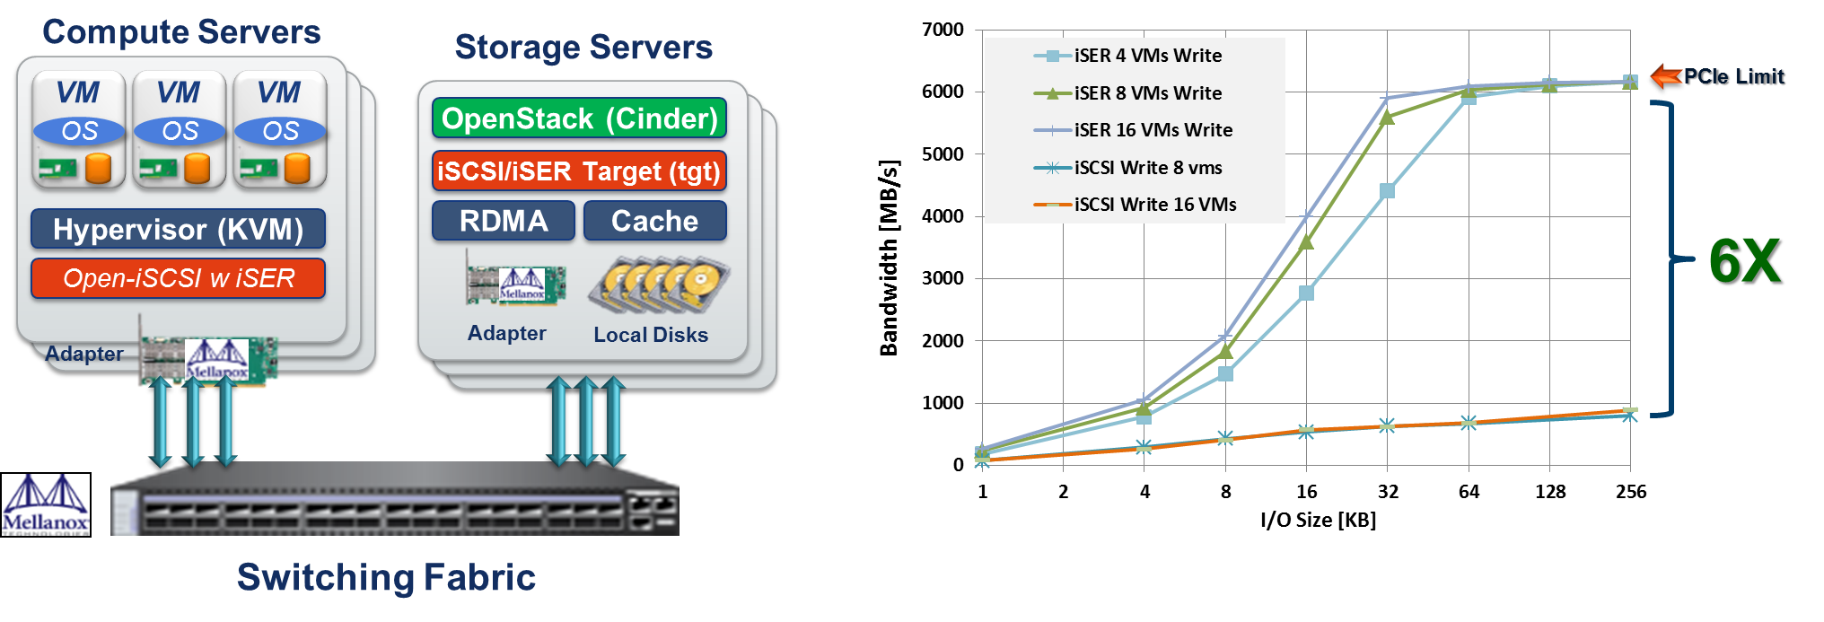
iSER in OpenStack
Using OpenStack Built-in components and management (Open-iSCSI, tgt target, Cinder), no additional software is required, RDMA is already inbox and used by our OpenStack customers !
Mellanox enable faster performance, with much lower CPU%
Next step is to bypass Hypervisor layers, and add NAS & Object storage

Slide 14
Thank You

