Slide 1

Architecture and Usages of Accelio
Eyal Salomon
Mellanox Technologies
2014 OFA Developer Workshop
Sunday, March 30 - Wednesday, April 2, 2014
Monterey CA

Slide 2
What is Accelio in a Nutshell
High-performance, Transport independent, Simple to use
Reliable Messaging and RPC Library for Accelerating applications
Support User space, Kernel, C/C++, Java, Python (Future) bindings
Optimal usage of CPU and Network hardware resources
Built in fault-tolerance, transaction reliability, and load-balancing
Integrated into OpenSource (e.g. HDFS, Ceph), and
Commercial Storage/DB products in-order to accelerate
its transport with minimal development/integration effort
OpenSource Community project from the ground up:
  Site: http://accelio.org
  Code in: http://github.com/accelio
  Project/Bug tracking: http://launchpad.net/accelio

Slide 3
Accelio Goal
Goal: Provide an easy to use, reliable, scalable, and high performance data/message delivery middleware that maximize efficiency of modern CPU and NIC hardware
Key features:
  Focus on high-performance asynchronous APIs
  Reliable message delivery (end to end)
  Request/Response (Transaction) or Send/Receive models
  Provide connection and resource abstraction to max scalability and availability
  Maximize multi-threaded application performance with dedicated HW resources per thread
  Designed to maximize the benefits of RDMA, hardware offloads, and Multi-core CPUs
  Will support multiple transport options (RDMA, TCP, ..)
  Native support for service and storage clustering/scale-out
  Small message combining
  Simple and abstract API

Slide 4
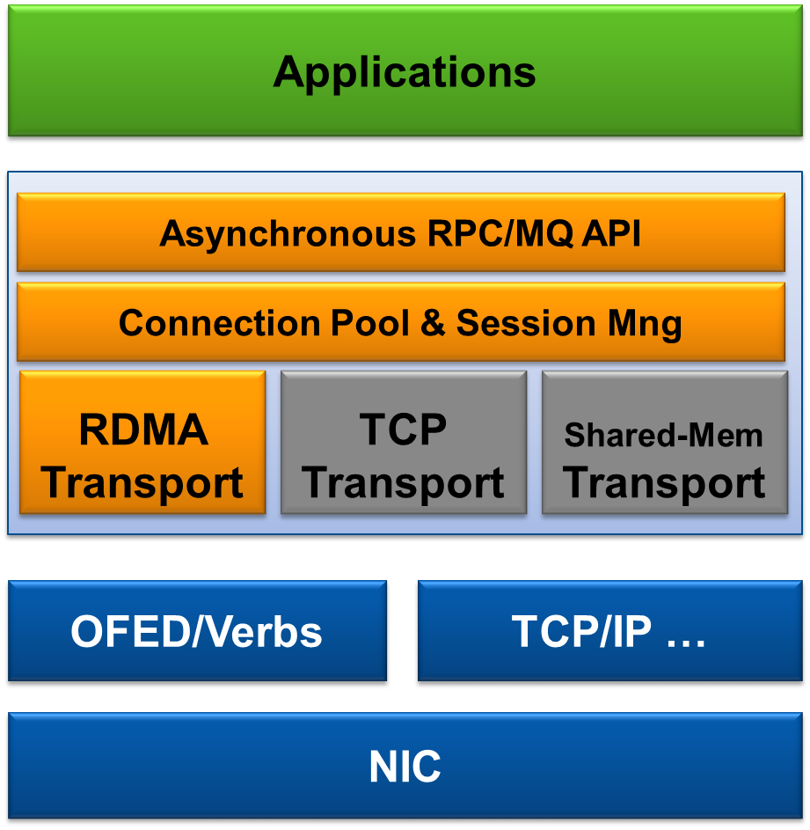
Accelio Architecture
Abstract, Easy to use API
Use multiple connections per session:
maximize CPU core usage/parallelism
High-availability & Migration
Scale network bandwidth
Pluggable Transports:
Code once for multiple HW options
Seamlessly use RDMA

Slide 5
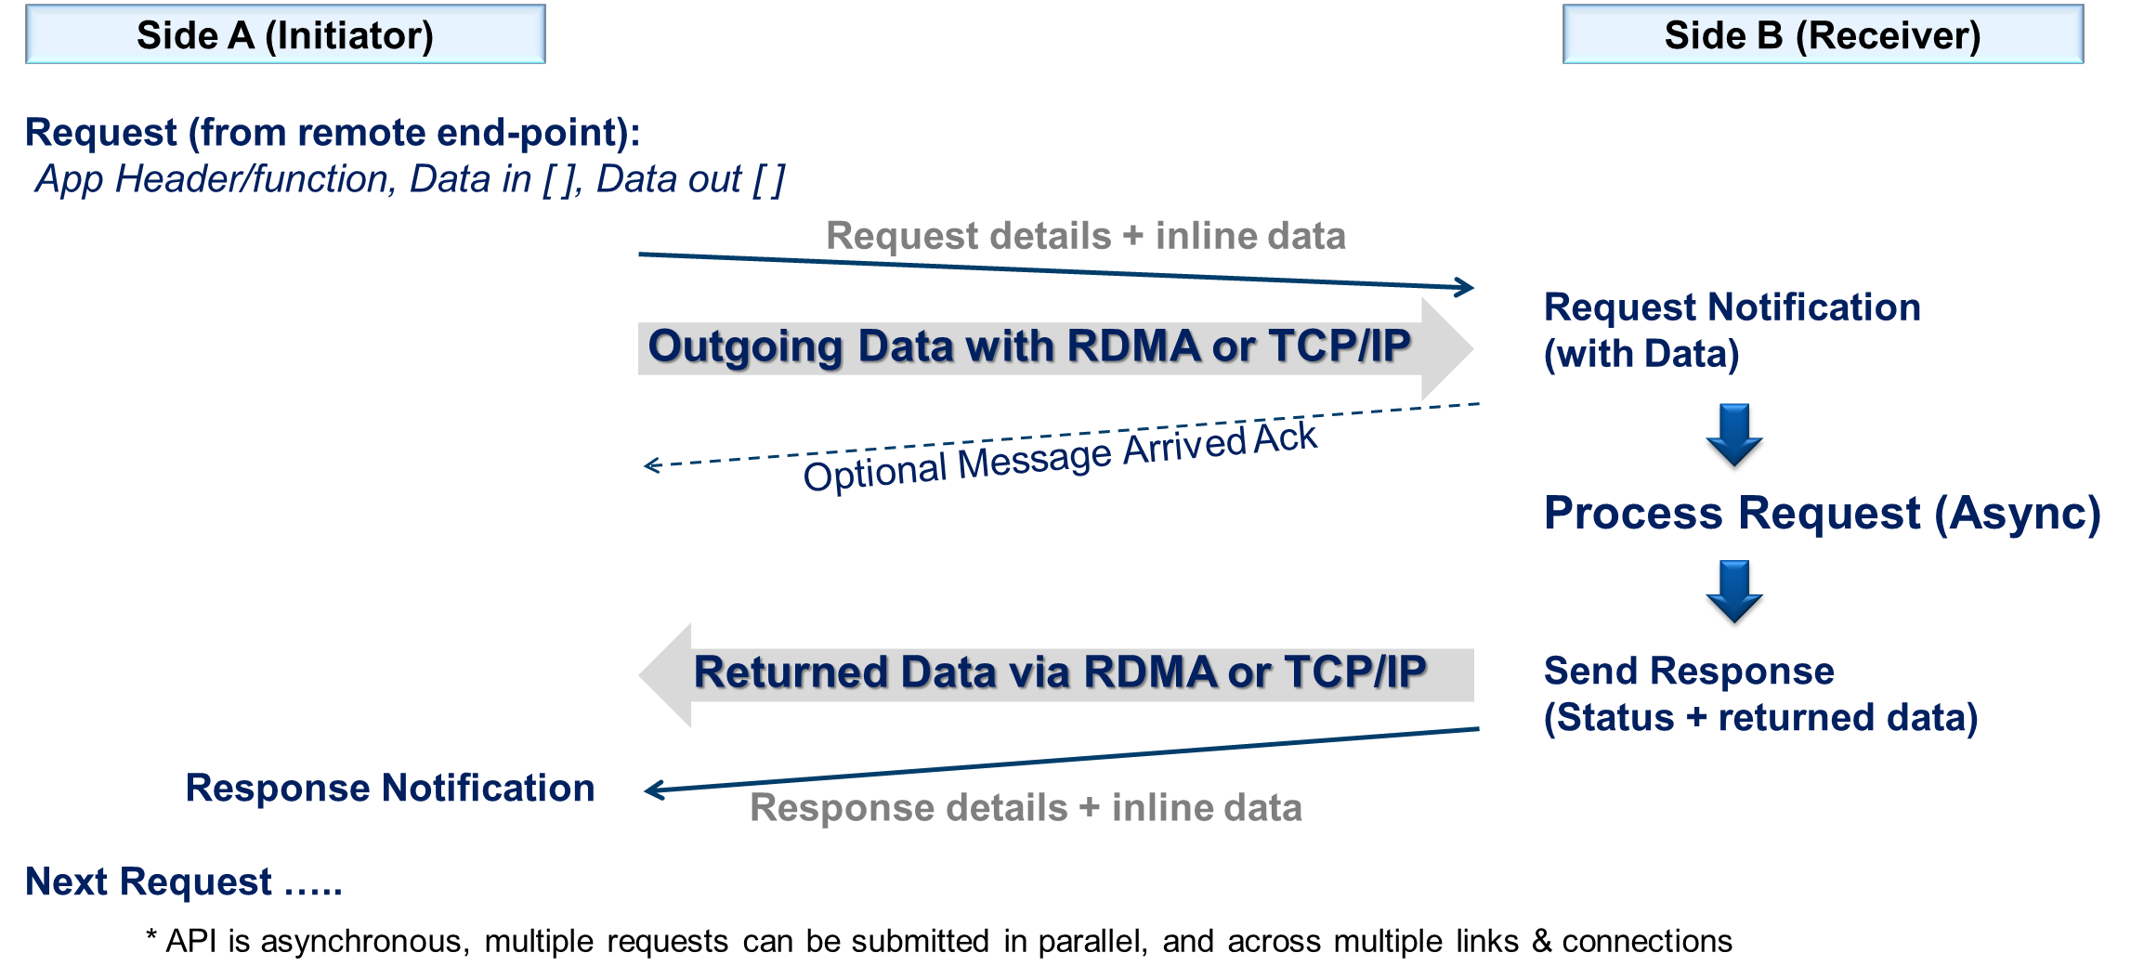
High Level Transaction Flow

Slide 6
Accelio Example - Hello Client
int main(int argc, char *argv[])
{
struct …
/* open one thread context set the polling timeout */
ctx = xio_context_create(NULL, 0);
/* create a session and connect to server */
session = xio_session_create(XIO_SESSION_CLIENT, &attr, url, 0, 0, &session_data);
session_data.conn = xio_connect(session, ctx, 0, NULL, &session_data);
…
xio_send_request(session_data.conn, session_data.req);
/* run the default xio main loop */
xio_context_run_loop(ctx, XIO_INFINITE);
/* normal exit phase */
xio_context_destroy(ctx);
return 0;
}

Slide 7
Accelio Example - Hello Client
int on_session_event(struct xio_session *session, struct xio_session_event_data *event_data,
void *cb_user_context)
{
switch (event_data->event) {
case XIO_SESSION_CONNECTION_TEARDOWN_EVENT:
xio_connection_destroy(event_data->conn);
break;
case XIO_SESSION_TEARDOWN_EVENT:
xio_session_destroy(session);
break;
}
return 0;
}
int on_response(struct xio_session *session, struct xio_msg *rsp, int more_in_batch,
void *cb_prv_data)
{
struct …
process_response(rsp); /* process the incoming message, send a new one */
xio_release_response(rsp); /* acknowledge xio that response resources can be recycled */
…
xio_send_request(session_data.conn, session_data.req);
return 0;
}

Slide 8
Accelio Example - Hello Server
int main(int argc, char *argv[])
{
struct …
/* create thread context for the server */
ctx = xio_context_create(NULL, 0);
/* bind a listener server to a portal/url */
server = xio_bind(ctx, &server_ops, url, NULL, 0, &server_data);
xio_context_run_loop(ctx, XIO_INFINITE);
/* normal exit phase */
xio_unbind(server);
xio_context_destroy(ctx);
return 0;
}

Slide 9
Accelio Example - Hello Server
static int on_new_session(struct xio_session *session, struct xio_new_session_req *req, void *cb_prv_data)
{
/* accept new connection request */
xio_accept(session, NULL, 0, NULL, 0);
return 0;
}
static int on_new_request(struct xio_session *session, struct xio_msg *req, int more_in_batch, void *cb_prv_data)
{
struct …
/* process request and send a response */
process_request(req);
/* attach the original request to response and send it */
response->request = req;
xio_send_response(response);
return 0;
}

Slide 10
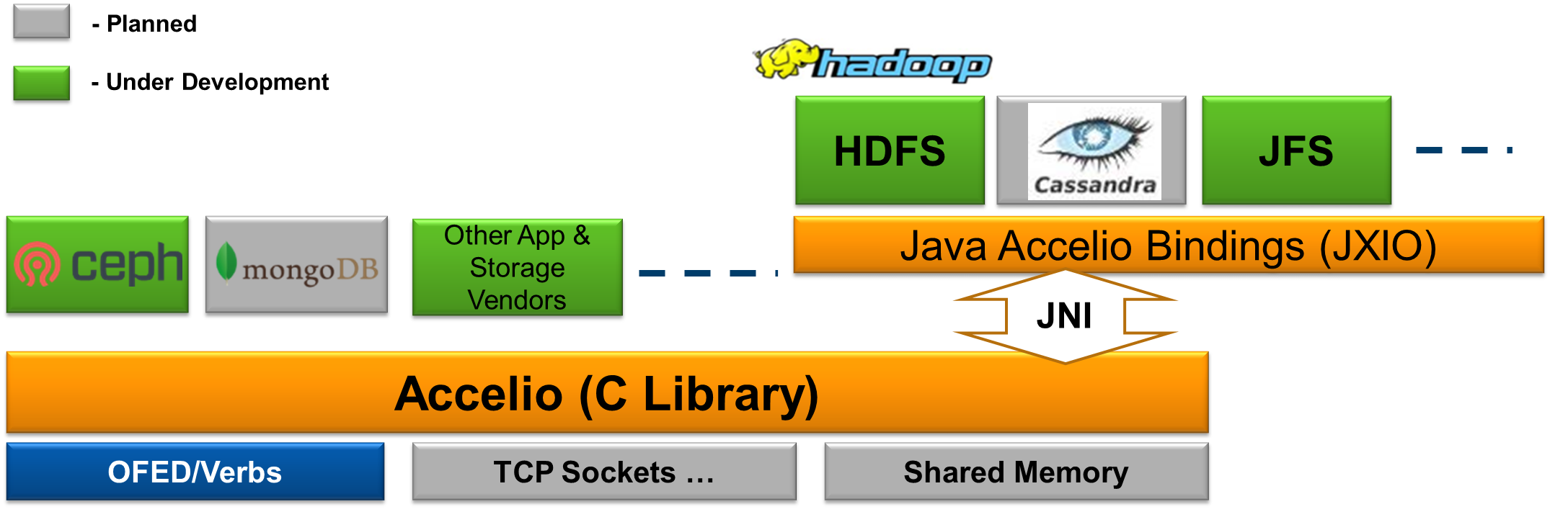
Accelio Integration With
Other Applications/Projects
Accelio is adopted as the high-performance, low-latency, Reliable Messaging/RPC library for variety Open-Source and Commercial products, customer projects
Support multiple bindings (Kernel C, User Space C/C++, Java, Python (future))

Slide 11
Use case 1: XNBD
Accelio based network block device
Multi-queue implementation in the block layer for high performance
Utilizes Accelio’s facilities and features:
  Hardware acceleration for RDMA
  Zero data copy
  Lockless design
  Optimal CPU usage
  Reliable message delivery
IO operation translation to libaio submit operations to remote device.
OpenSource Community project from the ground up:
  Code in: http://github.com/accelio/xnbd
Prerequisites:
  Accelio 1.1 version and above.
  Kernel version 3.13.1 and above.

Slide 12
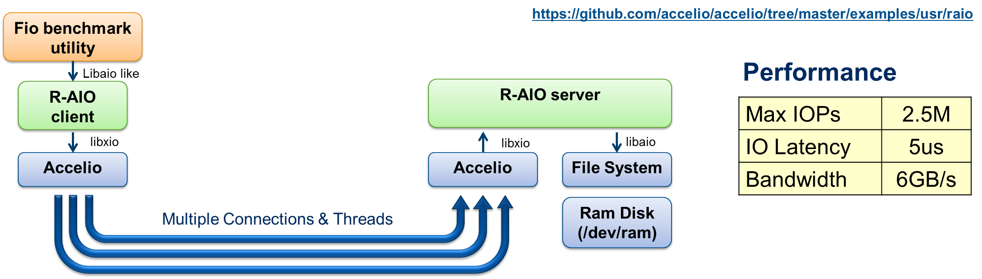
Use case 2: R-AIO Remote File
Access Application Example
Provide access to a remote file system by redirecting libaio (async file IO) commands to a remote server (which will issue the IO and return the results to the client)
Deliver extraordinary performance to remote ram file (/dev/ram)
  Using 4 CPUs & HW QPs for parallelism
  Similar performance to local ram file access (i.e. minimal degradation due to communication)

Slide 13
Use case 3: JXIO
JXIO provides the first RDMA API in JAVA
JXIO is a Java wrapper of Accelio library
Open source project: https://github.com/accelio/JXIO
Preserves Accelio’s zero copy and performance all the way
Every C struct in Accelio is represented by a matching Java class
Provides 1.5M transactions per second (in Java)
Reliable message delivery
Low memory footprint
Essential component in Mellanox’s HDFS RDMA acceleration solution

Slide 14
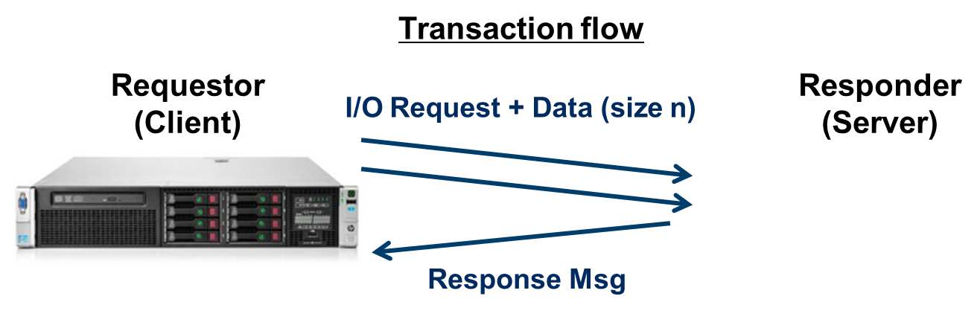
Test Configuration
Server
  HP ProLiant DL380p Gen8
  2 x Intel(R) Xeon(R) CPU E5-2650 0 @ 2.00GHz
  64 GB Memory
Adapters
  ConnectX3-Pro VPI (IB FDR or 40GbE)
  ConnectIB 16x PCIe
  OFED 2.1
OS
  RedHat EL 6.4
  Kernel: 2.6.32-358.el6.x86_64
Test
  Accelio I/O test utility in C, User space
  Request/Responce transactions (RPC)
  Over 1 or 2 ports, using auto
  load balancing based on threads

Slide 15
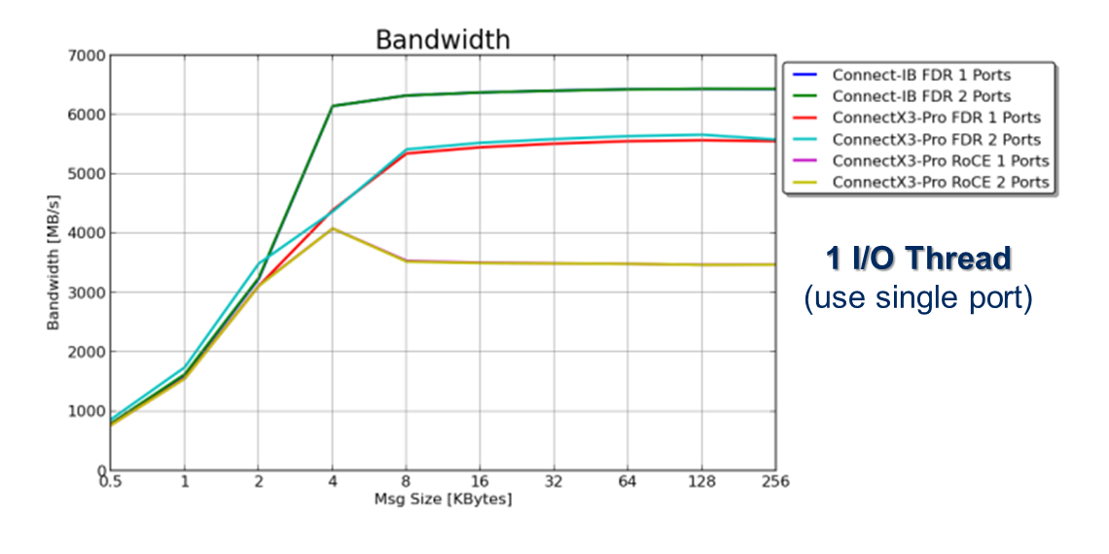
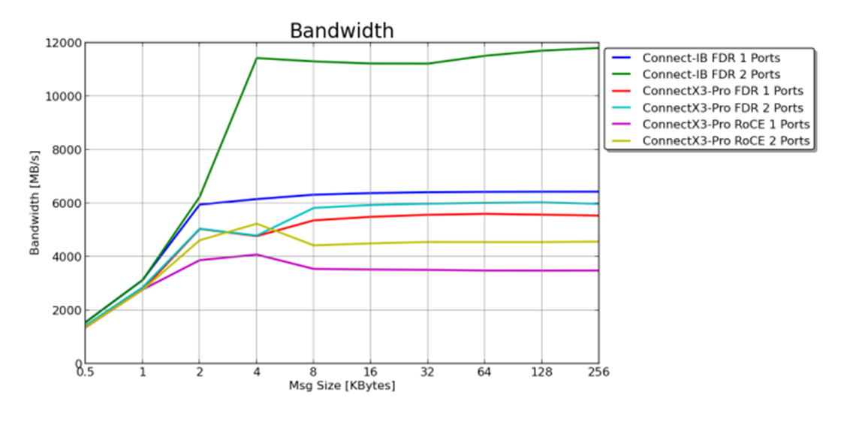

Bandwidth Results
~ 12GB/s with Connect-IB

Slide 16
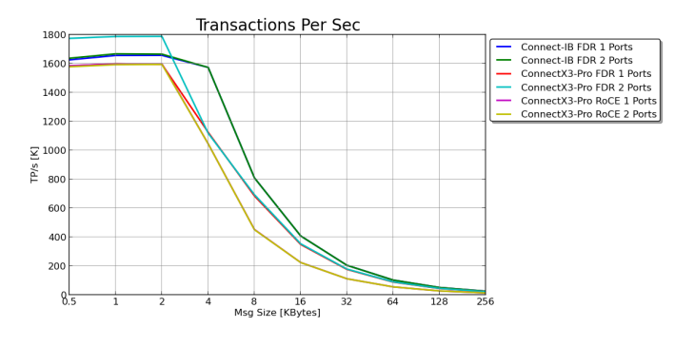
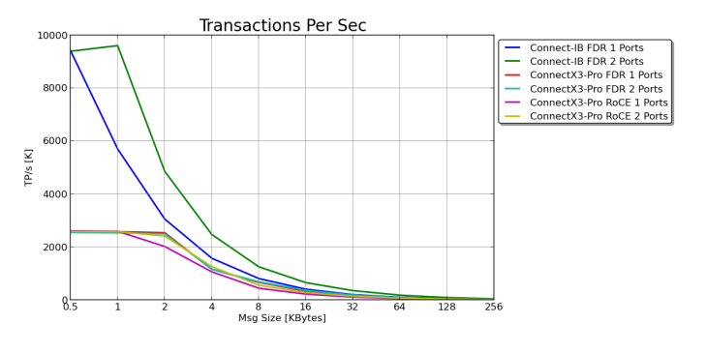
Transaction Per Second (IOP/s)
Results
Hit Max Bandwidth
1 I/O Thread
(use single port)
> 9M TP/s with Connect-IB
8 I/O Threads

Slide 17
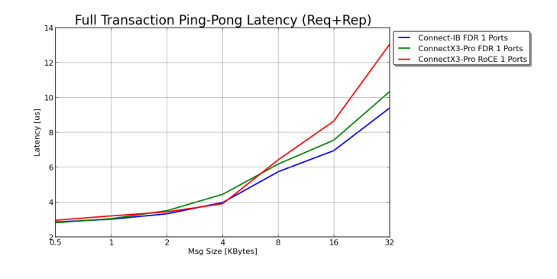
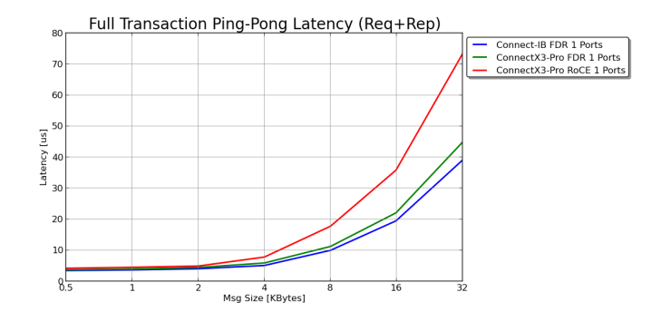
Round Trip Latency (Request & Response)
Results
Less than 3us in 1KB Messages
1 I/O Thread
Hit Max Bandwidth
8 I/O Threads

Slide 18
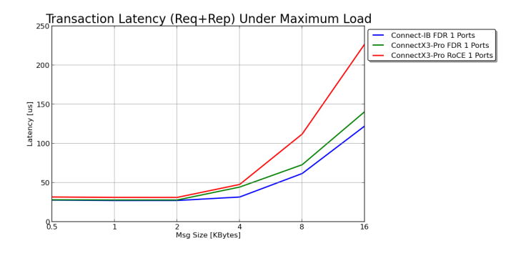
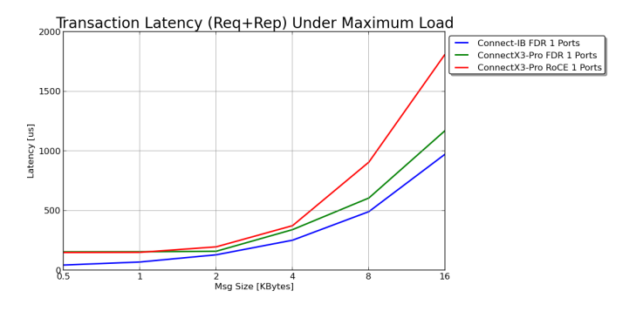
Latency Under Maximum Load (Millions of Messages/Sec)
1 I/O Thread
(use single port)
30us @ 1.8M Messages/Sec
Hit Max Bandwidth
(Link become congested)
44us @ ~9M Messages/Sec
With Connect-IB
8 I/O Threads

Slide 19
Open source project
  Initiated by Mellanox
  Partnership
  Companies and Individuals are welcome to join the project and contribute
  Web site: http://accelio.org
  Code in: http://github.com/accelio
  Project/Bug tracking: http://launchpad.net/accelio
  Email: info@accelio.org
  License: Dual BSD/GPLv2

Slide 20
Thank You

