Slide 1
Panel Discussion:
The Future of I/O From a CPU Architecture Perspective
Brad Benton
AMD, Inc.
#OFADevWorkshop

Slide 2
Future of I/O from CPU/Arch Perspective
Issues
Move to Exascale involves more parallel processing across more processing elements
  GPUs, FPGAs, Specialized accelerators,
  Processing In Memory (PIM), etc.
These elements frequently do not live in the same coherent memory domain
Results in much data movement to bring data to the needed processing element

Slide 3
Future of I/O from CPU/Arch Perspective
Heterogeneous System Architecture (HSA)
HSA Foundation
  “Not-for-Profit Industry Consortium of SOC and SOC IP vendors, OEMs, academia, OSVs and ISVs defining a consistent heterogeneous platform architecture to make it dramatically easier to program heterogeneous parallel devices”
  Develops open, royalty-free industry specifications and APIs for heterogeneous computing
  http://www.hsafoundation.com/
Goal: Bring Accelerators (and other devices) forward as first class citizens
  Unified address space
  Operate in pageable system memory
  Full memory coherence
  User mode dispatch/scheduling

Slide 4
Future of I/O from CPU/Arch Perspective
HSA Foundation Membership
50+ Members
  Multiple categories of membership
Founding Members
  AMD
  ARM
  Imagination
  MediaTek
  Qualcomm
  Samsung
  Texas Instruments

Slide 5


Future of I/O from CPU/Arch Perspective
Application-level access to HSA devices
C
Application talks directly to hardware
  No system call
  No kernel driver involved
  Hardware scheduling
  Low dispatch latency
Standardized binary packet format
  Architected Queueing Language (AQL)
C
Application C
C
C
C
B
B
HSA
Device
Application B
B
A
A
Application A
A

Slide 6
Future of I/O from CPU/Arch Perspective
HSA is Designed to go Beyond the GPU
CPU
Audio
Processor
Video
Hardware
Encode
Decode
Engines
Shared Memory, Coherency, User Mode Queues
GPU
Fixed
Function
Accelerator
DSP
Image
Signal Processing

Slide 7
Future of I/O from CPU/Arch Perspective
HSA and I/O Devices
Okay…HSA looks interesting from the viewpoint of accelerators, how is this related to I/O?
I/O devices can participate, as well!
The HSA and its programming model are designed to allow any I/O devices capable of page fault handling to participate in a shared virtual address space.

Slide 8
Future of I/O from CPU/Arch Perspective
HSA is Designed to go Beyond the GPU
CPU
Audio
Processor
Video
Hardware
Encode
Decode
Engines
Shared Memory, Coherency, User Mode Queues
GPU
Fixed
Function
Accelerator
DSP
Image
Signal Processing

Slide 9
Future of I/O from CPU/Arch Perspective
HSA is Designed to go Beyond the GPU
CPU
Audio
Processor
Video
Hardware
I/O
Devices
Shared Memory, Coherency, User Mode Queues
GPU
Fixed
Function
Accelerator
DSP
Image
Signal Processing

Slide 10
Future of I/O from CPU/Arch Perspective
HSA CPU/GPU Queueing
CPU
GPU

Slide 11
Future of I/O from CPU/Arch Perspective
HSA CPU/GPU Queueing + NIC Queueing
CPU
GPU
NIC

Slide 12
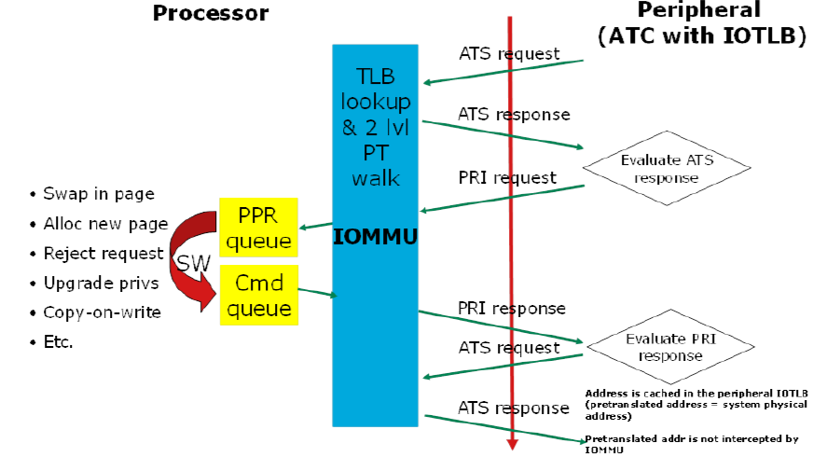
Future of I/O from CPU/Arch Perspective
HSA IOMMU/Device Interactions

Slide 13
Future of I/O from CPU/Arch Perspective
HSA and I/O Devices
Implications for OFA Software stack
  Unified memory addressing via system-wide accessible page tables
  Support for no pinning, on-demand paging options
  Aligns with requirements from MPI and PGAS input to OFIWG to simplify memory registration

Slide 14
Disclaimer & Attribution
The information presented in this document is for informational purposes only and may contain technical inaccuracies, omissions and typographical errors.
The information contained herein is subject to change and may be rendered inaccurate for many reasons, including but not limited to product and roadmap changes, component and motherboard version changes, new model and/or product releases, product differences between differing manufacturers, software changes, BIOS flashes, firmware upgrades, or the like. AMD assumes no obligation to update or otherwise correct or revise this information. However, AMD reserves the right to revise this information and to make changes from time to time to the content hereof without obligation of AMD to notify any person of such revisions or changes.
AMD MAKES NO REPRESENTATIONS OR WARRANTIES WITH RESPECT TO THE CONTENTS HEREOF AND ASSUMES NO RESPONSIBILITY FOR ANY INACCURACIES, ERRORS OR OMISSIONS THAT MAY APPEAR IN THIS INFORMATION.
AMD SPECIFICALLY DISCLAIMS ANY IMPLIED WARRANTIES OF MERCHANTABILITY OR FITNESS FOR ANY PARTICULAR PURPOSE. IN NO EVENT WILL AMD BE LIABLE TO ANY PERSON FOR ANY DIRECT, INDIRECT, SPECIAL OR OTHER CONSEQUENTIAL DAMAGES ARISING FROM THE USE OF ANY INFORMATION CONTAINED HEREIN, EVEN IF AMD IS EXPRESSLY ADVISED OF THE POSSIBILITY OF SUCH DAMAGES.
ATTRIBUTION
© 2014 Advanced Micro Devices, Inc. All rights reserved. AMD, the AMD Arrow logo and combinations thereof are trademarks of Advanced Micro Devices, Inc. in the United States and/or other jurisdictions. SPEC is a registered trademark of the Standard Performance Evaluation Corporation (SPEC). Other names are for informational purposes only and may be trademarks of their respective owners.

Slide 15
Thank You

