Slide 1
OFA Developer Workshop 2014
Shared Memory Communications over RDMA (SMC-R): Update
Jerry Stevens IBM
sjerry@us.ibm.com

Slide 2
Trademarks, copyrights and disclaimers
IBM, the IBM logo, and ibm.com are trademarks or registered trademarks of International Business Machines Corp., registered in many jurisdictions worldwide. Other product and service names might be trademarks of IBM or other companies. A current list of other IBM trademarks is available on the web at "Copyright and trademark information" at http://www.ibm.com/legal/copytrade.shtml
Other company, product, or service names may be trademarks or service marks of others.
THE INFORMATION CONTAINED IN THIS PRESENTATION IS PROVIDED FOR INFORMATIONAL PURPOSES ONLY. WHILE EFFORTS WERE MADE TO VERIFY THE COMPLETENESS AND ACCURACY OF THE INFORMATION CONTAINED IN THIS PRESENTATION, IT IS PROVIDED "AS IS" WITHOUT WARRANTY OF ANY KIND, EXPRESS OR IMPLIED. IN ADDITION, THIS INFORMATION IS BASED ON IBM’S CURRENT PRODUCT PLANS AND STRATEGY, WHICH ARE SUBJECT TO CHANGE BY IBM WITHOUT NOTICE. IBM SHALL NOT BE RESPONSIBLE FOR ANY DAMAGES ARISING OUT OF THE USE OF, OR OTHERWISE RELATED TO, THIS PRESENTATION OR ANY OTHER DOCUMENTATION. NOTHING CONTAINED IN THIS PRESENTATION IS INTENDED TO, NOR SHALL HAVE THE EFFECT OF, CREATING ANY WARRANTIES OR REPRESENTATIONS FROM IBM (OR ITS SUPPLIERS OR LICENSORS), OR ALTERING THE TERMS AND CONDITIONS OF ANY AGREEMENT OR LICENSE GOVERNING THE USE OF IBM PRODUCTS OR SOFTWARE.
© Copyright International Business Machines Corporation 2013. All rights reserved.

Slide 3
Agenda Topics
SMC-R Review
Status (what’s available)
Performance Overview
Linux SMC-R Status

Slide 4
Topic 1 SMC-R Review

Slide 5
Shared Memory Communications over RDMA Concepts / Overview
Shared Memory Communications
via RDMA
SMC-R enabled platform
SMC-R enabled platform
OS image
OS image
shared memory
shared memory
server
Sockets
Sockets
client
SMC
SMC
Virtual server instance
RNIC
RNIC
Virtual server instance
RDMA enabled (RoCE)
RDMA technology provides the capability to allow hosts to logically share memory. The SMC-R protocol defines a means to exploit the shared memory for communications - transparent to the applications!
Clustered Systems
SMC-R is an open sockets over RDMA protocol that provides transparent exploitation of RDMA (for TCP based applications) while preserving key functions and qualities of service from the TCP/IP ecosystem that enterprise level servers/network depend on! Draft IETF RFC for SMC-R:
http://tools.ietf.org/html/draft-fox-tcpm-shared-memory-rdma-03

Slide 6
Dynamic Transition from TCP to SMC-R
z/OS System A
z/OS System B
Middleware/Application
Middleware/Application
Sockets
Sockets
SMC-R
TCP
IP
Interface
TCP
IP
Interface
SMC-R
ROCE
OSA
OSA
ROCE
data exchanged
using RDMA
TCP connection establishment over IP
data exchanged
using RDMA
TCP syn flows (with TCP Options indicating SMC-R capability)
RDMA Network RoCE
IP Network (Ethernet)
Dynamic (in-line) negotiation for SMC-R is initiated by presence of TCP Options
TCP connection transitions to SMC-R allowing application data to be exchanged using RDMA
Notes:
Shared Memory Communications over RDMA (SMC-R) is a protocol that allows TCP sockets applications to transparently exploit RDMA (RoCE)
SMC-R is a “hybrid” solution that:
Uses TCP connection (3-way handshake) to establish SMC-R connection
Switching from TCP to “out of band” SMC-R is controlled by a TCP Option (Experimental Option “magic number”)
SMC-R “rendezvous” (RDMA attributes) information is then exchanged within the TCP data stream
Socket application data is exchanged via RDMA (write operations)
TCP connection remains active (controls SMC-R connection)
This model preserves many critical existing operational and network management features of TCP/IP

Slide 7
SMC-R (Contact and RDMA Processing)
z/OS V2R1 System A
z/OS V2R1 System B
Client application
RoCE
Server application
Socket API
Socket API
(1) TCP/IP handshake
TCP
IP
SMC-R
SMC-R
TCP
IP
OSA
OSA
(2) CLC
ROCE
(3) LLC
ROCE
SMC RDMA Memory Block
(4) Data
SMC RDMA Memory Block
4)
server written socket data
QP
SMC Link (RC-QPs)
QP
client written socket data
1) Application issues standard TCP Connect; Normal TCP/IP connection (3-way syn) handshake; Determine ability/desire to support SMC-Remote (based on TCP option)
2) When both hosts provide SMC TCP option then exchange RDMA credentials (QPs, RMBEs, GIDs, etc.) within TCP data stream (CLC messages – Connection Level Control messages) … can still fall back to IP
3) If first contact…. then establish point-to-point SMC Link via SMC LLC (Link Layer Control) commands (RDMA-Memory-Block (RMB) pair over RC-QP… the same link (QP/RMB) can be used for multiple TCP connections across same 2 peers)
4) Applications issue standard socket send; SMC-R performs RDMA-write into partner’s RMBE slot (RMB Element); peer consumes data via standard socket read

Slide 8
SMC-R Link Group Architecture
Rkey 4
Rkey 3
QP 8 Rkey 1
SMC Link Group
Rkey 2 QP 64
RMBs
3 & 4
SMC
SMC
X
RNIC
A
SMC Link 1
RNIC
C
RMB
1
RMB
2
RNIC
B
RNIC
D
SMC Link 2
QP 12 Rkey 1’
Rkey 3’
Rkey 4’
Rkey 2’ QP 68
(RoCE)
If one path (e.g. an RNIC) becomes unavailable (in this example RNIC A)… then:
traffic on the SMC Link 1 is transparently moved to SMC Link 2 using the redundant hardware
all application workload RDMA traffic continues without interruption…
once SMC Link 1 is recovered then traffic can resume using both paths.
Note that all paths (SMC Links) have equal access to all RMBs!

Slide 9
TCP Connection Load Balancing with SMC-R
RDMA direct data path
TCP/IP connection path

Slide 10
SMC-R Overview
Shared Memory Communications over RDMA (SMC-R) is a protocol that allows TCP sockets applications to transparently exploit RDMA (RoCE)
SMC-R is a “hybrid” solution that:
  Uses TCP connection (3-way handshake) to establish SMC-R connection
  Each TCP end point exchanges TCP options that indicate whether it supports the SMC-R protocol
  SMC-R “rendezvous” (RDMA attributes) information is then exchanged within the TCP data stream (similar to SSL handshake)
  Socket application data is exchanged via RDMA (write operations)
  TCP connection remains active (controls SMC-R connection)
  This model preserves many critical existing operational and network management features of TCP/IP

Slide 11
SMC-R Key Attributes - Summary
Optimized Network Performance (leveraging RDMA technology)
Transparent to (TCP socket based) application software
Leverages existing Ethernet infrastructure (RoCE)
Preserves existing network security model
Resiliency (dynamic failover to redundant hardware)
Transparent to Load Balancers
Preserves existing IP topology and network administrative and operational model

Slide 12
Topic 2 SMC-R Availability

Slide 13
New innovations available on
IBM zBC12 and zEC12

Slide 14
10GbE RoCE Express with SMC-R: Transparent optimized server to server networking!

Slide 15
Topic 3 SMC-R Performance

Slide 16
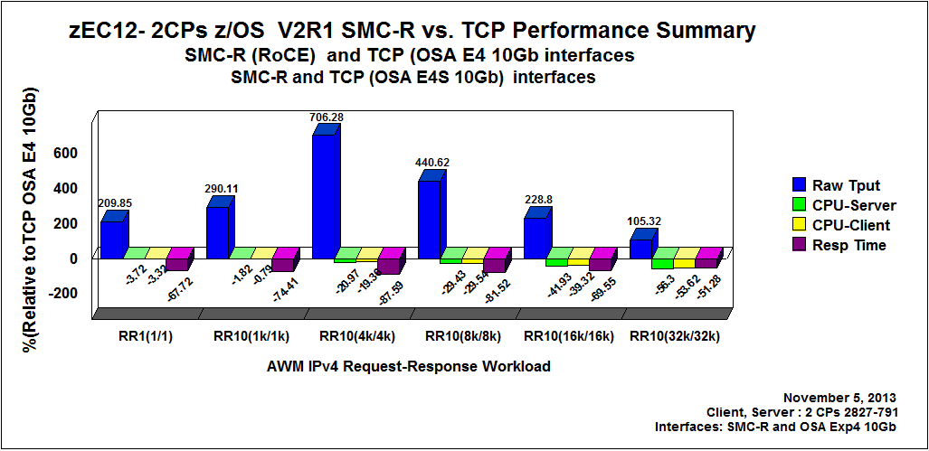
z/OS to z/OS SMC-R Performance
(micro benchmarks)
9.1 Gb/sec
(bi-directional)
CPU savings increases with payload

Slide 17
Performance Benefits: Actual Workloads

Slide 18
Performance Benefits: Actual Workloads
(continued)

Slide 19
Topic 4 Linux SMC-R Status

Slide 20
SMC-R for Linux: Overview
IBM is in the process of developing an SMC-R solution for Linux
kernel based solution (working towards upstream kernel acceptance)
No special license requirements (GPL)
Introduces a new AF_SMC socket family and a preload library to transparently run AF_INET socket applications for SMC-R (no application changes required)

Slide 21
SMC-R for Linux: Key Functions
Uses BSD sockets interface
Conforms to SMC-R specifications (RFC)
Provide key QoS (SSL, load balancer compatibility, HCA fail-over etc.)
Kernel solution enables key functions
(e.g. QP sharing, memory mgt, fork(), link groups etc.)
Will be Java enabled
Usability: minimal configuration steps required (i.e. zero IP topology changes)

Slide 22
SMC-R for Linux: Project Status
Linux internal testing is in progress
(significant progress with various levels of testing)
Posting code: objective is summer 2014

Slide 23
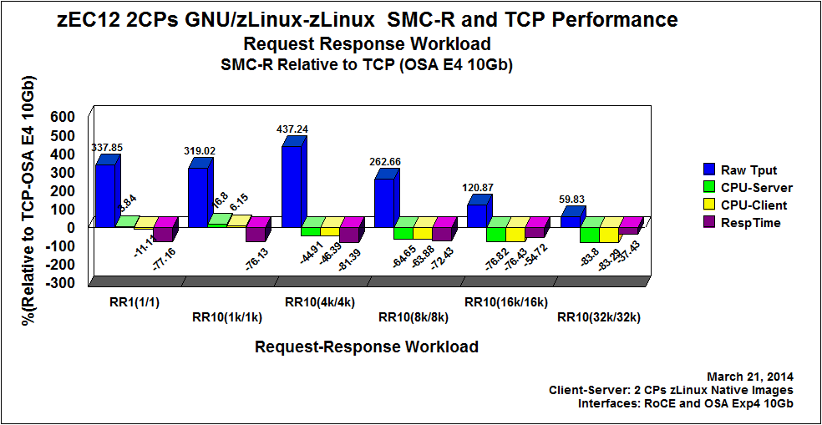
Linux to Linux SMC-R Performance
(micro benchmarks)
12 Gb/sec
(bi-directional)
CPU savings increases with payload
Note. Results are preliminary and are subject to change.

Slide 24
Linux Hardware Software Performance Configuration
Hardware Software Configuration used for measurements
  zEC12 Client, Server Linux on System z images with dedicated 2 CPs each
  Linux version (~ Red Hat 6.0)
    Linux SMC-R code is preliminary code
  z /OS V2R1
  Network interfaces used
    10GbE RoCE Express
    OSA Express4s 10Gb
  For TCP (Linux on System z) : Running Layer 2 Mode (Checksum Offload and Segmentation Offload not applicable)

Slide 25
SMC-R References
http://www-01.ibm.com/software/network/commserver/SMCR/

Slide 26
Thank You

