Slide 1
Scalable name and address resolution infrastructure -- Ira Weiny/John Fleck
#OFADevWorkshop

Slide 2
SA interaction difficulties
SA MAD formats, RMPP, libibumad “quirkiness”
Application shortcuts
Hard coded PR data
Ignoring parts of queried PR data
Only work on a limited set of clusters or cluster types
Direct access to libibumad and the SA are vectors for security breaches

Slide 3
Current stack is not scalable
Nodes access the same SA services multiple times from ibacm, kernel, libibumad…
PR queries
Notice/multicast registrations
Name resolution through standard DNS requires an ARP from IP to GID

Slide 4
ibacm name resolution
Relies on IPoIB (DNS, ARP, etc)
Names map to <GID, Pkey> “end point”
User’s often don’t care about the partition they are running on.
“cross” partition names can’t be resolved
Local apps need knowledge of a common partition prior to name resolution.
Some work done in this area via ibacm_hosts.data
Current name resolution requires source “end point” to be specified

Slide 5
ibacm as a SA proxy
ibacm provides a good starting point for addressing some of these concerns…

Slide 6
Goals
Provide controlled and consistent access to user space name and PR resolution services (AKA SA access)
SA access control
Accuracy
Ease of use
Portability
Enable all consumers to access ibssa
Provide caching and other ibacm services to kernel users

Slide 7
ibacm enhancements
Applications query ibacm as a local “SA proxy”
All SA interactions done through ibacm
Additional name services provided
ibacm can control access to SA and libibumad
ibacm is backed by “providers”
ibssa
Current features as default
Enhancements for name services are planned

Slide 8
ibacm enhancements
Name resolution services
“DNS” for direct name resolution
Name to PR (or GID, <GID, PR>, IP, <IP, PR>)
ibacm provides service to the kernel
Uses netlink
Leverages the same infrastructure for all users

Slide 9
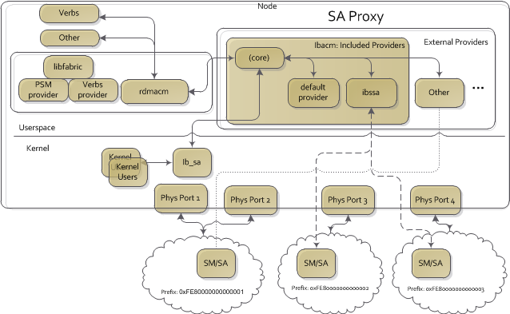
Arch

Slide 10
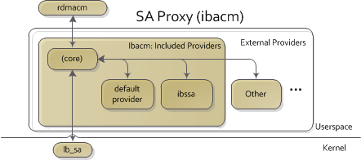
Architecture (non-eye chart)

Slide 11
Implementation plans
Separate out ibacm into “core” and default provider
Core handles
Provider loading and assignment to ports/End points
Steering client requests to correct provider
Port/device Events
Netlink requests and events
Administration like config file parsing, log file, etc
Default provider handles
Same functionality as current resolve functions

Slide 12
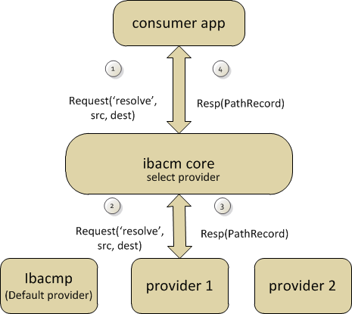
Initial data flow details

Slide 13
Provider API’s
Prototype code being worked
Collaborating with OFI WG and rdmacm
submission to the list imminent
“prov” branch in ibacm’s git tree
The API will evolve, collaborating with ibssa
Main API calls will include
Path Record resolution
Name to GID mapping helper

Slide 14
Expand *_getaddrinfo
Use ibacm first to resolve a Name prior to calling getaddrinfo (DNS)
Call can provide Path Record hints through the normal “hints” parameter
For example Service ID, Pkey etc.
Need both librdmacm and ibacm changes
Only single local end point can be supported now
Future local end point resolution can be determined by GID returned from provider name -> GID map

Slide 15
Kernel ibacm access
SRP, IPoIB, and rdma_cm kernel modules use ib_sa to query for Path Records
Extend ibacm PR resolution/caching to kernel modules
Use netlink messages to communicate with ibacm
Expand existing RDMA netlink interface
Currently connecting with ib_sa using ibacm messages
Exploring the use of ib_mad and using MAD formatted messages

Slide 16
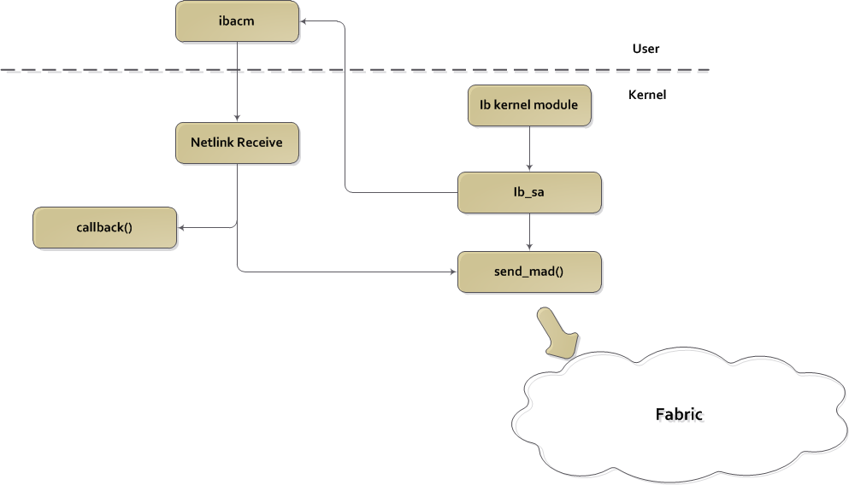
Overview

Slide 17
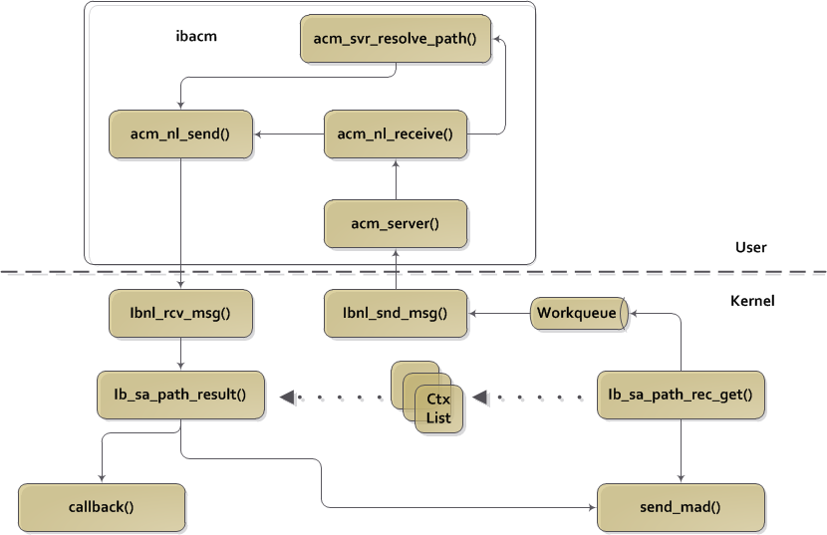
A little more detail…

Slide 18
Current Netlink / ibacm Message Format

Slide 19
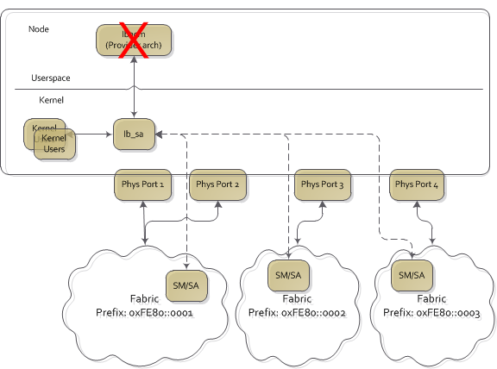
Kernel still uses SA when ibacm not available

Slide 20
Future work
SA event registration and reporting
Notice
Multicast
IP to GID mapping
IPoIB netlink to ibacm?
arpd extentions?

Slide 21
Thank you
Hal Rosenstock
Kaike Wan
Sean Hefty

Slide 22
Thank You

Slide 23
Current SA interactions
Applications
Direct SA
Libibumad
UD QP
Librdmacm
Ibacm
Dns/arp
Kernel
Direct SA access only

Slide 24
Name service requirements
Generic interface to request remote node by name through “DNS like” resolution
Mapping provided by providers based on cluster configuration, node configuration, and/or provider/SA communication.

Slide 25
librdmacm example
New librdmacm example app
$ resolve_name -h
usage: resolve_name <name>
[-h]
[-s <service id>] Specify a service ID in PR 'hints'

Slide 26
librdmacm example
$ resolve_name priv03
ai_family 0
ai_route : 0x1ff15a0
Path information
service_id: 0x0
dgid: fe80::11:7500:79:1815
sgid: fe80::11:7500:79:1763
dlid: 2
slid: 1
…
$ resolve_name google.com
ai_family 2
dest (null) 173.194.33.133

