Slide 1
Wrapping up the 10th OFA Workshop
#OFADevWorkshop

Slide 2
“Moore’s law is dead”
Dr. Thomas Sterling
“It will take some time to get there, but Pleiades continues to evolve”
Bob Ciotti – NASA/Ames
A chasm or a continuum?
General purpose clusters vs special purpose clusters?

Slide 3
Every I/O instruction being executed, every extra header byte being moved costs pico joules.
A pico joule here, a pico joule there, and pretty soon we’re talking about real joules…especially in an exascale world.
Power matters!

Slide 4
Storage, storage, storage!

Slide 5
We went looking for disruptive technologies, and boy did we find them.
It turns out that there is a high degree of synergy between NVM and high performance networking.
The TAC took the action to follow-up with the goal of annealing this into specific action.

Slide 6
A Big Topic – how to continue the evolution of OFS?
Everybody agrees on the objectives for the next evolution.
We’re talking about how to achieve those objectives, even if it’s a noisy discussion.
Which is what happens in an OpenSource world.

Slide 7
We started by thinking hard about how to extend the high performance networking paradigm. But without constraining our thought process.
That produced the notion of a “framework”
But…it was never the idea to create a fork.
The question now before us is this, “how do the results of that thought experiment relate to verbs?”

Slide 8
Speaking of evolution…
There were powerful sessions on topics like bonding, dynamic connected transport and On Demand Paging made it clear that RDMA is anything but static.

Slide 9
Last year we embarked on an objective to broaden the scope of OpenFabrics Software.
This year we made the tent even bigger with the notion of “interest groups”.
Extend the idea of interest groups at next year’s workshop?
Large scale users (nat’l labs, NASA) comprise a distinct interest group?

Slide 10
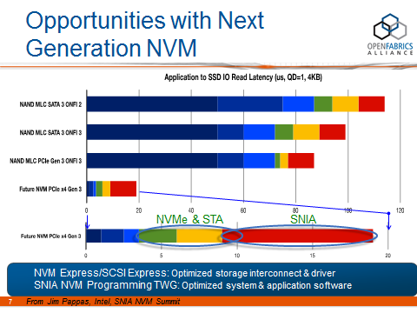
Makes you wonder if something similar is happening with OFS…
This was pretty astonishing.

Slide 11
We held an ad hoc meeting of one of the OFA’s working groups (the OFI WG)
Fifty people showed up!
Maybe next year this ought to be a bona fide part of the workshop agenda

Slide 12
We held an ad hoc meeting of one of the OFA’s working groups (the OFI WG)
Fifty people showed up!
Maybe next year this ought to be a bona fide part of the workshop agenda
(And maybe we should get a bigger room)

Slide 13
See you here next year

Slide 14
Thank You

