Slide 1
OpenFabrics Enterprise Distribution for
Windows
Stan C. Smith Ishai Rabinovitz Eric Lantz
3/16/2010

Slide 2
WinOF results
Efficient:
  90.1% cluster efficiency (HPL) on 512-core, 64-node cluster of Nehalem cores with QDR (40Gb/s) Infiniband
Scalable:
  History of Windows in the TOP100
    #10: Shanghai Supercomputer Center, Shanghai, China
    #23: National Center for Supercomputing Applications, Illinois, USA
    #40: UMEA University, Sweden
    #100: Aachen University, Germany
Notes:
#10: Shanghai Supercomputer Center, Shanghai, China
180.6 TeraFLOPS on 31,200 cores at 77.5% efficiency - with commodity hardware.
#23: National Center for Supercomputing Applications, Illinois, USA
68.5 TeraFLOPS on 9,472 cores at 77.7% efficiency
NetworkDirect ran hour-after-hour at full scale while we tuned.
#40: UMEA University, Sweden
46 TeraFLOPS on 5,376 cores at 85.5% efficiency
Best efficiency score at the time for an x86-64 architecture
#100: Aachen University, Germany
18.8 TeraFLOPS on 2,096 cores at 76.5% efficiency
Matched the best Linux efficiency on this cluster but with simpler cluster mgmt

Slide 3
WinOF 2.2
Just released (12-March-2010)
WHQL’ed source
IPoIB transitioned to NDIS 6.1
  NDIS 5.1 supported on Windows XP and Server 2003
OpenSM upgraded to version 3.3.3
  Improved robustness and scalability
  IB diagnostics support (saquery, ibnetdiscover)
NetworkDirect over winverbs provider
  Technical preview, default is ND/IBAL
uDAPL 2.0.27 code base
Bug fixes
Notes:
NDIS 6.1: Windows Server 2008, Server 2008 R2, Vista, and Windows 7
Still have support for NDIS 5.1

Slide 4
WinOF 2.2 Install
WIX 3 installer (MSI)
  Installers available for all current Windows versions
Support for HPC Server 2008 automated compute node deployment
  Windows Deployment Service (WDS) injecting the driver INF files
Last release under the WinOF name

Slide 5
OFED for Windows
www.openfabrics.org
5
Why change the Windows distribution name?
WinOF → OFED for Windows
Leverage OFED name branding
  Customers understand what OFED implies
  WinOF had to be explained….
  WinOF == OFED for Windows…
Continue version counting (next will be 3.0)
  Version number independent from OFED for Linux
    Different features (SDP, NetworkDirect)
    Independent release dates

Slide 6
OFED for Windows Roadmap
OFED for Windows 3.0 release (Q3’10)
  Microsoft NetworkDirect V2 APIs
    RDMA adoption in other MS products
  Mellanox InfiniBand over Ethernet (RoCEE) ‘Rocky’
  Qlogic HCA driver available
  EoIB (Ethernet Over IB) Beta
  Diagnostics plugins

Slide 7
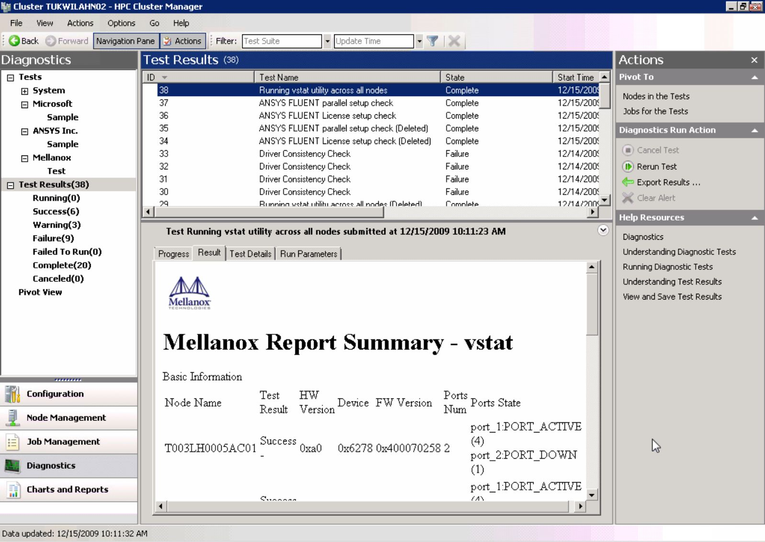
HPC Server 2008 R2 Diagnostics Framework
Built-in Diagnostic tests can be augmented with vendor-specific diagnostic downloads
History of Diagnostic Results automatically saved by the diagnostics framework.
Results displayed as HTML page

Slide 8
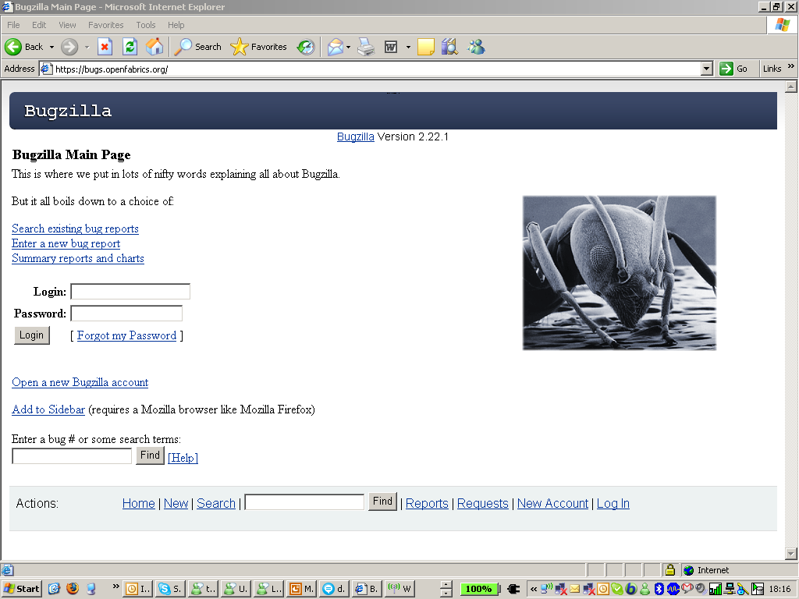
If You Want to Help….
Developing code
Sending patches and comments to the mailing list
(ofw@lists.openfabrics.org)
Doing QA
Opening bugs in Bugzilla (https://bugs.openfabrics.org/)
  When opening a new bug you
  can choose OpenFabrics Windows

