Slide 1
OFA Fabric Software Development Platform FSDP
Proposal
March, 2020

Slide 2
Executive summary
We propose that the OFA create the OFA Fabric Software Development Platform – OFA FSDP
Comprises a hardware platform and accompanying software infrastructure
Designed to provide its target clientele with easy access to a modern cluster to be used in the development, testing, and validation of software associated with client access to fabric services
Intended to operate primarily ‘lights out’
Sited at a commercial vendor site
Includes a range of “memberships” in the program
Promoter members are “full” FSDP members
Supported by normal OFA membership dues
Seen as a vehicle for driving OFA membership and stature in the community

Slide 3
Table of Contents
Motivation and Objectives
  Paul
Background
  Paul (actually Tatyana)
Program Overview
  Paul
Scope, Stakeholders, Target Audience
  Paul
Governance
  Team
  Naming – what to call this thing?
Infrastructure
  Doug
  Software Infrastructure (Doug’s materials)
  Hardware Infrastructure
Siting
  Jim
Funding and Costs
  Jim
  Membership proposal
  Program startup costs
  Program operation costs

Slide 4
Why an fsdp program
The simple answer - It is a core component of the OFA’s mission:
“The mission of the OpenFabrics Alliance (OFA) is to accelerate the development and adoption of advanced fabrics for the benefit of the advanced networks ecosystem.”
The OFA Fabric Software Development Platform, like the OFILP before it, is a key element in driving the adoption of advanced fabrics

Slide 5

question
Can we design a program that delivers greater value than the OFIPL at lower cost?
While serving the needs of:
Alliance members
The open community
Vendors
OEMs
In short, a program that delivers on the OFA’s mission

Slide 6
Target clients – a broader audience
  Linux Kernel Maintainers
  Hardware vendors*
  Distros**
  ISVs, Application, Middleware developers
  Network Services Consumers
  …
Broadly, anybody engaged in:
  Developing networking software
  Consuming networking services
*served by original OFILP (OpenFabrics Logo Program)
**served by the “on-demand” testing program at NMC

Slide 7
Serving our proposed target clients
Linux Upstream Maintainers
  Automatic, continuous testing of upstream software (kernel, rdma-core …)
  Centralized testing of multiple hardware vendors’ products
  Relieve maintainers of the burden of tracking the efficacy of hardware from multiple vendors
  Incubation of an open source community that contributes tests that can be run on the cluster
Hardware Vendors
  Private, on demand access to a multi-vendor cluster for testing/validation of new hardware, software, firmware
  Logo program, if desired
OS Distros: On demand testing for distros (Red Hat, SuSE, OFED, etc.)
  Private, on demand access to a multi-vendor cluster for e.g. release testing
  Logo program, if desired
ISVs, Applications, Middleware
  On demand testing of specific software (OpenMPI, AMQP, OpenStack, others)
  Software development (Apache? MySQL?)

Slide 8
serving our clients
1.
Support the upstream kernel release cycle
2.
Provide ‘On-demand’ access to all stakeholders
to a multi-vendor, multifabric testbed to all stakeholders
3.
Continue the Logo Program if desired, but based on Linux distributions

Slide 9
Two major usages, one possibility
Pre-release Integration Testing
  Objective: Identify problems in the upstream kernel introduced in the merge window
  Provide kernel maintainers a broad-based view of the state of device testing
    vs forcing maintainers to gather that information from each individual vendor
  Primarily targeted at supporting kernel maintainers
    vendors derive some benefit too
On-Demand Testing Capability for Distros, Vendors and Others
  Objective: Provide a hardware and software platform for use by clients ‘on-demand’
A Possible Third Objective – A Certification Program (‘Logo Testing’)
  Objective: An industry recognized, independent certification program allowing clients (e.g. primarily vendors and distros) to claim “compliance” to a given set of tests

Slide 10
Program objectives – high level
Driven by, and capable of testing, standard, commercially available, OS platforms
  SuSE, Red Hat, Debian, Ubuntu, etc.
Capable of testing specialized OS platforms (with additional software)
  OFED, MOFED, beta packages on top of the released OS platform code, upstream -rc releases, upstream final releases
Able to test user supplied software on any OS platform with or without OS updates
Adaptable to multiple different fabrics (see following slides on Scope)
Capable of testing interoperability across vendor hardware
  Broadcom RoCE to Mellanox RoCE for example
Runs mostly in lights out mode
  Able to automatically select machines to run tests on and install all necessary software for the test
  Able to give the option of automated testing or manual testing once the machines are installed
Able to manually schedule all or a portion of the cluster for user checkout

Slide 11
An instructive look in the rearview mirror
The original OpenFabrics Interoperability Logo Program was:
Designed to validate interoperability between vendors, and with the OFED stack
Narrowly focused on a small hardware vendor community
Centered around a certification program – ‘Logo Program’
Forced participants into a rigid program schedule
Paid for by the subscribers, who were charged a fixed base fee + an incremental fee based on number of devices tested
Over time …
OFED’s components were replaced by a community-supported open source RDMA subsystem
RDMA users and vendors expressed strong preference to test against standard Distros and upstream kernels
Industry consolidation reduced the number of hardware devices
Long Story Short – it was the right program for its time, but that time has passed

Slide 12
A better idea?
At the 2019 Workshop, a ‘re-imagined’ Interop program was proposed:
Targeted at a much broader audience
  Much more responsive to the needs of the broader networking community
  Still includes the traditional hardware vendors, but adds:
  Distros, Linux Kernel community, network software developers and others as stakeholders
Greatly improved flexibility for clients of the program, highly responsive to their needs
  Based on an ‘on-demand’ philosophy
  Retains the original logo program, if it is desired, but no longer the center of the universe
Integrates popular Distributions
  vs the former program, that was driven by OFED

Slide 13
What it is
The program is built around a ‘lights out’ cluster maintained and supported by the OFA
The cluster has potentially three major usages
  Pre-release integration testing
  On-demand testing
  A logo program
  Other use cases are likely to emerge as the industry becomes aware of the capability being offered
This section describes these three usages
The next section describes the hardware and software infrastructure

Slide 14
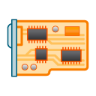
Usage: pre-release integration testing
Objective: Support the Linux kernel community through an integration testing program
Synchronized to, and automatically triggered by, the kernel release cycle
Executed late in the integration cycle, rc4 or 5
A local daemon patrols for changes in the upstream kernel
Driven by an OFA-defined test plan
Interactive test and debug cycle
Results reported thru standard open source mechanisms
test plan
start
kernel rc4
mailing list
Benefits:
Provides the Linux open source community with ‘one stop shopping’
Frees the vendors from duplicating tests being run by every other vendor
Think of it as collaborative debugging

Slide 15
Usage: ON-demand program
Tests are run ‘on-demand’, by either the client (e.g. h/w vendor, a distro…)
Test plan is executed selectively as specified by the client
Run against a defined (“certified”) hardware configuration
Run against a specific distribution(s)
test plan
vendor under test
On-Demand Testing
results
Results are returned to the client
distribution under test

Slide 16
Usage: logo program
Two possible types of Logos: Vendor Logo & Distro Logo
Logo tests are run ‘on-demand’, driven by OFA’s test plan
Test plan is executed selectively
Run against a defined (“certified”) hardware configuration
Run against a specific distribution(s)
Logo is awarded to Vendor or Distro
Certification includes:
Test environment
list of tests executed
pass/fail results
test plan
vendor under test
Logo Testing
LOGO
“Our new hardware is certified to work with RHEL x.x, SLES y.y”
or
“Our distribution is supported by the following hardware”
distribution under test

Slide 17
Fabric software development platform h/w
A partitionable hardware cluster
Lab machine
  Multi-vendor
  Multi-network types (e.g. IB, RoCE, iWARP …)
  Easily extensible to add new network types
  Controlled access from the Internet
    VPN account required to access cluster
    Account on cluster required to access functions of cluster controller
  Provisioned with existing OFA-owned hardware
    Currently stored at UNH-IOL
Lab machine
InfiniBand Fabric
RoCE Fabric
Lab machine
Internet
VPN
Firewall
Cluster Controller
Lab machine
Lab machine
Control Network
iWARP Fabric
OPA Fabric
Lab machine

Slide 18
fabric software development platform hardware
(provide an inventory of existing OFA-owned hardware currently stored at UNH-IOL)

Slide 19
FDSP software infrastructure
The cluster is automatically configured and run by the Beaker Lab Controller according to specifications for a particular client or usage
Lab machine
Automated System Configuration
Beaker powers on and off each lab machine as needed
Controls the dhcp boot parameters for each lab machine
Installs software as requested
  by setting up the proper PXE boot image in dhcp and then powering on the machine (which will be set to PXE boot)
Test Operation
Once the system is configured, the Beaker Lab Controller:
Pulls tests from the beaker test repo (automatic mode), or
Leaves the machines ready for ssh login (manual use mode).
Beaker test repo
Lab machine
End User
Beaker Web Interface
Lab machine
Beaker lab controller
RDMA Networks
Beaker CLI
Lab machine
CKI Runner
Lab machine
Control Network
Lab machine

Slide 20
FDSP software infrastructure
Integration Testing – Continuous Kernel Integration Runner serves as the “client”
Lab machine
Beaker test repo
Lab machine
End User
Beaker Web Interface
CKI Runner watches upstream source trees
tIt Triggers a preplanned automated test run depending on which tree triggered the run.
On request by the CKI Runner, the Beaker Lab Controller configures the system for Integration Testing
Lab machine
Beaker lab controller
RDMA Networks
Beaker CLI
Lab machine
CKI Runner
Lab machine
Control Network
Lab machine

Slide 21
FDSP software infrastructure
On-Demand (end user) Testing
Lab machine
End user uses the web interface or the command line interface (CLI) to initiate either an automated test run or a manual use run.
If an automated test run is initiated, it will run until it completes or times out, results emailed to the client
If something goes wrong during the run, the user can remotely logon the test machines up until the test timeout occurs, and then only the logs will still be available.
Beaker test repo
Lab machine
End User
Beaker Web Interface
Lab machine
Beaker lab controller
RDMA Networks
Beaker CLI
Lab machine
CKI Runner
Lab machine
Control Network
Lab machine

Slide 22
Fsdp software infrastructure
Based on the following open source (or soon to be) tools developed by Red Hat
CKI (Continuous Kernel Integration) Testing framework
  https://gitlab.com/cki-project
Beaker lab management software
  https://beaker-project.org/
Various tests used by Red Hat with Beaker for years
  https://github.com/CKI-project/tests-beaker

Slide 23
System Administration
Describe the proposal, and options, for administering the system
  Redhat initial volunteer
  Find a “permanent” volunteer
  Hire Ken Strandberg to work under the auspices of the IWG
  Others?

Slide 24
Program administraton
What is our proposal for administering the program (not the system)?
Who handles requests to participate? Who ensures that those requests turn into actual user accounts and ‘billing’?
Who allocates time on the cluster and resolves conflicts?

Slide 25

Existing Governance Model - Tatyana
OFA IWG
Open to participation by all
IWG oversees the programs via the Test Plan
test plan(s)
As of today, the distro testing program is strictly ‘debug’ (no logo)
OFA Interop Logo Program
Funded by subscribers
Confidential
OFILP
Distro testing
Cadence
OFILP runs on a regular cadence
Distro testing is ‘on demand’
Logo Events
Debug Events
Opportunity: Create synergy, deliver greater value

Slide 26
Evolved Governance Model
OFA IWG
Open to participation by all
IWG oversees the programs via the Test Plan
Placeholder slide
test plan(s)
As of today, the distro testing program is strictly ‘debug’ (no logo)
OFA Interop Logo Program
Funded by subscribers
Confidential
OFILP
Distro testing
Cadence
OFILP runs on a regular cadence
Distro testing is ‘on demand’
Logo Events
Debug Events
Opportunity: Create synergy, deliver greater value

Slide 27
Siting – 3 Locations – Jim R.
Prepare and distribute a “Testing Services Discussion Document - JimR
  Targeted 3 locations listed below, emailed Document to VTM and NMC 2/11. UNH-IOL intentionally held. No response from VTM as of 2/17, ping. Schedule NMC call week of 2/17
UNH-IOL
  Decide when to read-in UNH-IOL on “Testing Services” leading to a quote
  Current inventory AR: Doug, target ETA?
VTM Beaverton
  Discuss “Testing Services” leading to a quote
NMC
  As of 2/17 current contract still has not been responded to, ping
  Discuss “Testing Services” leading to a quote

Slide 28
Funding model – jim
Must be a member of the OFA to use the test cluster, whether as an unlimited testing membership level or pay-as-you-go
Cluster is supported by OFA Membership dues
Propose 3 levels of Membership:
  Promoter Member (statutory): senior rights including unlimited testing
  Voting FSDP Member: Right to vote in IWG but not to chair; unlimited testing
  Non-Voting FSDP Member: No right to vote in the IWG, unlimited testing
  Pay-as-you-go Member: access to the cluster on a “per-use” basis
  Individual Member: Limited to bona fide individuals with a demonstrated need to use the cluster
IWG is treated as a “Works of Authorship” working group
  Decisions are made via voting mechanisms
  Anyone may attend meetings, but may not participate, except Voting FSDP Members
Opens:
  what about kernel maintainers?

Slide 29
Costs
Start up costs
Operational costs
  Facility rental
  Support staff

Slide 30
Bonepile
Slides from past iterations that we are not quite ready to delete yet

Slide 31
Topics
Objective – Increase value to OFA Members, Industry, and the Open Community
  Motivation
  Who Benefits
  Scope – IB, RoCE, iWARP, libfabric …
What happened to the old program
  Decreasing demand leading to cascade failure, on-going issues with program costs, troublesome vendor interactions
  OFED is Dead, Long Live OFED! (from an interop perspective)
Describing a new Interop Program – Three Key Components
  Kernel Pre-Release Testing
  On-Demand Testing for Vendors and Distros
  Machine Checkout (on-demand)
Governance Model
  No change – the IWG controls the program via written test plans
Testing Infrastructure
  Infrastructure needs for Pre-release Testing
  Infrastructure needs for On-demand Testing
  Requirements
Funding
  Current proposal is embodied in the OFA’s new proposed membership class proposal
Program Vendors – currently NMC, UNH-IOL
  Should we seek other vendors?
The Ask

Slide 32
To Do
Create a coherent Testing Program
  Build synergy between the existing Interop Program and Distro Testing Program
  Draws from the best features of both
  Deliver greater value to the Linux community, OFA members, hardware vendors, industry, and everybody else
Modernize the Interop Program by adding standard distributions
Integrate the needs of the Linux community into the Program
Respond to demand for ‘on-demand’ testing
Update the current program by modernizing the existing test plan
  The focus is on providing a logo for hardware vendors against a specific set of distro(s)
  OFA continues to own the test plan
  But vendors have some control over which tests are run
Add a distro component to the current logo program
  The focus is on providing a validated list of hardware with which a given distro operates correctly
  Against a subset of the testplan benchmarks as defined by the distro
Don’t preclude compliance testing (e.g. libfabric testing)
Test against current, up to date hardware that is constantly maintained

Slide 33
NMC Distro Testing
Need arose for distro vendors to test their OFED stack for pre-release with a 3rd party entity
Contract formed with New Mexico Consortium (NMC) and OFA to provide testing ground for vendors to submit their pre-release distro and test against hardware
  NMC had hardware that was not utilized 9 months out of the year and kept relatively up to date
Initially started off with NMC providing no cost support for testing
  Intent was to provide charging once the program was fully solidified
Distro test framework based on UNH-IOL interop testing
  Tested distro against various RDMA hardware (IB, OPA, RoCE, iWARP), both for functionality and usability
Reported results back to vendor
  Provided follow up and retesting as issues were found
SUSE was the only vendor so far utilizing the program
LANL staff were the ones performing the testing on behalf of NMC
  Additional contract/support may be need to be addressed if moving forward with NMC and LANL

Slide 34
An instructive look in the rearview mirror
The Basic Objective behind the original Interop Program
To build industry confidence in the newly emerging InfiniBand Architecture
At the time, the OpenFabrics Enterprise Distribution – OFED, was a key industry enabler
The only open source distribution supporting the InfiniBand Architecture
The purpose of the interop program was to verify that a diverse set of hardware devices:
would interoperate among themselves, and
would interoperate with OFED

Slide 35
OFILP- openfabrics interop logo program
The original Interop program, dating to the 2000s
Long story short …
Was tightly coupled with, and driven by, OFED
  Did vendor devices interoperate with OFED?
  Did vendor devices interoperate with each other?
Narrowly focused on a small hardware vendor community
  InfiniBand, RoCE, iWARP
Centered around a certification program – ‘logo program’
Forced vendors into a rigid schedule
  (2x “interop events” 2x “debug events” per year)

Slide 36
OFILP mechanics
Subscribers paid a fixed base fee, + an incremental fee based on number of devices tested
Program operated on a cost recovery basis, with the OFA serving as the financial backstop
Cost per device was based on a forecast of the aggregate number of devices to be tested (all vendors)
Like clockwork
(until it’s not)
spring
Debug
LOGO
The annual cycle included two debug events, and two logo events, all bundled together and covered by the single subscription fee
Fees for each vendor were calculated based on the number of devices to be tested at the beginning of each year
An ‘all or nothing’ program
annual
cycle
LOGO
Debug
fall

Slide 37
What happened?
Original objective: Accelerate adoption of the new InfiniBand Architecture by assuring the industry that InfiniBand h/w and s/w components were reliable and interoperable
  Validate that IB devices interoperated with each other and with OFED
Over time …
  OFED’s components replaced by a community-supported open source RDMA subsystem
    OFED is no longer the main ‘go to’ for Distros and others
    Hence vendors saw shrinking utility in testing against OFED
    Strong preference to test against standard Distros instead
  Industry consolidation reduced the number of hardware vendors; in some cases only one vendor survives
  Thus fixed program costs were amortized over, and paid by, a shrinking client pool
    Fixed program costs divided by total number of devices tested
Net result
  Eventually, the costs of the program could not be supported by the remaining interop subscribers
Long Story Short – it was the right program for its time, but that time has passed

Slide 38
Program scope
Much larger than the original Interoperability Program
Designed to appeal to a much larger list of stakeholders
Scope – as always the scope is limited to ‘advanced networks’
  Does not include standard networking such as sockets/TCP/IP
  Does not include compliance to wire specifications
  Does include testing of software stacks
  Does allow for testing of interoperability among vendors

Slide 39
Stakeholders
Direct Stakeholders
  Kernel maintainers
  Hardware vendors
  Distros
Indirect Stakeholders
  OpenFabrics Alliance
  OEMs (rely on the IHVs to test hardware)
  Upstream Linux RDMA community
  OFA Alliance Members who have a stake in the success of the OFA

Slide 40
stakeholder wish lists
Kernel Maintainers, Linux Open Source Community
  Improve the fidelity of kernel pre-release testing
  Focus on integration testing late in the kernel release cycle (when vendor driver updates have been integrated)
  Ensure that existing drivers interop correctly with a pre-release kernel
  Provide visibility to upstream maintainers into what’s been tested by vendors
Hardware Vendors
  Reduce testing costs;
  Test new hardware and/or software interoperability with other vendors and/or multiple distros
  An independent certification program driven by an industry-defined test plan (for those who want it)
  test upstream drivers
Distros
  Support for testing release candidates against a stable, current, multi-vendor hardware base
  Test backported drivers – ensure that features that work in the upstream version did not get broken in the Distro
  The opportunity to evaluate vendor backported drivers before inclusion in a GA release
  May value a certification program

Slide 41
Upstream kernel pre-release testing
Why?
  Ensures that existing drivers interop correctly with a pre-release kernel
  Provides visibility to upstream maintainers into what’s been tested by vendors
  Creates a fuller picture of device testing during the kernel pre-release process
How?
  Provide a known test plan to be used during the kernel pre-release process
  Support integration testing late in the kernel release cycle (when all vendors driver updates have been integrated)
  Provide results to the upstream linux-rdma mailing list for faster response times
ed note: either beef up this slide and add a corresponding version for the h/w vendors, or ditch this slide and rely on the previous slide to get the message across.

Slide 42
Testing infrastructure
The requirements for the two program components may very well be different:
Kernel Pre-Release testing
  Requires a “certified”, known good hardware configuration
On-Demand Testing
  For Distros: May also rely on a certified hardware configuration
  For Vendors: Is likely to require more frequent changes to the underlying hardware configuration
Testing on a “known good” certified hardware configuration can be conducted anywhere such a cluster is available
On-demand testing for vendors may require that the OFA control or manage the cluster testbed

Slide 43
Agenda
Why an Interop program at all
What the heck is interoperability, and what do we have today?
  Hardware-based debug + logo program, based at University of New Hampshire Interoperability Lab (UNH-IOL)
  ‘On-demand’ distro testing program, hosted by the New Mexico Consortium (NMC)
The role of the IWG
  What the IWG does, how it related to UNH-IOL and NMC
A Modest Proposal for the next evolution – The OFA Testing Program
  Build synergy between the existing programs, deliver greater value to participants, the community, and the industry

Slide 44
interoperability means:
Historically, the ‘distro’ was OFED + CentOS
app
app
OFED
OFED
1
2
h/w vendor 1
h/w vendor 2
cable b
cable c
Devices interoperate with their peers
  “Horizontal interoperability”
Devices interoperate with the s/w stack
  “Vertical Interoperability”
sw x
sw y

Slide 45
next steps
→ Meet our new IWG Chair – Tatyana Nikolova ←
Come to the BoF to discuss the strawman proposal – Pros and Cons
Make the proposal better!
Work with our testing vendors on the program details
  New Mexico Consortium - NMC
  University of New Hampshire Interoperability Lab – UNH-IOL
Detailed proposal to the OFA’s Board of Directors in the next few months
Join the Interoperability Working Group
Be an active part in driving this forward

Slide 46
a streamlined virtuous cycle
start
kernel pre-release testing
validated h/w & drivers
high quality distributions
end

Slide 47
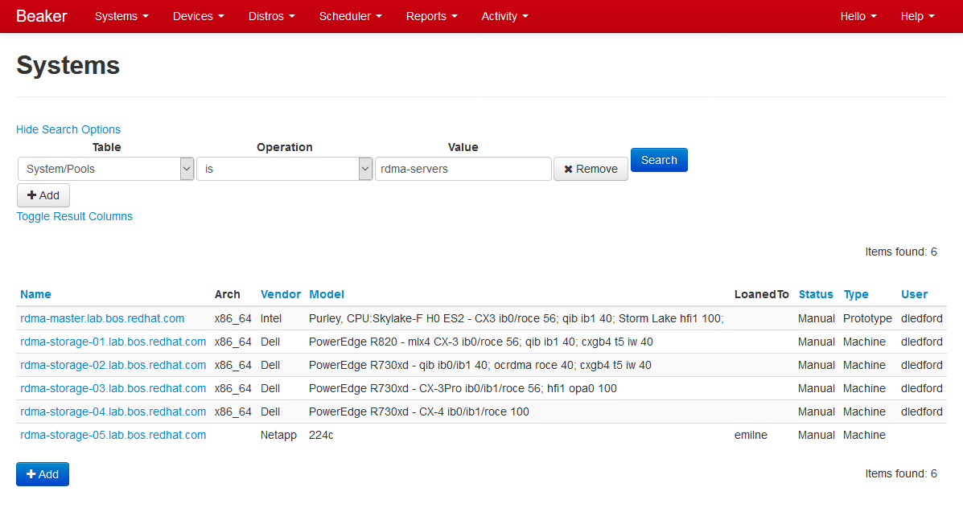
Beaker Web Interface – System Search

Slide 48
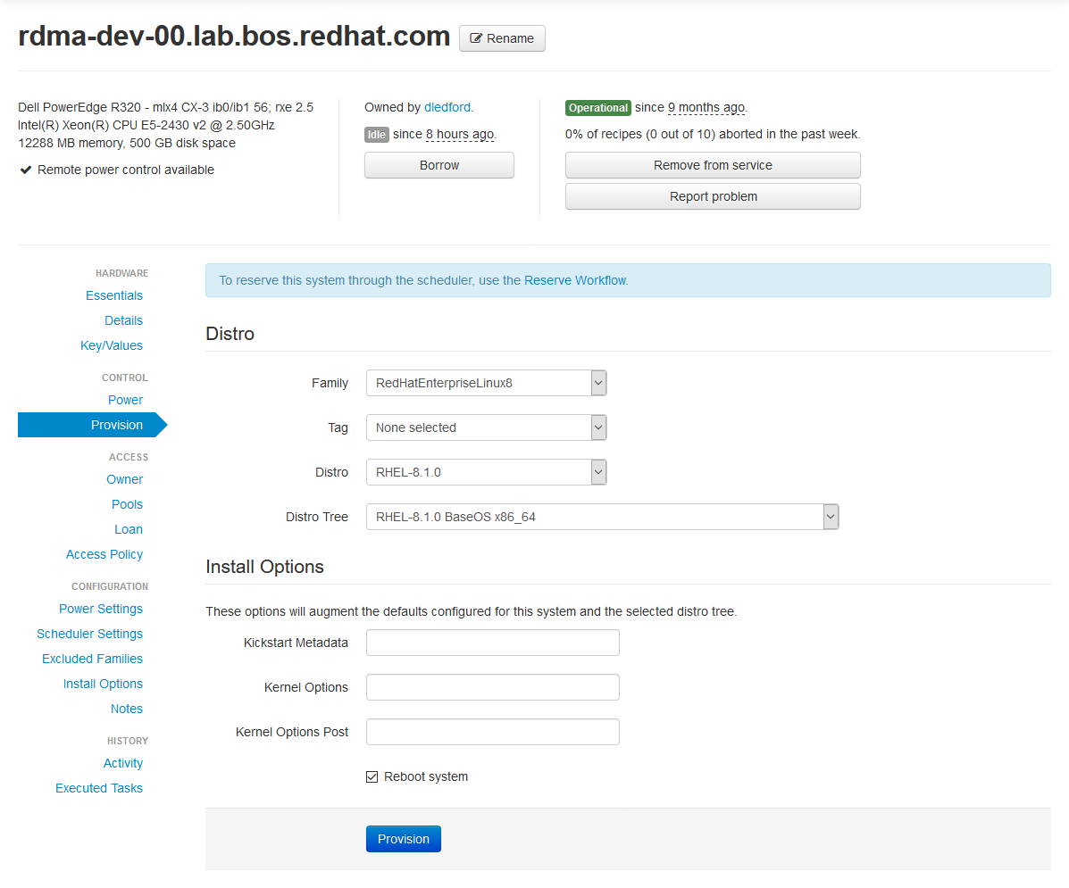
Beaker Web Interface – Provisioning

Slide 49
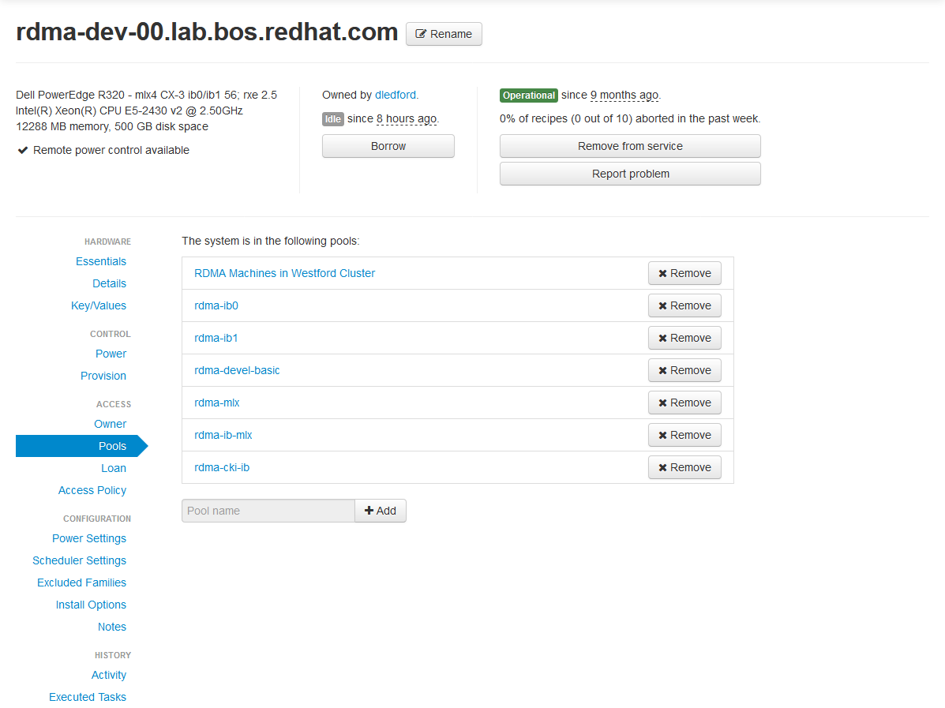
Beaker Web Interface – Pools

Slide 50
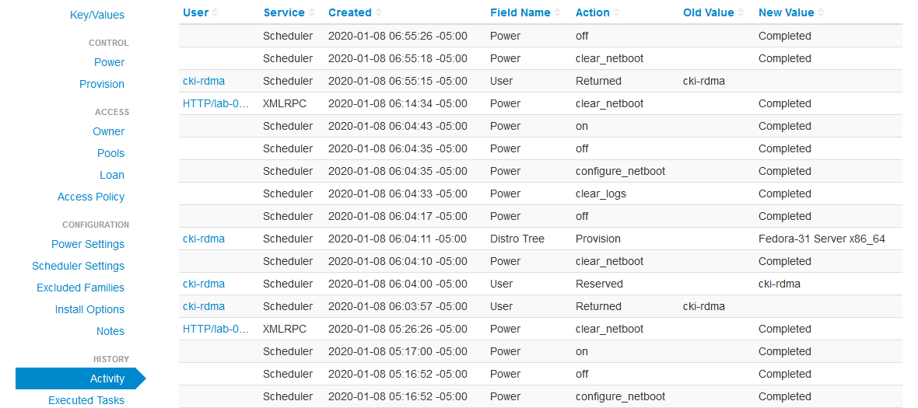
Beaker Web Interface – Activity

Slide 51
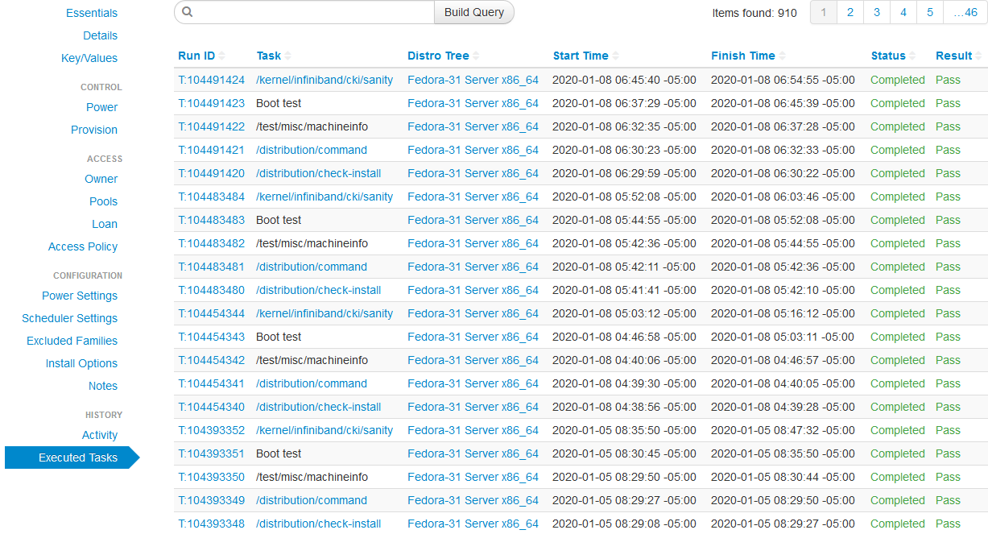
Beaker Web Interface – Executed Tasks

Slide 52
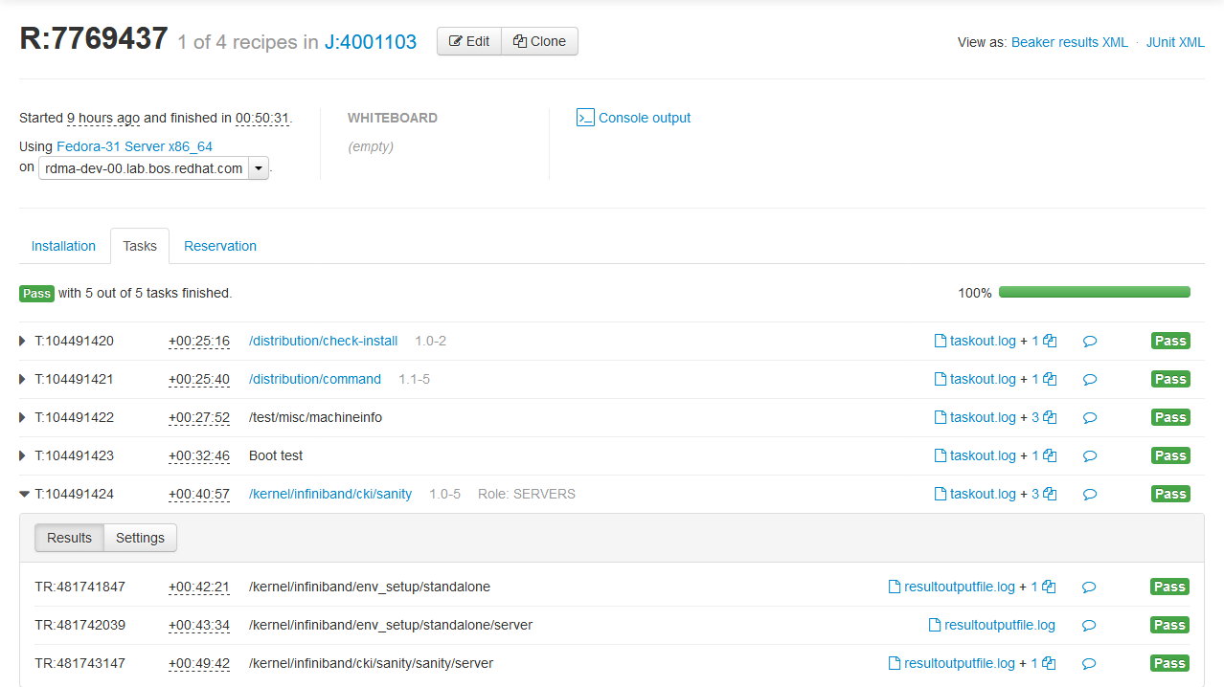
Beaker Web Interface – Job Log

