Slide 1
OFA Fabric Software Development Platform FSDP
Proposal
April, 2020

Slide 2
To close the proposal
Slide 23 – FSDP H/W Infrastructure - Doug to fill in hardware details
  Everything except UNH-IOL inventory now done
Slide 25 – Siting Options – Jim to clean up, add Ken’s options to the list
Slide 29 – Costs – Still need siting quotes

Slide 3
Executive summary
We propose that the OFA create the OFA Fabric Software Development Platform – OFA FSDP
Comprises a hardware platform and accompanying software infrastructure
Designed to provide its target clientele with easy access to a modern cluster incorporating high performance network technologies to be used in the development, testing, and validation of software associated with client access to fabric services
Intended to operate primarily ‘lights out’
Sited at a commercial colocation facility or similar site
Includes a range of “memberships” in the program
Promoter members are “full” FSDP members
Supported by normal OFA membership dues
Seen as a vehicle for driving OFA membership and stature in the community
Will strengthen the cooperation between the OFA and various upstream communities

Slide 4
Table of Contents
Motivation and Objectives
Background
Program Overview - Fabric Software Development Platform (FSDP) program
Fabric Software Development Platform – Hardware and Software Infrastructure
Program and Cluster Administration
Governance – FSDP Working Group
Siting Options
Membership, Costs, Funding Model

Slide 5
Why an fsdp program
The simple answer - It is a core component of the OFA’s mission:
“The mission of the OpenFabrics Alliance (OFA) is to accelerate the development and adoption of advanced fabrics for the benefit of the advanced networks ecosystem.”
The OFA Fabric Software Development Platform, like the OFILP (the old Logo program) before it, is a key element in driving the adoption of advanced fabrics

Slide 6

question
Can we design a program that delivers greater value than the OFILP at lower cost?
While serving the needs of:
Alliance members
The open community
Vendors
OEMs
In short, a program that delivers on the OFA’s mission

Slide 7
Target clients – a broader audience
  Upstream Linux kernel and user space software maintainers
  Hardware vendors*
  Distros**
  ISVs, Application, Middleware developers
  Network Services Consumers
  …
Broadly, anybody engaged in:
  Developing networking software
  Consuming networking services
*served by original OFA Logo Program
**served by the “on-demand” testing program at NMC

Slide 8
Serving our proposed target clients
Upstream Linux Maintainers
  Automatic, continuous testing of upstream software (kernel, rdma-core, …)
  Centralized testing of multiple hardware vendors’ products
  Relieve maintainers of the burden of tracking the efficacy of hardware from multiple vendors
  Incubation of an open source community that contributes tests that can be run on the cluster
Hardware Vendors
  Private, on demand access to a multi-vendor cluster for testing/validation of new hardware, software, firmware
  Logo program, if desired
OS Distros: On demand testing for distros (Red Hat, SuSE, OFED, etc.)
  Private, on demand access to a multi-vendor cluster for e.g. release testing
  Logo program, if desired
ISVs, Applications, Middleware
  On demand testing of specific software (OpenMPI, AMQP, OpenStack, others)
  Software development (Apache? MySQL?)

Slide 9
serving our clients
1.
Support upstream release cycles
2.
Provide ‘On-demand’ access to all stakeholders
to a multi-vendor, multifabric testbed
3.
Continue the Logo Program if desired, but based on Linux distributions

Slide 10
Two major usages, one possibility
Continuous Integration Testing
  Objective: Identify problems in the upstream software introduced in the development cycle
  Provide maintainers a broad-based view of the state of device testing
    vs forcing maintainers to gather that information from each individual hardware vendor
  Primarily targeted at supporting kernel maintainers and to a lesser degree user space maintainers (rdma-core, etc)
    hardware vendors derive some benefit too
On-Demand Development and Testing Capability for Distros, Vendors and Others
  Objective: Provide a hardware and software platform for use by clients ‘on-demand’
A Possible Third Objective – A Certification Program (‘Logo Testing’)
  Objective: An industry recognized, independent certification program allowing clients (primarily hardware vendors and distros) to claim “compliance” to a given set of tests

Slide 11
An instructive look in the rearview mirror
The original OpenFabrics Interoperability Logo Program was:
Designed to validate interoperability between vendors, and with the OFED stack
Narrowly focused on a small hardware vendor community
Centered around a certification program – ‘Logo Program’
Forced participants into a rigid program schedule
Paid for by the subscribers, who were charged a fixed base fee + an incremental fee based on number of devices tested
Over time …
OFED’s components were replaced by a community-supported open source RDMA subsystem
RDMA users and vendors expressed strong preference to test against standard Distros and upstream kernels
Industry consolidation reduced the number of hardware devices
Long Story Short – it was the right program for its time, but that time has passed

Slide 12
A better idea?
At the 2019 Workshop, a ‘re-imagined’ Interop program was proposed:
Targeted at a much broader audience
  Much more responsive to the needs of the broader networking community
  Still includes the traditional hardware vendors, but adds:
  Distros, Linux Kernel community, network software developers and others as stakeholders
Greatly improved flexibility for clients of the program, highly responsive to their needs
  Based on an ‘on-demand’ philosophy
  Retains the original logo program, if it is desired, but no longer the center of the universe
Integrates popular Distributions
  vs the former program, that was driven by OFED

Slide 13
What it is
The program is built around a ‘lights out’ cluster maintained and supported by the OFA
The cluster has three major initial uses
  Continuous Integration testing
  On-demand testing
  A logo program
Other use cases are likely (and encouraged!) to emerge as the industry becomes aware of the capability being offered

Slide 14
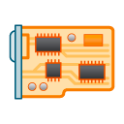
Usage: pre-release integration testing
Objective: Support the Linux community through an integration testing program
Synchronized to, and automatically triggered by, upstream release cycles
A local daemon patrols for changes in upstream repos
Driven by an OFA-defined test plan specific to the repo that has pending changes
Results reported thru standard open source mechanisms
Repo with pending changes
test plan
Benefits:
Provides the Linux open source community with ‘automated integration verification’
Frees the vendors from duplicating tests being run by every other vendor
FSDP runner
mailing list
Think of it as collaborative debugging

Slide 15
Usage: ON-demand program
Necessary machines are made available to the client (e.g. h/w vendor, a distro…) for its exclusive use for a defined duration
Private debug, design validation, testing …
Cost for use of the cluster depends on the FSDP membership level – see the section on “Membership”
During that interval, the allocated machines are dedicated for the sole use of that client
Use of the cluster is not necessarily driven by the OFA-defined test plan
test plan
vendor under test
On-Demand Testing
results
Results are returned to the client
distribution under test

Slide 16
Usage: logo program
Two possible types of Logos: Vendor Logo & Distro Logo
Logo tests are run ‘on-demand’, driven by OFA’s test plan
Test plan is executed selectively
Run against a defined (“certified”) hardware configuration
Run against a specific distribution(s)
Logo is awarded to Vendor or Distro
Certification includes:
Test environment
list of tests executed
pass/fail results
test plan
vendor under test
Logo Testing
LOGO
“Our new hardware is certified to work with RHEL x.x, SLES y.y”
or
“Our distribution is supported by the following hardware”
distribution under test

Slide 17
Fabric software development platform
A partitionable hardware cluster
Lab machine
  Multi-vendor
  Multi-network types (e.g. IB, RoCE, iWARP …)
  Easily extensible to add new network types
  Controlled access from the Internet
    VPN account required to access cluster
    Account on cluster required to access functions of cluster controller
  Provisioned with existing OFA-owned hardware
    Currently stored at UNH-IOL
Lab machine
InfiniBand Fabric
RoCE Fabric
Lab machine
Internet
VPN
Firewall
Cluster Controller
Lab machine
Lab machine
Control Network
iWARP Fabric
OPA Fabric
Lab machine

Slide 18
FsdP software infrastructure
The cluster is automatically configured and run by the Beaker Lab Controller according to specifications for a particular client or usage
Lab machine
Automated System Configuration
Beaker powers on and off each lab machine as needed
Controls the dhcp boot parameters for each lab machine
Installs software as requested
  by setting up the proper PXE boot image in dhcp and then powering on the machine (which will be set to PXE boot)
Test Operation
Once the system is configured, the Beaker Lab Controller:
Pulls tests from the beaker test repo (automatic mode), or
Leaves the machines ready for ssh login (manual use mode).
Beaker test repo
Lab machine
End User
Beaker Web Interface
Lab machine
Beaker lab controller
RDMA Networks
Beaker CLI
Lab machine
CKI Runner
Lab machine
Control Network
Lab machine

Slide 19
FSDP software infrastructure
Integration Testing – Continuous Kernel Integration Runner serves as the “client” (Note: although the program is called a CKI runner, it monitors more than just kernel trees for changes)
Lab machine
Beaker test repo
Lab machine
End User
Beaker Web Interface
CKI Runner watches upstream source trees
CKI Runner triggers a preplanned automated test run depending on which tree triggered the run.
On request by the CKI Runner, the Beaker Lab Controller configures the system for Integration Testing
Beaker will run the automated test plan and record test results
On completion, CKI Runner will perform the predefined actions with the results (email upstream mailing list likely the common action)
Lab machine
Beaker lab controller
RDMA Networks
Beaker CLI
Lab machine
CKI Runner
Lab machine
Control Network
Lab machine

Slide 20
FSDP software infrastructure
On-Demand (end user) Testing
Lab machine
End user uses the web interface or the command line interface (CLI) to initiate either an automated test run or a manual use run.
If an automated test run is initiated, it will run until it completes or times out, results emailed to the client
If something goes wrong during the run, the user can remotely logon the test machines up until the test timeout occurs, and then only the logs will still be available.
Beaker test repo
Lab machine
End User
Beaker Web Interface
Lab machine
Beaker lab controller
RDMA Networks
Beaker CLI
Lab machine
CKI Runner
Lab machine
Control Network
Lab machine

Slide 21
fSDP hardware Infrastructure
Inventory of existing OFA-owned hardware currently stored at UNH-IOL
  Much of the existing hardware at the UNH-IOL is older and likely not what we want to carry forward into this new program
Proposed cluster hardware
  20 test servers – These hold various vendor’s cards and are standardized for reasonable performance on tests
    Typical configuration:
      24 core CPU
      64GB RAM
      128GB OS drive
      One or more fabric access cards
  1 head node – Runs the cluster, stores all logs, runs interface to access cluster
  1 serial console server – Provides access to lowest level debugging in the case that kernel oops renders ssh session unusable

Slide 22
FSDP testing usage Model
FSDP WG oversees the cluster testing activities via defined Test Plans, different subsets of tests from the test library can be used for CI testing and distro/IHV logo testing
FSDP Test Library
FSDP WG is open to participation by all, however only those at a voting membership level and above can vote on the pre-defined Logo Test Plans
CI test plan
Distro test plan
Fabric specific test plan
Upstream
testing
Distro testing
IHV
testing
Cadence
Upstream testing triggered by changes in repos
Distro testing is ‘on demand’
Logo testing in ‘on demand’
FSDP usage is ‘on demand’
Debug
Debug
Logo
Debug
Logo

Slide 23
Upstream collaboration
The FSDP Test Library is simply a repo of tests that can be run on the cluster. Anyone is welcome to contribute to this test repo or use this repo in their own projects.
FSDP Test Library
Upstream maintainers are welcome to send an email to the FSDP WG mailing list requesting their project be included in CI testing. They need only list the repo they wish to be monitored and the tests they want run.
CI test plan
Distro test plan
Fabric specific test plan
Upstream
testing
Distro testing
IHV
testing
As upstream developers find problems, they can contribute tests for those specific problems to be included in the CI testing. In this way, we will be seeding what should turn into a vibrant upstream ecosystem for improved tests.
Debug
Debug
Logo
Debug
Logo

Slide 24
Program administration
The Program will be administered by the OFA’s FSDP Working Group (FSDPWG)
  This is distinct from the day-to-day operation of the testing site
The FSDPWG will serve as a gate keeper:
  Controlling initial access to the program
  Authorizing user accounts for sysadmin to manage
  Approving individual membership requests
  Approving requests for adding new repos into CI testing
  Receiving and acting upon complaints of problems that, for whatever reason, couldn’t be handled by day-to-day administrators
The FSDPWG will define all potential logo test plan specifications
The FSDPWG will be responsible for validating any potential logo test results
  FSDPWG is the OFA agent that issues a logo

Slide 25
Siting Options
Basic plan is to engage with service providers we have experience with or have reason to believe could be cost-effective and reliable
Requirements have been expressed as:
  “Testing Services Discussion Document”: an informal alternative or possibly preliminary to a traditional RFQ/RFP
  Ken is taking this to a new level, translating this into a RFQ with some additional, very useful detail for his potential service providers. This obviously can and will be used with other potential service providers
UNH-IOL:
  “Discussion Document” has been communicated, no response yet
  Working issues of our existing HW inventory on-site – what’s there and what to do about it
VTM Beaverton: working the “Discussion Document”
NMC: working the “Discussion Document”
TBD service providers sourced by Ken: about to begin evaluation of Ken’s RFQ

Slide 26
Plan for ongoing cluster Administration
Red Hat initial volunteer to setup FSDP cluster and stand up CKI runners and beaker instance
In the process, a system administration guide will be created to detail the common tasks and steps required to keep the cluster operational
Once a guide is created, it will be utilized to facilitate one of the following options:
  Check with the FSDP WG to see if the day to day maintenance is something they could handle
  If the FSDPWG does not feel confident they can manage the day to day needs of the cluster, then shop the administration guide to various contract administrators in search of pricing
Physical Site Administrators/Managers, provided by vendor that provides siting
  Provides day-to-day physical support
  Administrators will be expected to intervene under unusual circumstances, for example a runaway job or a machine that won’t boot
  Administrators will respond to unexplained outages and restart/repair/otherwise intervene as required
  Will need to interface with the permanent

Slide 27
Membership model
Membership level | OFA Rights | IWG Rights | FSDP Rights
Promoter | Full rights as defined by Bylaws | -right to serve as FSDP WG Chair - right to vote in FSDP WG | Unlimited access
OFA Statutory membership [1]
Membership level | OFA Rights | IWG Rights | FSDP Rights
Voting FSDP Member | n/a | - right to vote in FSDP WG | Unlimited access
Non-voting FSDP Member | n/a | - none | Unlimited access
Individual Member | n/a | - none | Free access
FSDP membership
[1] Any membership levels defined in the OFA Bylaws are ‘statutory members’ by California law and have special voting rights when changes to the bylaws are considered. In order to simplify making changes to the bylaws, only one level of membership is defined in the bylaws: Promoter Level. Promoter level members of the OFA will automatically have the highest level of FSDP membership. All other FSDP membership levels will be defined by separate, OFA Board approved policy. All on-demand access to the cluster requires FSDP membership.

Slide 28
Funding model
CI Testing is provided by the OFA to the upstream community free of charge in the same spirit as the 0-day and syzkaller programs
Cluster is supported by both OFA Membership and FSDP Membership dues
Propose 4 levels of Membership:
  Promoter Member (statutory): senior rights including unlimited testing
  Voting FSDP Member: Right to vote in FSDP WG but not to chair; unlimited testing
  Non-Voting FSDP Member: No right to vote in the FSDP WG; unlimited testing
  Individual Member: Limited to bona fide individuals with a demonstrated need to use the cluster
FSDP WG is treated as a “Works of Authorship” working group
  Decisions are made via voting mechanisms
  Anyone may attend meetings, but voting is limited to FSDP voting members (including OFA Promoters)
  Voting mainly applies to any pre-defined logo test plans

Slide 29
Costs – as of 4/9 nothing new to discuss
Start up costs
  20 test machines @ $2,500/ea
  1 head node @ $10,000
  1 serial console server @ $3,200
  IHVs that want their equipment specifically included in the upstream CI testing will be expected to donate HCAs, cables, and switches for their specific fabrics
  In an effort to reduce startup costs, donations of suitable servers would be greatly appreciated
Operational costs
  Facility rental
  Support staff
Jim and Doug to collaborate

Slide 30
Fsdp software infrastructure
Based on the following open source (or soon to be) tools developed by Red Hat
CKI (Continuous Kernel Integration) Testing framework
  https://gitlab.com/cki-project
Beaker lab management software
  https://beaker-project.org/
Various tests used by Red Hat with Beaker for years
  https://github.com/CKI-project/tests-beaker

Slide 31
NMC Distro Testing
Need arose for distro vendors to test their OFED stack for pre-release with a 3rd party entity
Contract formed with New Mexico Consortium (NMC) and OFA to provide testing ground for vendors to submit their pre-release distro and test against hardware
  NMC had hardware that was not utilized 9 months out of the year and kept relatively up to date
Initially started off with NMC providing no cost support for testing
  Intent was to provide charging once the program was fully solidified
Distro test framework based on UNH-IOL interop testing
  Tested distro against various RDMA hardware (IB, OPA, RoCE, iWARP), both for functionality and usability
Reported results back to vendor
  Provided follow up and retesting as issues were found
SUSE was the only vendor so far utilizing the program
LANL staff were the ones performing the testing on behalf of NMC
  Additional contract/support may be need to be addressed if moving forward with NMC and LANL

Slide 32
OFILP- openfabrics interop logo program
The original Interop program, dating to the 2000s
Long story short …
Was tightly coupled with, and driven by, OFED
  Did vendor devices interoperate with OFED?
  Did vendor devices interoperate with each other?
Narrowly focused on a small hardware vendor community
  InfiniBand, RoCE, iWARP
Centered around a certification program – ‘logo program’
Forced vendors into a rigid schedule
  (2x “interop events” 2x “debug events” per year)

Slide 33
OFILP mechanics
Subscribers paid a fixed base fee, + an incremental fee based on number of devices tested
Program operated on a cost recovery basis, with the OFA serving as the financial backstop
Cost per device was based on a forecast of the aggregate number of devices to be tested (all vendors)
Like clockwork
(until it’s not)
spring
Debug
LOGO
The annual cycle included two debug events, and two logo events, all bundled together and covered by the single subscription fee
Fees for each vendor were calculated based on the number of devices to be tested at the beginning of each year
An ‘all or nothing’ program
annual
cycle
LOGO
Debug
fall

Slide 34
Stakeholders
Direct Stakeholders
  Kernel maintainers
  Hardware vendors
  Distros
Indirect Stakeholders
  OpenFabrics Alliance
  OEMs (rely on the IHVs to test hardware)
  Upstream Linux RDMA community
  OFA Alliance Members who have a stake in the success of the OFA

Slide 35
stakeholder wish lists
Kernel Maintainers, Linux Open Source Community
  Improve the fidelity of kernel pre-release testing
  Focus on integration testing late in the kernel release cycle (when vendor driver updates have been integrated)
  Ensure that existing drivers interop correctly with a pre-release kernel
  Provide visibility to upstream maintainers into what’s been tested by vendors
Hardware Vendors
  Reduce testing costs;
  Test new hardware and/or software interoperability with other vendors and/or multiple distros
  An independent certification program driven by an industry-defined test plan (for those who want it)
  test upstream drivers
Distros
  Support for testing release candidates against a stable, current, multi-vendor hardware base
  Test backported drivers – ensure that features that work in the upstream version did not get broken in the Distro
  The opportunity to evaluate vendor backported drivers before inclusion in a GA release
  May value a certification program

Slide 36
Upstream kernel pre-release testing
Why?
  Ensures that existing drivers interop correctly with a pre-release kernel
  Provides visibility to upstream maintainers into what’s been tested by vendors
  Creates a fuller picture of device testing during the kernel pre-release process
How?
  Provide a known test plan to be used during the kernel pre-release process
  Support integration testing late in the kernel release cycle (when all vendors driver updates have been integrated)
  Provide results to the upstream linux-rdma mailing list for faster response times
ed note: either beef up this slide and add a corresponding version for the h/w vendors, or ditch this slide and rely on the previous slide to get the message across.

Slide 37
interoperability means:
Historically, the ‘distro’ was OFED + CentOS
app
app
OFED
OFED
1
2
h/w vendor 1
h/w vendor 2
cable b
cable c
Devices interoperate with their peers
  “Horizontal interoperability”
Devices interoperate with the s/w stack
  “Vertical Interoperability”
sw x
sw y

Slide 38
a streamlined virtuous cycle
start
kernel pre-release testing
validated h/w & drivers
high quality distributions
end

Slide 39
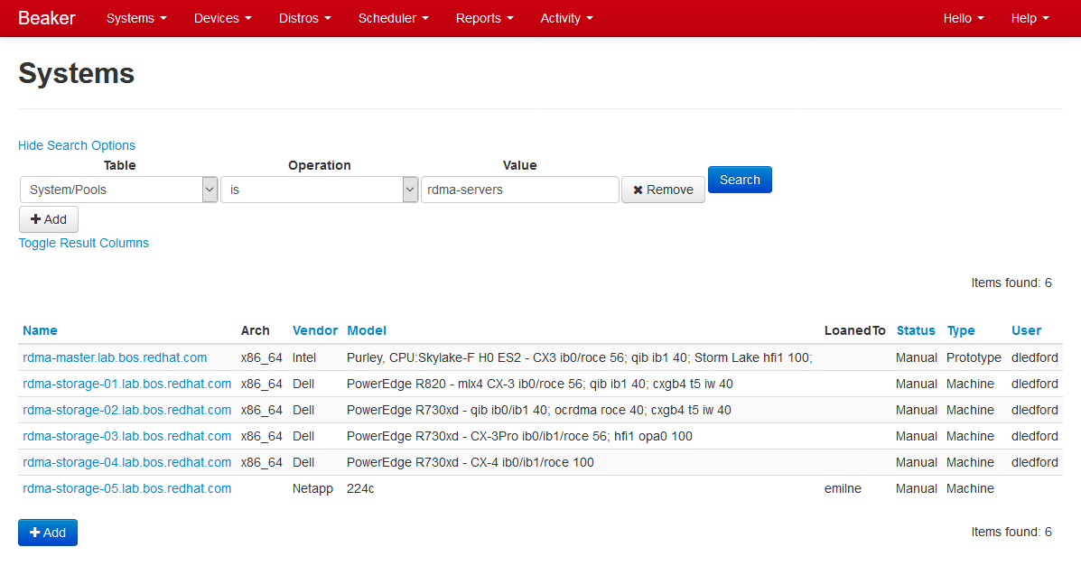
Beaker Web Interface – System Search

Slide 40
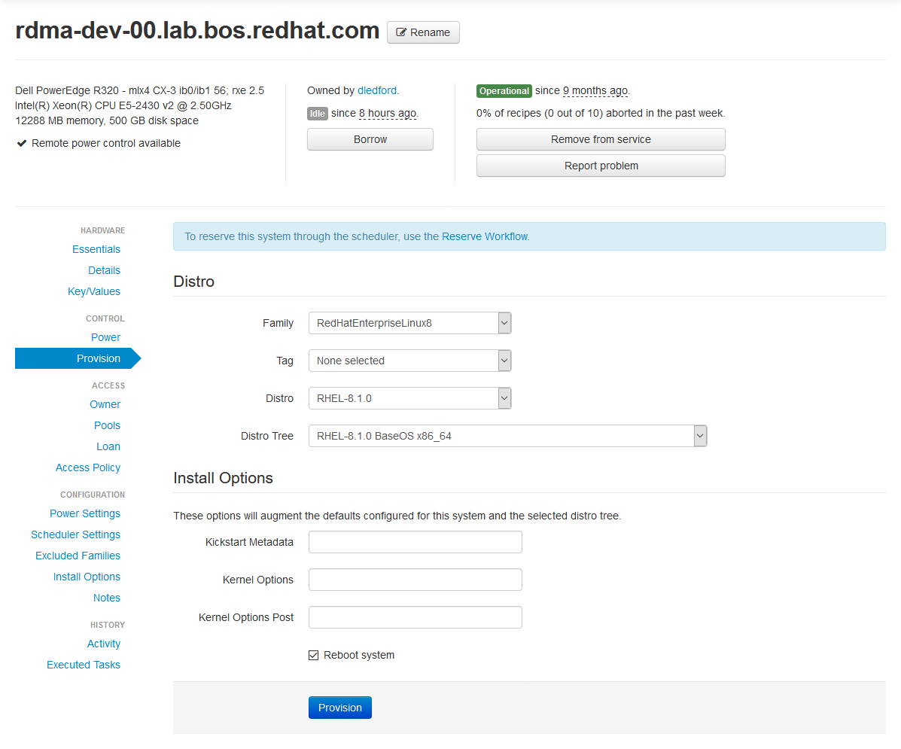
Beaker Web Interface – Provisioning

Slide 41
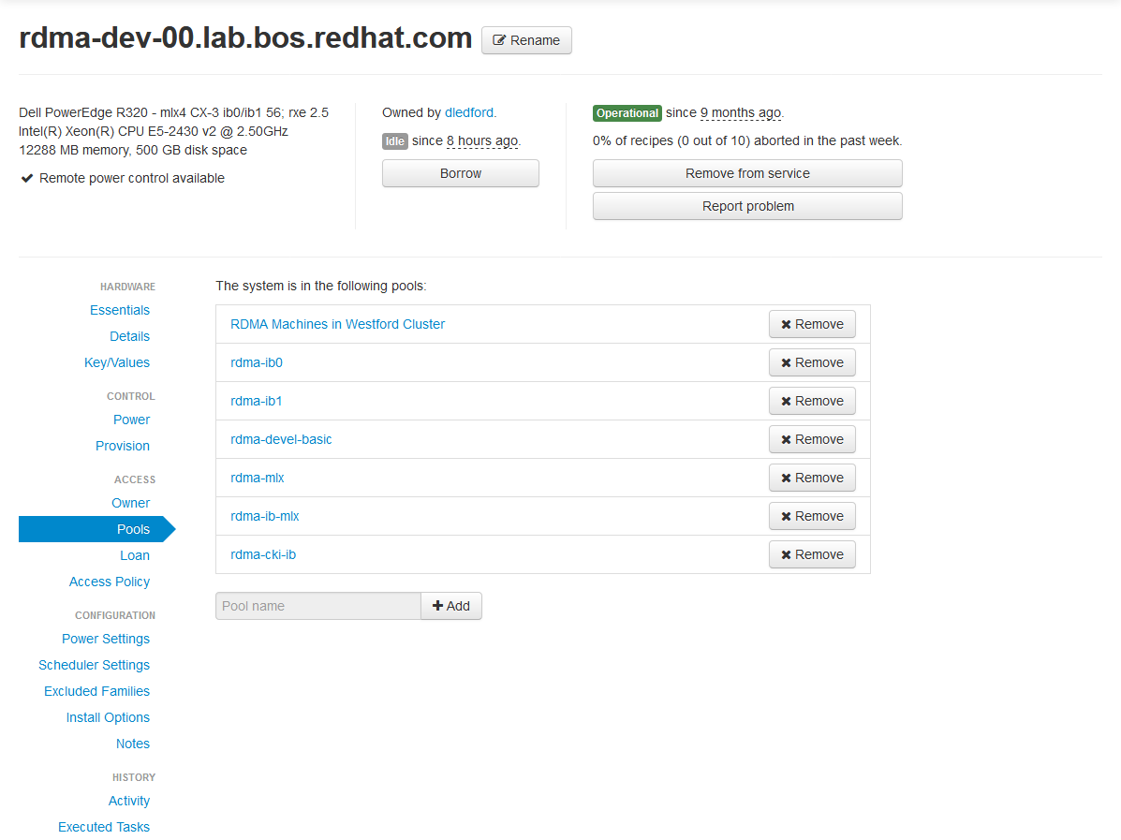
Beaker Web Interface – Pools

Slide 42
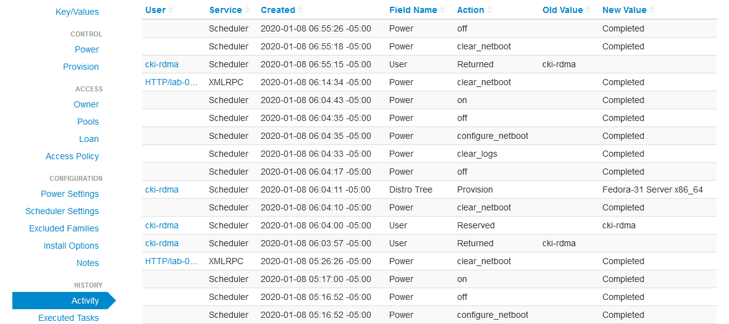
Beaker Web Interface – Activity

Slide 43
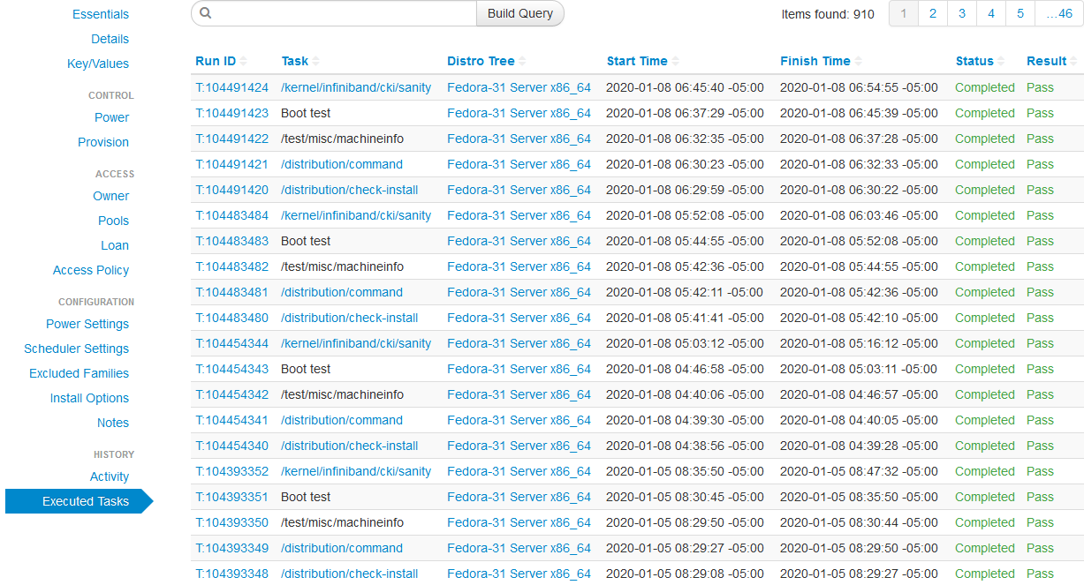
Beaker Web Interface – Executed Tasks

Slide 44
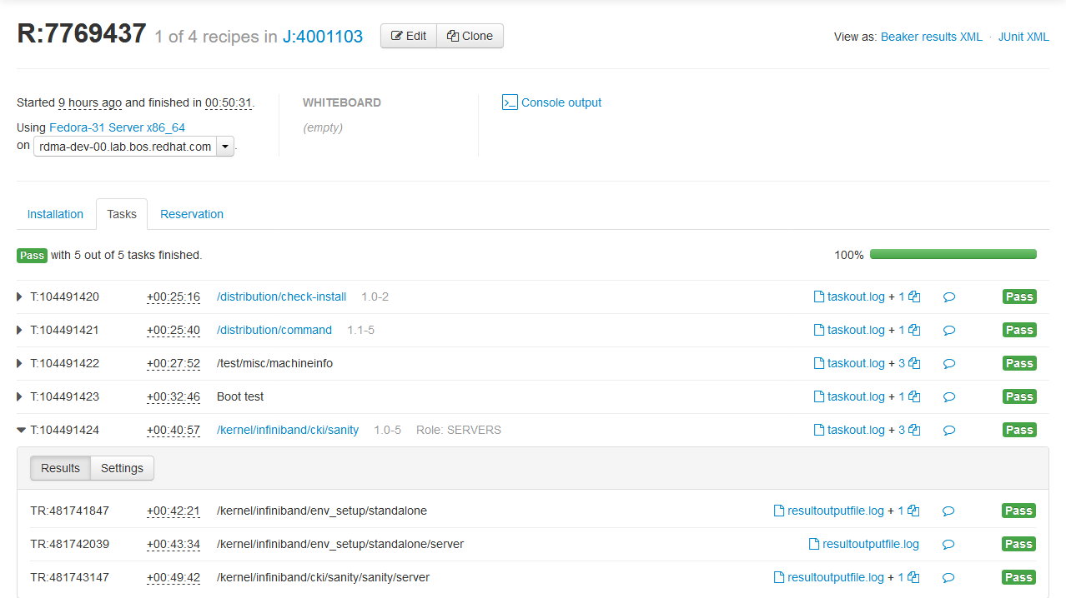
Beaker Web Interface – Job Log

Slide 45
Program objectives – high level
Driven by, and capable of testing, standard, commercially available, OS platforms
  SuSE, Red Hat, Debian, Ubuntu, etc.
Capable of testing specialized OS platforms (with additional software)
  OFED, MOFED, beta packages on top of the released OS platform code, upstream -rc releases, upstream final releases
Able to test user supplied software on any OS platform with or without OS updates
Adaptable to multiple different fabrics (see following slides on Scope)
Capable of testing interoperability across vendor hardware
  Broadcom RoCE to Mellanox RoCE for example
Runs mostly in lights out mode
  Able to automatically select machines to run tests on and install all necessary software for the test
  Able to give the option of automated testing or manual testing once the machines are installed
Able to manually schedule all or a portion of the cluster for user checkout

