Slide 1
OFA Fabric Software Development Platform FSDP
Proposal
May, 2020

Slide 2
Executive summary
We propose that the OFA create the OFA Fabric Software Development Platform – OFA FSDP
Comprises a hardware platform and accompanying software infrastructure
Designed to provide its target clientele with easy access to a modern cluster incorporating high performance network technologies to be used in the development, testing, and validation of software associated with client access to fabric services
Intended to be mostly automated and require little active maintenance, aka ‘lights out’
Sited at a commercial colocation facility or similar site
Promoter members are full FSDP members
Lower level memberships will be made available at a reduced price point
Anyone wishing to make use of the FSDP must have an OFA membership at some level
Supported by normal OFA membership dues
Seen as a vehicle for driving OFA membership and stature in the community
Will strengthen the cooperation between the OFA and various upstream communities
The OFA will provide continuous integration testing to the upstream communities free of charge

Slide 3
Table of Contents
Motivation and Objectives
Program Overview - Fabric Software Development Platform (FSDP) program
Fabric Software Development Platform – Hardware and Software Infrastructure
Program and System Administration
Governance – FSDP Working Group
Membership, Funding Model
Siting Options

Slide 4
Why an fsdp program
The simple answer - It is a core component of the OFA’s mission:
“The mission of the OpenFabrics Alliance (OFA) is to accelerate the development and adoption of advanced fabrics for the benefit of the advanced networks ecosystem.”
The OFA Fabric Software Development Platform, like the OFILP (the old Logo program) before it, is a key element in driving the adoption of advanced fabrics

Slide 5
An instructive look in the rearview mirror
The original OpenFabrics Interoperability Logo Program was:
Designed to validate interoperability between vendors, and with the OFED stack
Narrowly focused on a small hardware vendor community
Centered around a certification program – ‘Logo Program’
Forced participants into a rigid program schedule
Paid for by the subscribers, who were charged a fixed base fee + an incremental fee based on number of devices tested
Over time …
OFED’s components were replaced by a community-supported open source RDMA subsystem
RDMA users and vendors expressed strong preference to test against standard Distros and upstream kernels
Industry consolidation reduced the number of hardware devices
Long Story Short – it was the right program for its time, but that time has passed

Slide 6
question
Can we design a program that delivers greater value than the OFILP at lower cost?
While serving the needs of:
Alliance members
The open community
Vendors
OEMs
In short, a program that delivers on the OFA’s mission

Slide 7
A better idea?
At the 2019 Workshop, a ‘re-imagined’ Interop program was proposed:
Designed to be responsive to the needs of a much broader audience
Continues to serve the traditional hardware vendors and distros
Adds Linux community, network software developers, middleware developers and others as stakeholders
Greatly improved flexibility for clients of the program
Based on an ‘on-demand’ philosophy
Retains the original logo program, (if desired by the client base), but no longer the center of the universe
Integrates popular distributions
Compared to the OFILP, which was driven by OFED
Fundamental Shift In Philosophy
Old: OFILP consisted of debug events and logo events for IHVs; focused on awarding an OFA Logo
New: FSDP is an experimental cluster, supported and maintained by the OFA and made available to members for testing, debug, and validation

Slide 8
Serving our proposed target clients
Upstream Linux Maintainers
Automatic, continuous testing of upstream software (kernel, rdma-core, …)
Centralized testing of multiple hardware vendors’ products
Relieve maintainers of the burden of tracking the efficacy of hardware from multiple vendors
Incubation of an open source community that contributes tests that can be run on the cluster
Hardware Vendors *
Private, on demand access to a multi-vendor cluster for testing/validation of new hardware, software, firmware
Logo program, if desired
OS Distros: On demand testing for distros (Red Hat, SuSE, OFED, etc.) **
Private, on demand access to a multi-vendor cluster for e.g. release testing
Logo program, if desired
ISVs, Applications, Middleware
On demand testing of specific software (OpenMPI, AMQP, OpenStack, others)
Software development (Apache? MySQL?)
*served by original OFA Logo Program
**served by the “on-demand” testing program at NMC

Slide 9
What it is
The program comprises a ‘lights out’ cluster maintained and supported by the OFA
Easily accessible to OFA members
The cluster has at least three intended uses
Continuous Integration testing
On-demand testing
An optional logo program
Other uses are likely (and encouraged!) to emerge as the industry becomes aware of the capability being offered

Slide 10
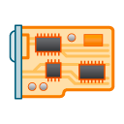
Usage: pre-release integration testing
Objective: Support the Linux community through an integration testing program
Synchronized to, and automatically triggered by, upstream release cycles
A local daemon patrols for changes in specific upstream repos
Driven by a test plan specific to the repo that has pending changes
Results reported thru standard open source mechanisms
test plan
Repo with pending changes
Benefits:
Provides the Linux open source community with ‘automated integration verification’
Frees the vendors from duplicating tests being run by every other vendor
FSDP runner
mailing list
Provided as a service by the OFA to the open community

Slide 11
Usage: ON-demand program
Machines and associated networks are available to the client (e.g. h/w vendor, a distro…) for their use
Private debug, design validation, testing …
Access to the cluster requires membership in the OFA – see the section on “Membership”
Members may use the cluster as fits their needs, they need not use any OFA-defined test plan
While machines can be checked out manually for periods of time, it is preferred that members utilize the automated testing capabilities of the cluster to maximize cluster usefulness
test plan
vendor under test
On-Demand Testing
results
Results are returned to the client
distribution under test

Slide 12
Usage: logo program
Two possible types of Logos: Vendor Logo & Distro Logo
Logo tests are run ‘on-demand’
OFA-defines the test plan, vendor specifies the tests to be run
OFA arbitrates disputes (same as OFILP)
Run against a defined (“certified”) hardware configuration
Run against a specific distribution(s)
Logo is awarded to Vendor or Distro
Certification includes:
Test environment
Hardware configuration
list of tests executed
pass/fail results
test plan
vendor under test
Logo Testing
LOGO
“Our new hardware is certified to work with RHEL x.x, SLES y.y”
or
“Our distribution is supported by the following hardware”
distribution under test

Slide 13
Fabric software development platform
A partitionable hardware cluster
Lab machine
Lab machine
Multi-vendor
Multi-network types (e.g. IB, RoCE, iWARP …)
Easily extensible to add new network types
Controlled access from the Internet
VPN account required to access cluster
Account on cluster required to access functions of cluster controller
InfiniBand Fabric
RoCE Fabric
Lab machine
Internet
VPN
Firewall
Cluster Controller
Lab machine
Lab machine
Control Network
iWARP Fabric
OPA Fabric
Lab machine

Slide 14
FsdP software infrastructure
The cluster is automatically configured and run by the Beaker Lab Controller according to specifications for a particular client or usage
Lab machine
Automated System Configuration
Beaker powers on and off lab machines as needed
Controls the dhcp boot parameters for each lab machine
Installs software as requested
by setting up the proper PXE boot image in dhcp and then powering on the machine (which will be set to PXE boot)
Test Operation
Once the system is configured, the Beaker Lab Controller:
Pulls tests from the beaker test repo (automatic mode), or
Leaves the machines ready for ssh login (manual use mode).
Beaker Test Repo
Lab machine
End User
Beaker Web Interface
Lab machine
Beaker Lab Cntroller
RDMA Networks
CKI Runner
Beaker CLI
Lab machine
Lab machine
Control Network
Lab machine

Slide 15
FSDP software infrastructure
Integration Testing - Continuous Kernel Integration Runner serves as the “client”
(Note: CKI runner monitors more than just kernel trees for changes)
Lab machine
Beaker Test Repo
CKI Runner watches upstream source trees
CKI Runner triggers a preplanned automated test run depending on which tree triggered the run
On request by the CKI Runner, the Beaker Lab Controller configures the system for Integration Testing
Beaker will run the automated test plan and record test results
On completion, CKI Runner will perform the predefined actions with the results (email upstream mailing list likely the common action)
Lab machine
End User
Beaker Web Interface
Lab machine
Beaker Lab Cntroller
RDMA Networks
CKI Runner
Beaker CLI
Lab machine
Lab machine
Control Network
Lab machine

Slide 16
FSDP software infrastructure
On-Demand (end user) Testing
Lab machine
End user uses the web interface or the command line interface (CLI) to initiate either an automated test run or a manual use run.
If an automated test run is initiated, it will run until it completes or times out, results emailed to the client
If something goes wrong during the run, the user can remotely log in to the test machines up until the test timeout occurs, and then only the logs will still be available.
Beaker Test Repo
Lab machine
End User
Beaker Web Interface
Lab machine
Beaker Lab Cntroller
RDMA Networks
CKI Runner
Beaker CLI
Lab machine
Lab machine
Control Network
Lab machine

Slide 17
fSDP hardware Infrastructure
Inventory of existing OFA-owned hardware currently stored at UNH-IOL
Existing hardware at the UNH-IOL is older and may not serve our needs well
Ownership of some resources at the UNH-IOL is unclear
Proposed cluster hardware
20 test servers to start, grow to 30 servers on year 3, then buy another 10 servers every 2 years and retire the 10 oldest servers so that we stay at a total count of 30 servers
These hold various vendor’s cards and are standardized for reasonable performance on tests
Typical configuration:
24 core CPU
64GB RAM
128GB OS drive
One or more fabric access cards
1 head node – Runs the cluster, stores all logs, runs interface to access cluster
1 serial console server – Provides access to lowest level debugging in the case that kernel oops renders ssh session unusable

Slide 18
Program administration
Program will be administered by the OFA’s FSDP Working Group (FSDPWG)
This is distinct from the day-to-day operation of the testing site
The FSDPWG will serve as a gate keeper:
Controlling initial access to the program
Authorizing user accounts for sysadmin to manage
Approving individual membership requests
Approving requests for adding new repos into CI testing
Receiving and acting upon complaints of problems that, for whatever reason, couldn’t be handled by day-to-day administrators
The FSDPWG defines all potential logo test plan specifications
The FSDPWG responsible for validating logo test results
FSDPWG is the OFA agent that issues a logo
FSDPWG arbitrates logo testing disputes (same as OFILP)

Slide 19
FSDP testing usage Model
The FSDP Test Library is a repo of tests that can be run on the cluster.
Anyone is welcome to contribute to this test repo or use this repo in their own projects
Test library is available to clients for
CI testing
distro/IHV testing
Logo test plan is an FSDP-defined subset of the Test Library
Upstream testing is automatic
Distro and IHV testing is “on-demand”
FSDP Test Library
CI test plan
Distro test plan
Fabric specific test plan
Upstream
testing
Distro testing
IHV
testing
Significant change
OFILP: test plans were developed and by IWG
FSDP: test plans are developed in the open source community. FSDPWG selects the subset comprising the Logo Program(s)
Debug
Debug
Logo
Debug
Logo

Slide 20
Upstream collaboration
FSDP Test Library
Upstream maintainers are welcome to send an email to the FSDP WG mailing list requesting their project be included in CI testing. They need only list the repo they wish to be monitored and the tests they want run.
CI test plan
Distro test plan
Fabric specific test plan
Upstream
testing
Distro testing
IHV
testing
As upstream developers find problems, they can contribute tests for those specific problems to be included in the CI testing. In this way, we will be seeding what should turn into a vibrant upstream ecosystem for improved tests.
Debug
Debug
Logo
Debug
Logo

Slide 21
Membership model
Membership level | OFA Rights | IWG Rights | FSDP Rights
Promoter | Full rights as defined by Bylaws | -right to serve as FSDP WG Chair - right to vote in FSDP WG | Unlimited access
OFA Statutory membership [1]
Membership level | OFA Rights | IWG Rights | FSDP Rights
Voting FSDP Member | n/a | - right to vote in FSDP WG | Unlimited access
Non-voting FSDP Member | n/a | - none | Unlimited access
Individual Member | n/a | - none | Free access
FSDP membership [2]
[3]
[1] Promoter Members are ‘statutory members’ by California law with special voting rights concerning the bylaws. Promoter is the only membership level defined in the bylaws.
[2] FSDP Members are OFA members; FSDP membership levels are defined by OFA membership policy.
[3] Access to the cluster requires OFA membership: either Promoter Member, or one of the FSDP Member levels.

Slide 22
Funding model
Program is an OFA budgetary expense; it is supported by OFA membership dues
Versus OFILP which was wholly supported by fees charged to the client
Propose 3 levels of FSDP Membership (in addition to the statutory Promoter Member):
Voting FSDP Member: Right to vote in FSDP WG but not to chair; unlimited testing
Non-Voting FSDP Member: No right to vote in the FSDP WG; unlimited testing
Individual Member: Limited to bona fide individuals with a demonstrated need to use the cluster
FSDPWG is treated as a “Works of Authorship” working group as described in the proposed IPR policy document
Decisions are made via voting mechanisms
Anyone may attend meetings and participate; voting is limited to Promoters and Voting FSDP members
Voting mainly applies to ratification of pre-defined logo test plans and acceptance of logo test results
Significant Changes
CI Testing provided by the OFA to the upstream community free of charge
Old: OFILP was funded by fees charged to the client, run on a cost recovery basis
New: FSDP is an OFA budgetary expense funded by member dues

Slide 23
Siting Options
We have received quotes from five potential hosting sites
UNH-IOL
$2,500 monthly recurring charge
$250/month for 10 hours/month of service or $1,000/month for 10 hours/week of service, cheapest service rates of all quotes
Facilities are well suited to hosting members that need actual physical access to the cluster
Extremely high initial setup charge
VTM Beaverton
$2,700 monthly recurring charge
$120/hr for services
No mention of whether or not they can do the beaker admin tasks
TierPoint (www.tierpoint.com)
$1,400 monthly recurring charge, very low internet budget, high power budget, overage charges for each
Completely lacking any quotes for requested services
Opus Interactive (www.opusinteractive.com)
$1,134 monthly recurring charge, moderate internet budget, moderate power budget, overage charges for each
Only quoted some of the services requested and highest for all services they did quote
John Companies, Inc (www.johncompanies.com)
$1,995 monthly recurring charge, unlimited gigabit internet, moderate power budget, no overage charges but will need to upgrade to higher monthly plan to get more than 2.8kW power in rack
Provided quotes for all services requested, hourly rates lowest of all quotes except UNH-IOL
Can be combined with our OFA website service to save a little money as John Companies is where the OFA servers are currently located

Slide 24
Plan for ongoing cluster Administration
Ken Strandberg – Long time OFA sysadmin, has offered to install and manage the Beaker instance in the cluster for a very reasonable price
$1,000 non-recurring setup charge
$800 monthly recurring admin charge
This is based on an estimate of 10 hours per month of required maintenance activity, with the ability to adjust the number if it turns out that this is not a reasonable estimate of time needed to manage the cluster
Other possible options include having one of the vendors do the work
John Companies provided a reasonable quote on a by-the-hour basis
UNH-IOL might include Beaker management in their Advanced Support option, waiting to hear from them
Regardless of who initially sets up the Beaker cluster, final acceptance of the setup will require the creation of a system administration guide to detail the common tasks and steps required to keep the cluster operational
This will be retained by the OFA in the case that cluster management needs to be transitioned from one place to another
Physical Site Administrators/Managers provided by vendor that provides siting
Provides day-to-day physical support
Administrators will be expected to intervene under unusual circumstances, for example a runaway job or a machine that won’t boot
Administrators will respond to unexplained outages and restart/repair/otherwise intervene as required
Will need to interface with the Beaker/Cluster admin person

Slide 25
Deep dive into the numbers

Slide 26
Next steps
OFA Board vote to approve the proposal
Secure member commitments to provide necessary HCAs, cables, etc.
Finalize membership levels and dues
Including Promoter Member dues
Requires a Board vote to establish a new OFA Membership policy and due schedule
Select a hosting contractor; execute a contract
Begin building a client base
Preliminary discussions held with a few key clients (mainly distros)
Start building the cluster

Slide 27
To close the proposal
Slide 23 – FSDP H/W Infrastructure - Doug to fill in hardware details
Everything except UNH-IOL inventory now done
Slide 29 – Costs – Initial version done, needs eyes on it

Slide 28
Costs
Start up costs
20 test machines @ $2,500/ea
1 head node @ $10,000
1 serial console server @ $3,200
22 server install charges at $190/ea
IHVs that want their equipment specifically included in the upstream CI testing will be expected to donate HCAs, cables, and switches for their specific fabrics
Assume that we will buy 10 new servers every 2 years, and starting at year 5 we will retire 10 of the oldest servers when we buy the 10 new servers (donations from member IHVs would be greatly appreciated here)
Operational costs
Facility rental
$1,995/month for hosting of equipment, all inclusive
Support staff
$75/month for spares inventory management + $95/hour for time working on machines, assume 4 hours per month
Beaker management at estimated 15 hours per month

Slide 29
Costs – continued

Slide 30
Fsdp software infrastructure
Based on the following open source (or soon to be) tools developed by Red Hat
CKI (Continuous Kernel Integration) Testing framework
https://gitlab.com/cki-project
Beaker lab management software
https://beaker-project.org/
Various tests used by Red Hat with Beaker for years
https://github.com/CKI-project/tests-beaker

Slide 31
NMC Distro Testing
Need arose for distro vendors to test their OFED stack for pre-release with a 3rd party entity
Contract formed with New Mexico Consortium (NMC) and OFA to provide testing ground for vendors to submit their pre-release distro and test against hardware
NMC had hardware that was not utilized 9 months out of the year and kept relatively up to date
Initially started off with NMC providing no cost support for testing
Intent was to provide charging once the program was fully solidified
Distro test framework based on UNH-IOL interop testing
Tested distro against various RDMA hardware (IB, OPA, RoCE, iWARP), both for functionality and usability
Reported results back to vendor
Provided follow up and retesting as issues were found
SUSE was the only vendor so far utilizing the program
LANL staff were the ones performing the testing on behalf of NMC
Additional contract/support may be need to be addressed if moving forward with NMC and LANL

Slide 32
OFILP- openfabrics interop logo program
The original Interop program, dating to the 2000s
Long story short …
Was tightly coupled with, and driven by, OFED
Did vendor devices interoperate with OFED?
Did vendor devices interoperate with each other?
Narrowly focused on a small hardware vendor community
InfiniBand, RoCE, iWARP
Centered around a certification program – ‘logo program’
Forced vendors into a rigid schedule
(2x “interop events” 2x “debug events” per year)

Slide 33
OFILP mechanics
Subscribers paid a fixed base fee, + an incremental fee based on number of devices tested
Program operated on a cost recovery basis, with the OFA serving as the financial backstop
Cost per device was based on a forecast of the aggregate number of devices to be tested (all vendors)
Like clockwork
(until it’s not)
spring
Debug
LOGO
The annual cycle included two debug events, and two logo events, all bundled together and covered by the single subscription fee
Fees for each vendor were calculated based on the number of devices to be tested at the beginning of each year
An ‘all or nothing’ program
annual
cycle
LOGO
Debug
fall

Slide 34
Stakeholders
Direct Stakeholders
Kernel maintainers
Hardware vendors
Distros
Indirect Stakeholders
OpenFabrics Alliance
OEMs (rely on the IHVs to test hardware)
Upstream Linux RDMA community
OFA Alliance Members who have a stake in the success of the OFA

Slide 35
stakeholder wish lists
Kernel Maintainers, Linux Open Source Community
Improve the fidelity of kernel pre-release testing
Focus on integration testing late in the kernel release cycle (when vendor driver updates have been integrated)
Ensure that existing drivers interop correctly with a pre-release kernel
Provide visibility to upstream maintainers into what’s been tested by vendors
Hardware Vendors
Reduce testing costs;
Test new hardware and/or software interoperability with other vendors and/or multiple distros
An independent certification program driven by an industry-defined test plan (for those who want it)
test upstream drivers
Distros
Support for testing release candidates against a stable, current, multi-vendor hardware base
Test backported drivers – ensure that features that work in the upstream version did not get broken in the Distro
The opportunity to evaluate vendor backported drivers before inclusion in a GA release
May value a certification program

Slide 36
Upstream kernel pre-release testing
Why?
Ensures that existing drivers interop correctly with a pre-release kernel
Provides visibility to upstream maintainers into what’s been tested by vendors
Creates a fuller picture of device testing during the kernel pre-release process
How?
Provide a known test plan to be used during the kernel pre-release process
Support integration testing late in the kernel release cycle (when all vendors driver updates have been integrated)
Provide results to the upstream linux-rdma mailing list for faster response times
ed note: either beef up this slide and add a corresponding version for the h/w vendors, or ditch this slide and rely on the previous slide to get the message across.

Slide 37
interoperability means:
Historically, the ‘distro’ was OFED + CentOS
app
app
OFED
OFED
1
2
h/w vendor 1
h/w vendor 2
cable b
cable c
Devices interoperate with their peers
“Horizontal interoperability”
Devices interoperate with the s/w stack
“Vertical Interoperability”
sw x
sw y

Slide 38
a streamlined virtuous cycle
start
kernel pre-release testing
validated h/w & drivers
high quality distributions
end

Slide 39
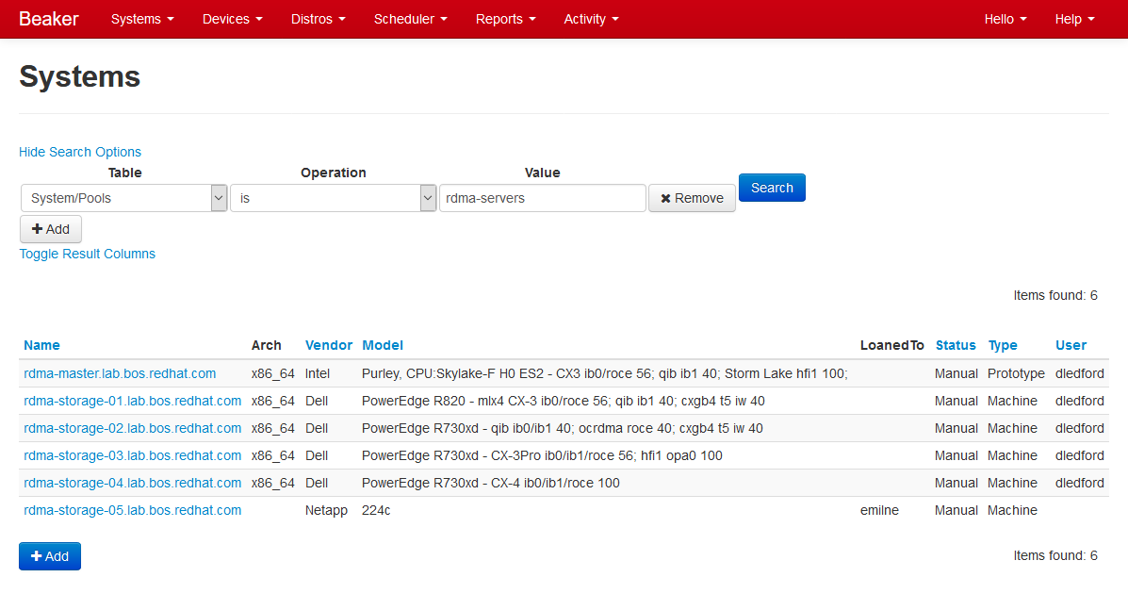
Beaker Web Interface – System Search

Slide 40
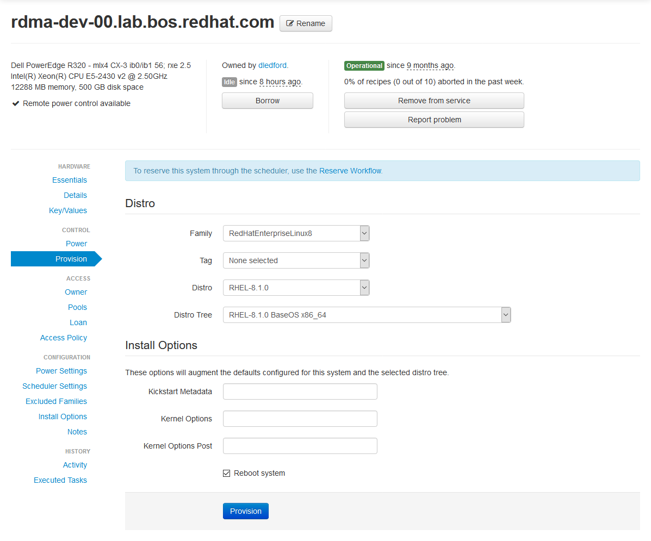
Beaker Web Interface – Provisioning

Slide 41
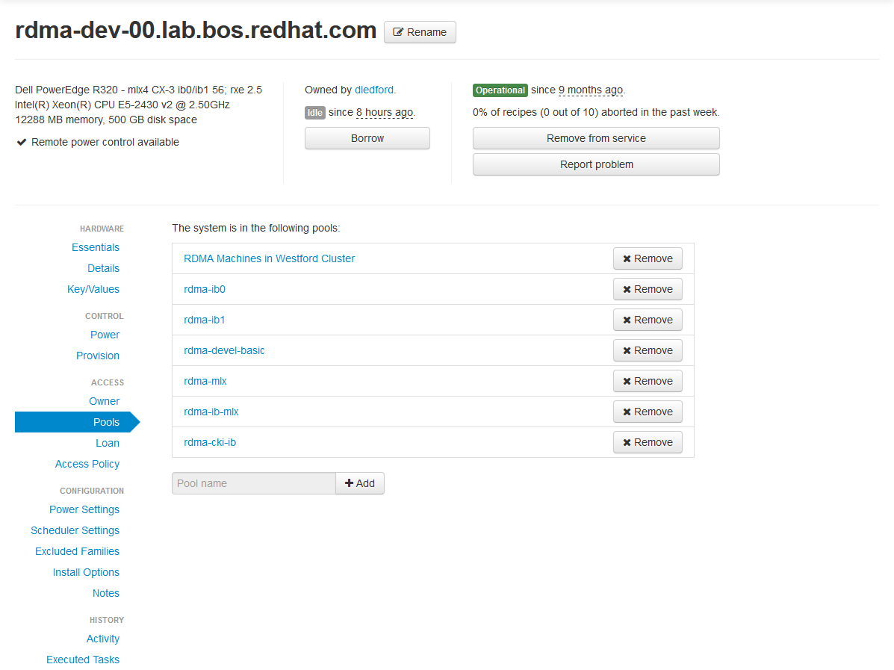
Beaker Web Interface – Pools

Slide 42
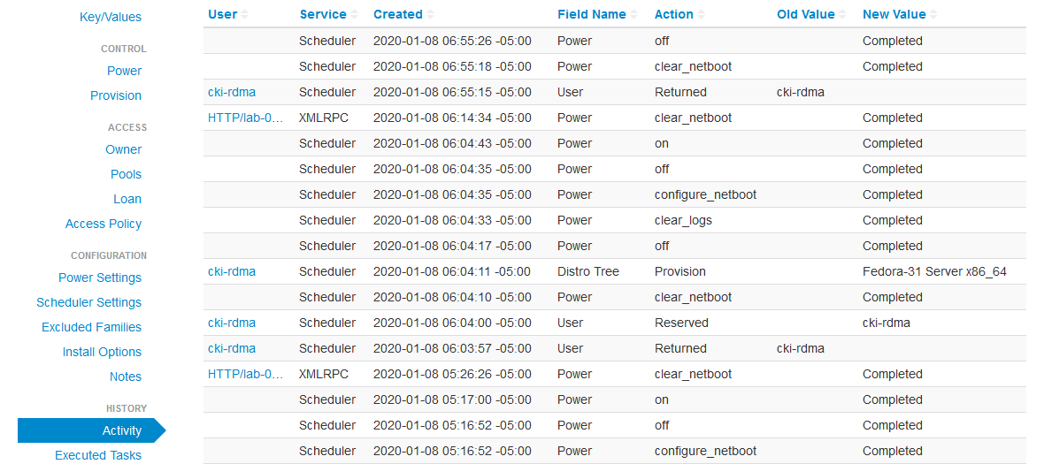
Beaker Web Interface – Activity

Slide 43
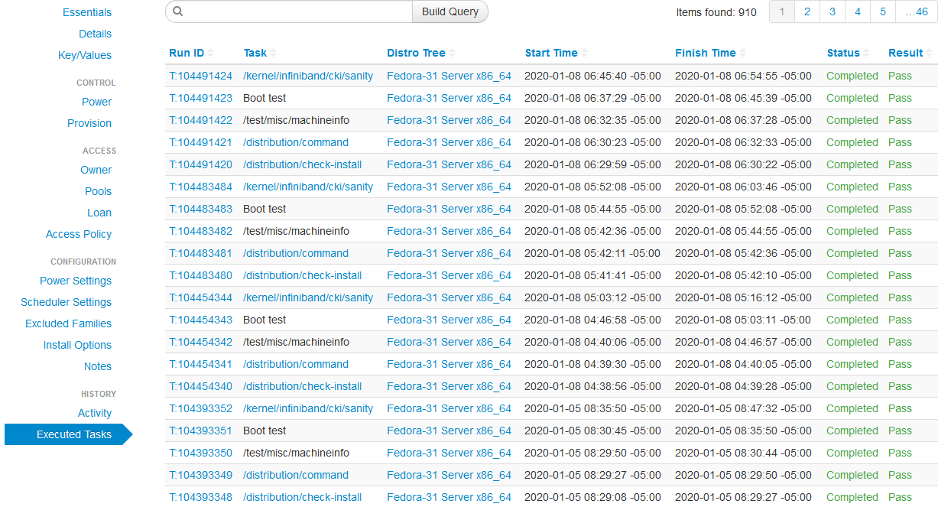
Beaker Web Interface – Executed Tasks

Slide 44
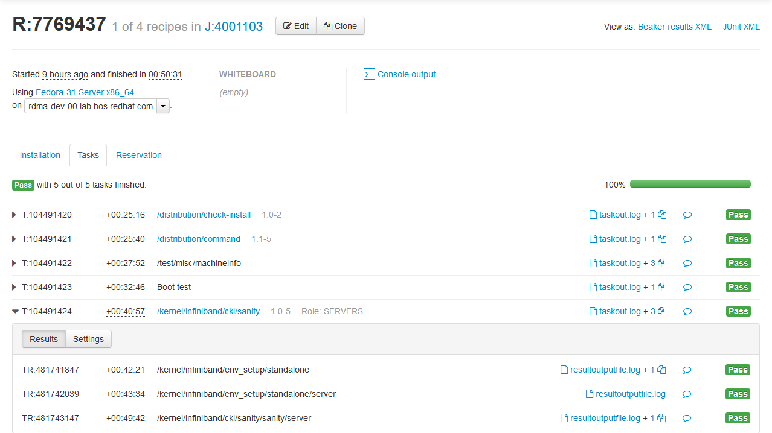
Beaker Web Interface – Job Log

Slide 45
Program objectives – high level
Driven by, and capable of testing, standard, commercially available, OS platforms
SuSE, Red Hat, Debian, Ubuntu, etc.
Capable of testing specialized OS platforms (with additional software)
OFED, MOFED, beta packages on top of the released OS platform code, upstream -rc releases, upstream final releases
Able to test user supplied software on any OS platform with or without OS updates
Adaptable to multiple different fabrics (see following slides on Scope)
Capable of testing interoperability across vendor hardware
Broadcom RoCE to Mellanox RoCE for example
Runs mostly in lights out mode
Able to automatically select machines to run tests on and install all necessary software for the test
Able to give the option of automated testing or manual testing once the machines are installed
Able to manually schedule all or a portion of the cluster for user checkout

Slide 46
Target clients – a broader audience
Upstream Linux kernel and user space software maintainers
Hardware vendors*
Distros**
ISVs, Application, Middleware developers
Network Services Consumers
…
Broadly, anybody engaged in:
Developing networking software
Consuming networking services
*served by original OFA Logo Program
**served by the “on-demand” testing program at NMC

Slide 47
serving our clients
1.
Support upstream release cycles
2.
Provide ‘On-demand’ access to all stakeholders
to a multi-vendor, multifabric testbed
3.
Continue the Logo Program if desired, but based on Linux distributions

Slide 48
Two major usages, one possibility
Continuous Integration Testing
Objective: Identify problems in the upstream software introduced in the development cycle
Provide maintainers a broad-based view of the state of device testing
vs forcing maintainers to gather that information from each individual hardware vendor
Primarily targeted at supporting kernel maintainers and to a lesser degree user space maintainers (rdma-core, etc)
hardware vendors derive some benefit too
On-Demand Development and Testing Capability for Distros, Vendors and Others
Objective: Provide a hardware and software platform for use by clients ‘on-demand’
A Possible Third Objective – A Certification Program (‘Logo Testing’)
Objective: An industry recognized, independent certification program allowing clients (primarily hardware vendors and distros) to claim “compliance” to a given set of tests

