Slide 1
Redfish Overview
& Fabric (Gen-Z) Deep Dive
Jeff Hilland
President, DMTF
Distinguished Technologist Manageability,
Hewlett Packard Enterprise
Copyright © 2019, DMTF.

Slide 2
Disclaimer
The information in this presentation represents a snapshot of work in progress within the DMTF.
This information is subject to change without notice. The standard specifications remain the normative reference for all information.
For additional information, see the DMTF website.

Slide 3
A Hybrid IT Management Solution
Design Tenets
Leverage common Internet / Web Services standards, other standards where appropriate
Protocol Suite
REST & JSON
Represent modern hardware designs (standalone to scale-out, current silicon, OCP)
Does not require a PhD to design or use.
HTTPS / SSL: Primary data transport
SSDP from uPnP: Service Discovery
HTTP-based alert subscription
Modern, standards-based
Widely used for web services, software defined and public APIs
Easy for IT professionals and amateurs to utilize
Data Model
Schema-based, starting with CSDL & JSON Schema
An easy to use data model that a human can just read
Prepare to add schema language definitions as market changes
Separation of protocol from data model, allowing them to be revised independently
Leverage OData v4
Create new modeling tenants to facilitate ease of design (inheritance by copy, polymorphism by union)

Slide 4
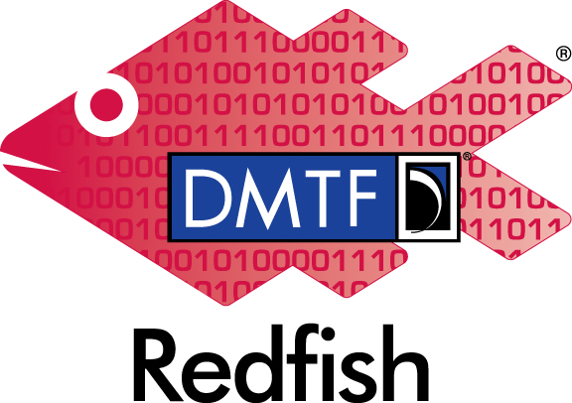
What is Redfish?
Industry Standard Software Defined
Management for Converged, Hybrid IT
  HTTPS in JSON format based on OData v4
  Schema-backed but human-readable
  Equally usable by Apps, GUIs and Scripts
  Extensible, Secure, Interoperable
Initial release in 2015 focused on Servers
  A secure, multi-node capable replacement for IPMI-over-LAN
  Represent full server category: Rackmount, Blades, HPC, Racks, Future
  Intended to meet OCP Remote Machine Management requirement
Expand scope since then to the rest of IT infrastructure
  Additional features coming out approximately every 4 months
  Working with SNIA to cover more advanced Storage (Swordfish)
  Working with The Green Grid & ASHRAE to cover Facilities (DCIM)
  Adapt IETF & other models to cover some level of Ethernet Switching
  Work with Gen-Z & others to cover Fabrics

Slide 5








DMTF Redfish Forum
Co-Chairs: Jeff Autor (HPE), Mike Raineri (Dell)
Redfish Forum Leadership Companies
Redfish Supporting Companies
American Megatrends Inc, ARM Inc, Artesyn Embedded Technologies, Cray Inc., Flex, Fujitsu, Huawei, IBM, Insyde Software Corp, Mellanox Technologies, Microsemi/Microchip, NetApp, OSIsoft LLC, Quanta Computer, Solarflare Communications, Toshiba, Western Digital Corporation
Redfish Industry Alliance Partners & efforts
OCP (Open Compute Project) – Collaborating on profile definition
UEFI – Collaborating on Firmware Update and Host Interface work
SNIA – Collaborating on Storage modeling / alignment between SNIA SSM and Redfish
TGG – Pursuing relationship to work on Power/Cooling (existing DMTF Alliance Partner)
IETF – working on Switch modeling (no official alliance)
ASHRAE – American Society of Heating, Refrigerating and Air Conditioning Engineers
BBF – Broadband Forum
Gen-Z – Gen-Z Consortium
PICMG – Open Modular Computing for IIoT
NVMe – NVMe-MI
Notes:
5

Slide 6











Timeline of Redfish® Specification
The DMTF Redfish technology
  Sep 2014: SPMF Formed in DMTF.
  Aug 2015: Redfish Specification with base models (v1.0)
  2016.1: Models for BIOS, disk drives, memory, storage, volume (2016.1)
  2016.2: Models for endpoint, fabric, switch, PCIe device, zone, software/firmware inventory & update (2016.2)
  2016.3: Adv. communications devices (multi-function NICs), host interface (KCS replacement), privilege mapping (2016.3)
  2017.1: Composability (2017.1), WIP for Telemetry
  2017.2: Location, errata (2017.2), WIPs for Ethernet Switching, DCIM, OCP & Profiles
  2017.3: Profiles, Query parameters, errata (2017.3)
  2018.1: LDAP/AD, SSE, Assembly,
  2018.2: OpenAPI, Telemetry, Jobs, Schedule, Compose II, Message II
  2018.3: Certificates, Sensor II (DCIM), FPGA
  2019.1: Spec Clean up; Additions to Certs, Telemetry, Console, Syslog
  2019.2: FW Update multipart, PCIe mods, Composition Registry
  2019.3: SNMP, SMTP, Swordfish
  2019.4: Gen-Z, PDU, Facilities (DCIM); Finish clean up
  Enhancements & errata every release.
Alignment with other standard organizations
  Aug 2016: SNIA releases first model for network storage services (Swordfish). Sep 2019: Swordfish 1.1
  Working open YANG Redfish mapping algorithm for Ethernet Switch
  DMTF created work registers with UEFI, TGG, OCP, ASHRAE, Broadband Forum, ETSI-NFV, NVMe, PICMG, Gen-Z, ODCC for work on Redfish

Slide 7
Redfish Resource Map (simplified)
Collection
Resource
Singleton
Resource
Subordinate
Resources
& Collections
/redfish/v1
Service Root
/redfish/v1/Systems
./Systems/<id>
Collection of Systems
"Logical view"
Computer System
Tasks
Processors
Sessions
Disks
Computer Systems
NICs
Accounts
/redfish/v1/Chassis
Events
Collection of Chassis
"Physical view"
./Chassis/<id>
Chassis
Power
Registries
Thermal
Schemas
/redfish/v1/Managers
Managed By
Collection of Managers
"Management"
./Managers/<id>
BMC
LogService
NW protocol
GET http://<ip-addr>/redfish/v1/Systems/{id}/Processors/{id}
Use the Redfish Resource Explorer (redfish.dmtf.org) to explore the resource map

Slide 8
Other Parts of Redfish DMTF is more than just Redfish
Host Interface
  Architectural Successor for KCS is a virtual NIC
Profiles
  Define requirements for solutions down to the property level
Open Source
  Tools, Interoperability Tests and Integration with other efforts (like OpenStack, Ansible and others).
Developer Hub
  Documentation, Education, Mockups and more
SMBIOS
PMCI
  MCTP, PLDM, SPDM, RDE & Others
CIM Forum
  SMASH, DASH and CIM maintenance
The organization that also brought you OVF, CIMI, CMDBf & DMI

Slide 9
Gen-Z Fabric extensions for Redfish
Ver. 1.0.1
November 2019

Slide 10
Redfish Common Fabric Model
Collection of Fabrics off of the Service Root
  Fabrics have Switches, Endpoints and Ports
Switches
  Switches have Ports that represent the connection
Endpoints
  Represent the “logical” endpoint, not where the cable ends.
    Parts of the protocol stack/standard that determine source or destination
  Think of this as the addressability bits
    Initiator and Target IDs for SAS
    IP Addresses and Rkeys for RDMA
  Endpoints are associated to Ports
Zones
  Represents what is allowed to communicate.
  Zones contain Endpoints.
    Initiator or Target permission is restricted by Endpoint properties.
/redfish/v1
Fabrics
1
Switches
Zones
Endpoints
1
1
1
Ports
1
collection resource
singleton resource
Subordinate object
Navigation Link (odata.id)

Slide 11
Gen-Z additions to the Fabric Model
Goal of Gen-Z Fabric extensions
Support the management of port-based Gen-Z Fabrics(Initiators/Targets)
Support Fabric-attached Resources (Targets)
Status
Redfish has an existing model for host/target mechanism on a port-based fabric
Formed a DMTF work register to develop the schema and mockups representing Gen-Z fabric management
Gen-Z schemas v1.0 approved by Redfish Forum
Schemas included in Redfish schema release v2019.4
  DSP8010 available for download at http://www.dmtf.org/standard/redfish
Media
Controllers
FabricAdapter
1
Memory
Chunks
Fabrics
Gen-Z
AddressPools
AP1
Switches
Zones
Endpoints
1
1
1
Ports
Zone of Zones
1
collection resource
singleton resource
Subordinate object
Navigation Link (odata.id)

Slide 12

Top Level Fabric Gen-Z Extensions
1..n
Ports
Routes
/redfish/v1/Fabrics/GenZ
1..n
Switches
VCAT
Model of Gen-Z Fabric
1..n
Endpoints
MediaController
/redfish/v1/Fabrics
Using Switches, Endpoints, and Zones
FabricAdapter
Use to manage the Fabric health and state
1..n
Zones
Switch
1..n
AddressPools
MemoryChunks
Routes
VCAT
/redfish/v1
/redfish/v1/Systems
1..n
Ports
Metrics
Root Resource
Collection of Systems
1..n
/redfish/v1/Systems/<id>/FabricAdapters
GenZ
SSDT
Links to all content
“Logical” view of general purpose systems
Registries
Bridge from SoC interface to Gen-Z Fabric
MSDT
Sessions
REQ-VCAT
Accounts
RSP-VCAT
Schemas
Events
/redfish/v1/Chassis/<id>/MediaControllers
/redfish/v1/Chassis
Media controller for Gen-Z access
Ports
Collection of Chassis
“Physical” view of the system
/redfish/v1/Chassis/<id>/MemoryDomains
MemoryChunks
1..n
/redfish/v1/Chassis/<id>
Collection of exportable memory regions
Chassis
/redfish/v1/Chassis/<id>/Memory
Chassis global physical asset info
Physical Media of resource
Power
Thermal

Slide 13
Fabric model (Gen-Z) to FAM
Service
Root
Target Side
Initiator Side
Systems
Fabrics
Chassis
GenZ
1
1
Fabric
Adapters
Memory
Address
Pools
Zones
Switches
Media
Controllers
Memory
Domains
1
Pool1
Zone1
Switch1
1
1
1
Ports
ConnectedEntity/
Links.Endpoints
Ports
1
Ports
Links.MediaControllers
Endpoints
Memory
Chunks
Initiator Endpoint
Target Endpoint
1
AssociatedEndpoint
1
ConnectedEntity/
Links.Endpoints
ConnectedPort/
ConnectedPort
1
ConnectedEntity/
Links.Endpoints
ConnectedPort/ConnectedPort
ConnectedEntity/
Links.Endpoints
resources
Navigation Link
New resource
Notes:
Update Connectivity Links

Slide 14
Fabric Model

Slide 15
Fabric model of a Gen-Z Switch
1..n
Routes
/redfish/v1/Fabrics/GenZ/Switches/
Switch<ID>
Ports
VCAT
/redfish/v1/Fabrics
Model of Gen-Z Fabric
Metrics
/redfish/v1
1..n
Collection of Switch Components
Root Resource
Use to track the Fabric health and state
/redfish/v1/Fabrics/GenZ
Links to all content
Model of Gen-Z Fabric
1..n
Control Space
Registries
Using Switches, Endpoints, and Zones
1..n
Endpoints
Sessions
Zones
Accounts
1..n
AddressPools
Schemas
Events

Slide 16
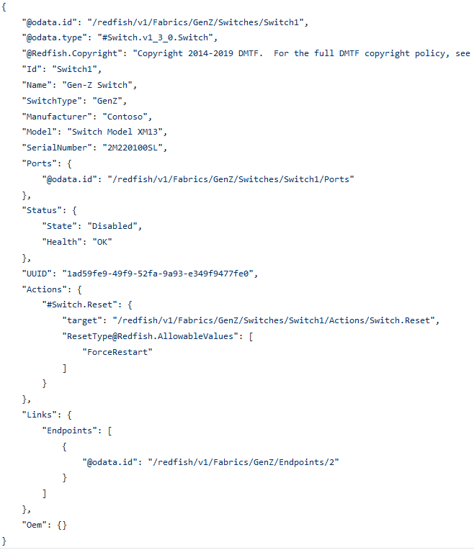
Fabric Model of a Gen-Z Switch
Gen-Z Switch Details
  Describes Switch Details
  Contains Ports
  Enable/Disables Switch functionality
  Allows for switch-specific configuration

Slide 17
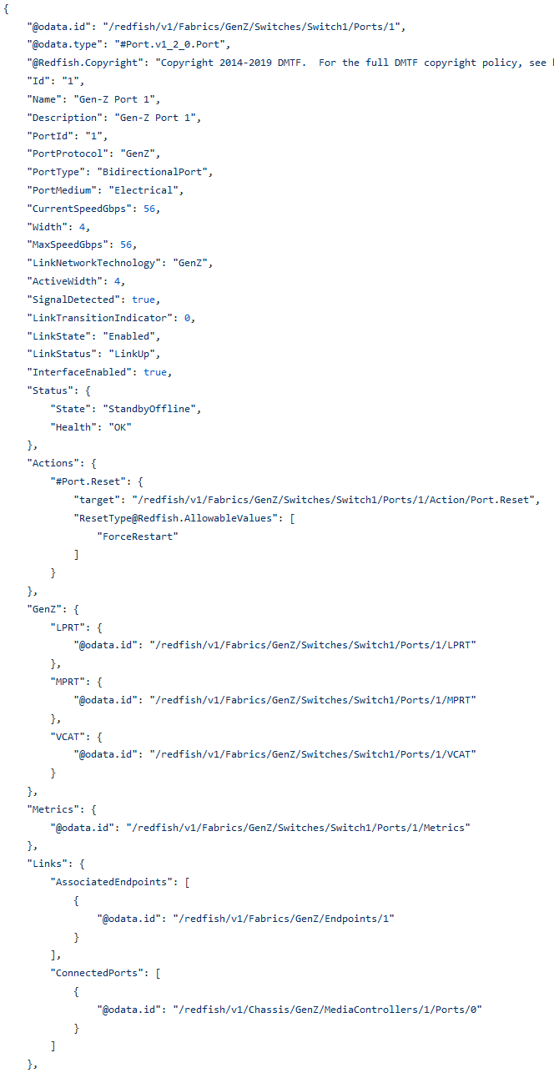
Fabric Model of Gen-Z Switch Ports
Gen-Z Port Details
  Describes Port details
  Describes Routing Info
  Describes Virtual Channels

Slide 18
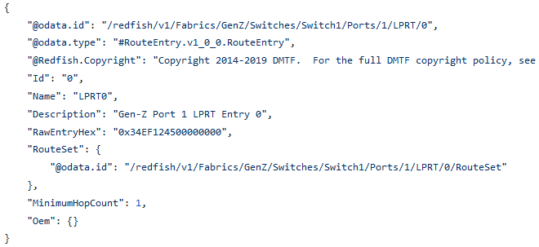
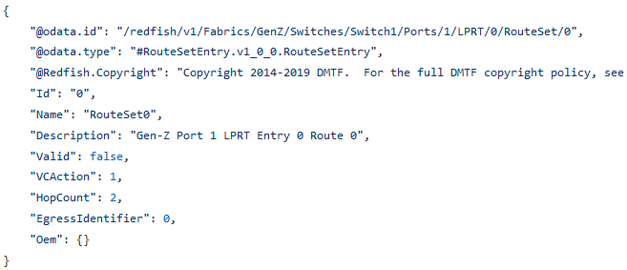
Fabric Model of Gen-Z Switch Port Routes
Route Table Entry
Gen-Z Ports have 2 route tables
  Linear Packet Relay Table(LPRT)
  Multi-subnet Packet Relay Table(MPRT)
LPRT has 4k possible route table entries
MPRT has 64k possible route table entries
  Patch each route entry to set route info
  Use RawEntryHex to patch the entire entry at once
  Can patch specific route data if required
Route Set Entry

Slide 19
Fabric Model of a Gen-Z Switch Port Route DeepPatch
Each port has 4k LPRT entries, 64k MPRT entries and 32 VCAT entries
  Lot of data to transmit to HW
  High radix switches have many ports to patch!
Propose to utilize a “Deep Patch” method to patch many entries at once
  Entries can be sparse
  Single connection to server for patching many entries
  Reduces amount of data being transmitted to the HW
  Use relative identifier “Id” to reduce amount of characters being sent to HW
Deep Patch support expected in next release of Redfish Specification
Ex. PATCH /redfish/v1/Fabrics/GenZ/Switches/Switch1/Ports/1 [ {“LPRT”:{ “Members”:[ { “Id”: 1, “RawEntryHex”: “0x12dfeb” } ] } } ]

Slide 20
Example Deep Patch (Proposed)
PATCH /redfish/v1/Fabrics/GenZ/Switches/Switch1/Ports/1
[
{ “LPRT”: {
“Members”: [
{ “Id”: 1, “RawEntryHex”: “0x12dfeb” },
{ “id”: 2, “RawEntryHex”: “0x334ddf” },
{ “Id”: 9, “RawEntryHex”: “0x073e5d”}
]
},
{ “MPRT”: {
“Members”: [
{ “Id”: 1, “RawEntryHex”: “0x31124fd”},
{ “Id”: 7, “RawEntryHex”: “0x1b458df”}
]
}
}
]

Slide 21
Fabric Attached target
Model

Slide 22
Fabric model to a Fabric Attached Target
Routes
Ports
VCAT
/redfish/v1/Fabrics/GenZ
Switches
/redfish/v1/Fabrics
Model of Gen-Z Fabric
Endpoints
Using Switches, Endpoints, and Zones
Use to track the Fabric health and state
Zones
AddressPools
/redfish/v1
/redfish/v1/Chassis/<id>/MediaControllers
Root Resource
Media controller for Gen-Z access
Links to all content
1..n
Registries
Sessions
Accounts
1..n
/redfish/v1/Chassis/<id>
/redfish/v1/Chassis/<id>/MemoryDomains
1..n
Chassis
1..n
MemoryChunks
Schemas
Chassis global physical asset info
Collection of exportable memory regions
Events
Power
Thermal
1..n
/redfish/v1/Chassis
Collection of Chassis
/redfish/v1/Chassis/<id>/Memory
“Physical” view of the system
Physical Media of resource
Notes:
Update Pointers

Slide 23
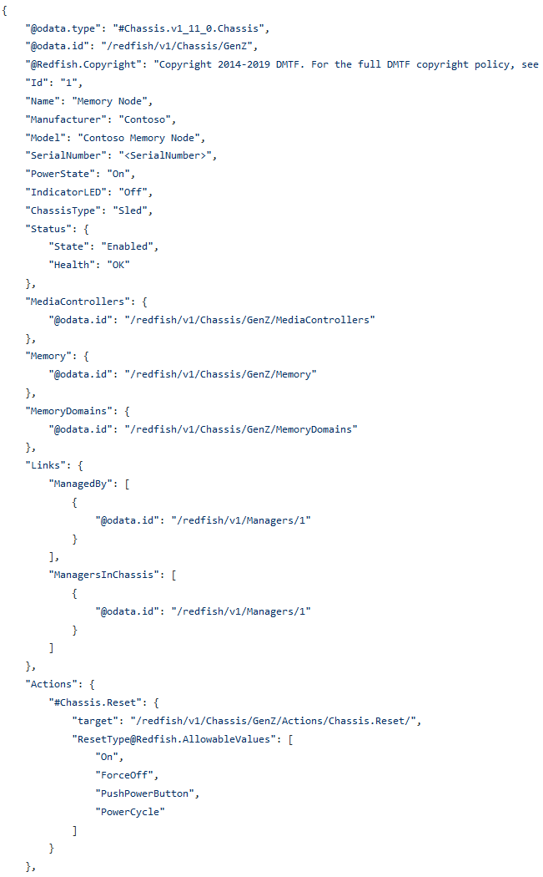
Model of Fabric Attached Memory
FAM resides in Chassis
  Physical description of media
  Not associated with a specific system
    Not attached to an SoC
  Can be composed with multiple systems
Add MediaControllers to describe FAM controller
Use Memory and MemoryDomains to describe assignable media

Slide 24
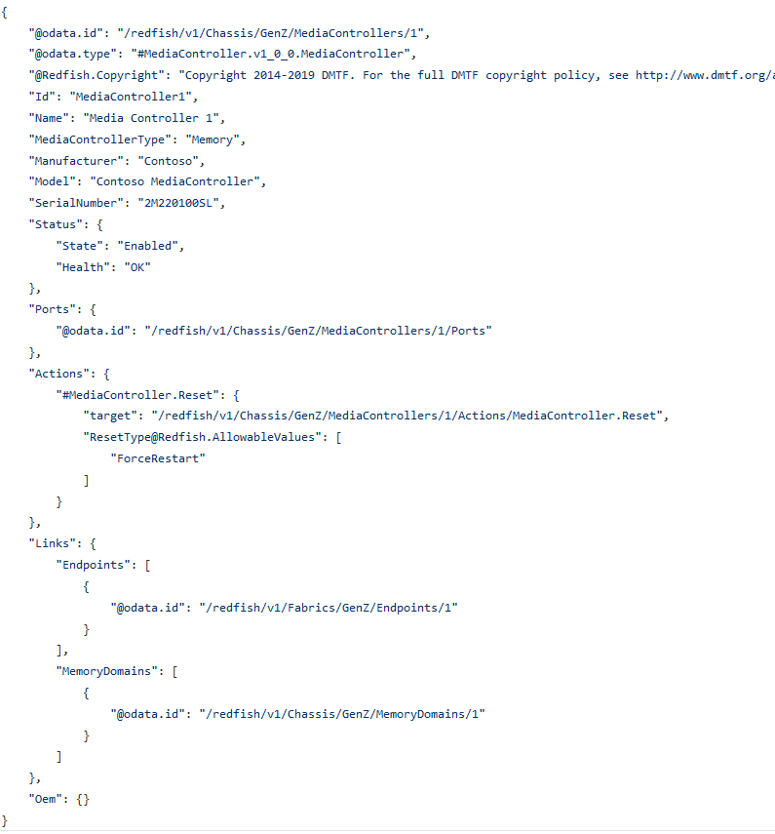
Model of MediaController
MediaController physical device
  Has Gen-Z Ports, same as Fabric Switches
Can configure MediaController settings
Describes status of controller
Links to associated endpoint and MemoryDomain

Slide 25
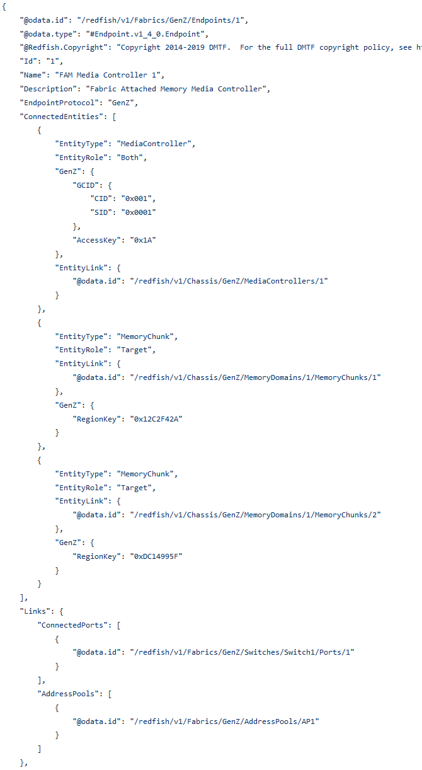
Model of FAM Endpoint
Fabric Endpoint describes MediaController and Memory Chunks
Each MemoryChunk describes a region of FAM
  Includes attributes of the region like Region Key
Each Endpoint describes the Global Component Identifier (GCID)
  Logical Fabric Identifier
  Used in Gen-Z Address from Initiator

Slide 26
Fabric Adapter
Model

Slide 27
Fabric model of a Gen-Z Bridge (Initiator)
Routes
Ports
VCAT
/redfish/v1/Fabrics/GenZ
Switches
Metrics
Model of Gen-Z Fabric
Endpoints
MediaController
/redfish/v1/Fabrics
FabricAdapter
Fabrics Extension
Includes Switches, Endpoints, and Zones
Zones
Switch
Use to track the Fabric health and state
AddressPools
/redfish/v1
Root Resource
Links to all content
Routes
Registries
VCAT
Sessions
1..n
Accounts
/redfish/v1/Systems
/redfish/v1/Systems/<id>/FabricAdapter
Ports
Metrics
Collection of Systems
1..n
Schemas
SSDT
Events
“Logical” view of general purpose systems
Bridge from SoC Interface to
GenZ Fabric
MSDT
REQ-VCAT
RSP-VCAT

Slide 28
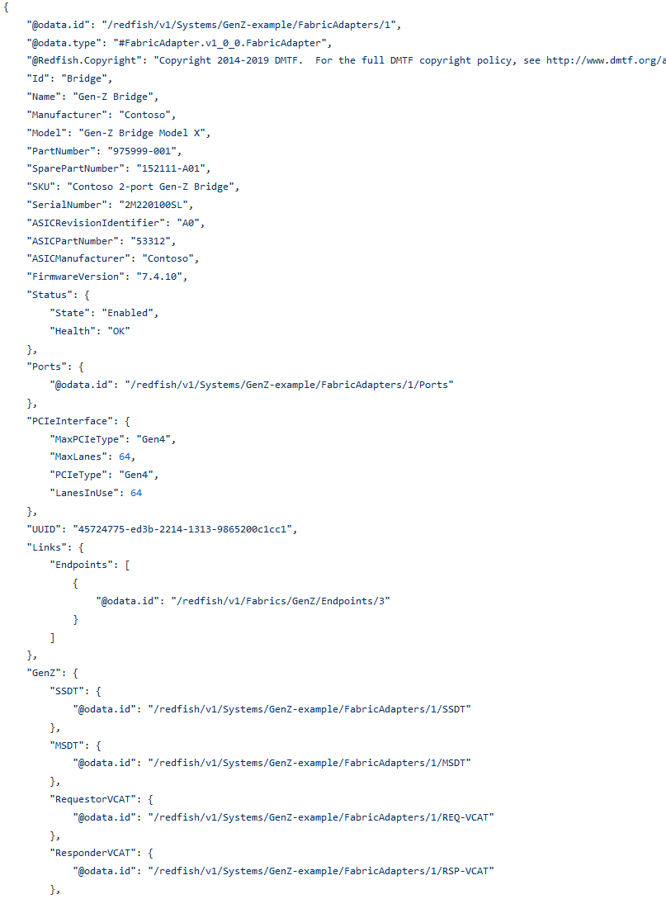
Model of a Gen-Z Fabric Adapter(Initiator)
Fabric Adapter bridges Gen-Z Fabric and SoC Interface
Fabric Adapter has a Gen-Z Requestor to inject packets into the Fabric
  Uses Routing tables to determine path to target
  Describes the details of the Adapter HW
Fabric Adapter may also contain an Integrated switch
  May contain ports for packet relaying
Fabic Adapters may also be a responder on the Gen-Z Fabric

Slide 29
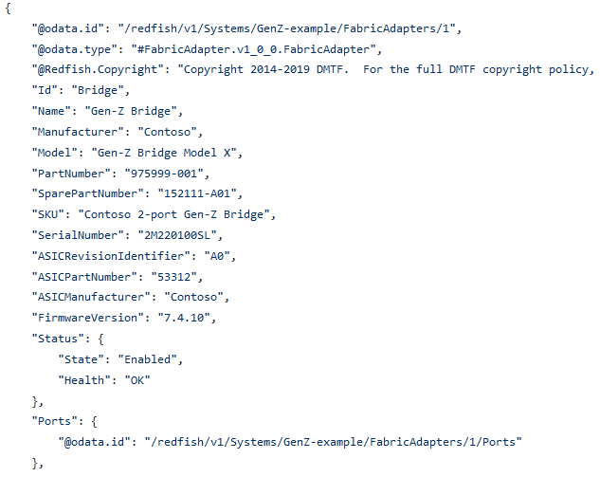
Model of a Embedded Switch in Fabric Adapter
Some Fabric Adapters may contain an embedded switch
Embedded Switches have Gen-Z Ports
  If ports can relay traffic, they would have route tables
  If Ports do not relay traffic, ports would not require routing tables
  Ports also describe Virtual Channels (VCAT) like Switch ports

Slide 30
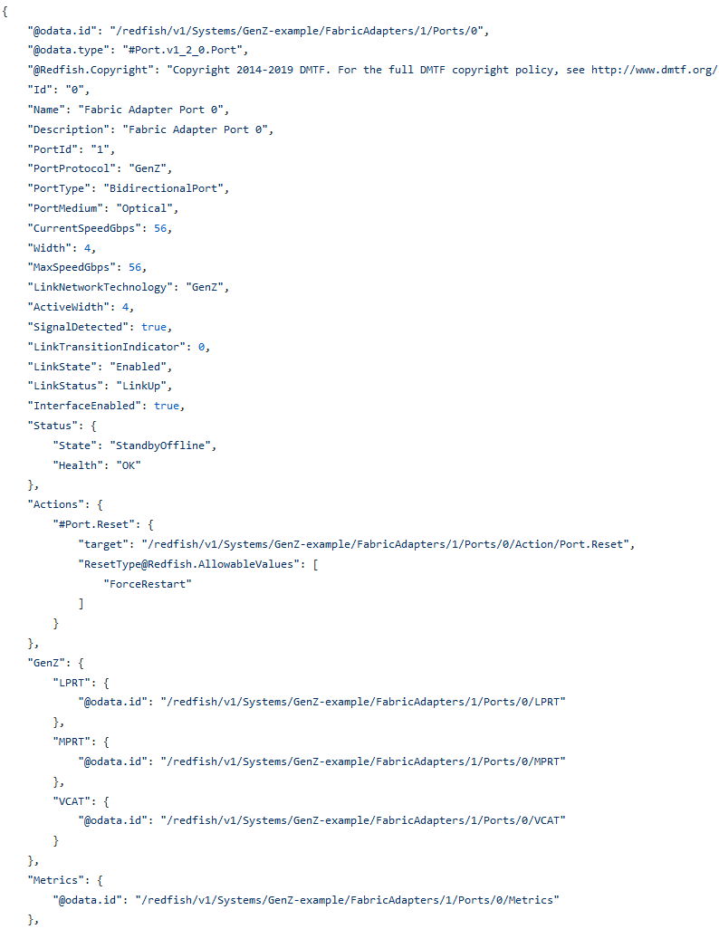
Model of a Embedded Switch Port
Embedded Switch Ports
  Same as switch ports in Fabrics
  Ports can relay traffic, so they have route tables
  Ports also describe Virtual Channels(VCAT)

Slide 31
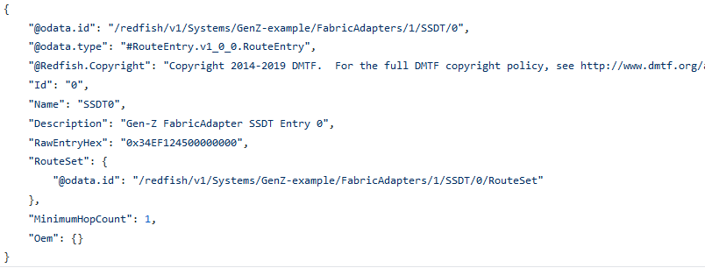
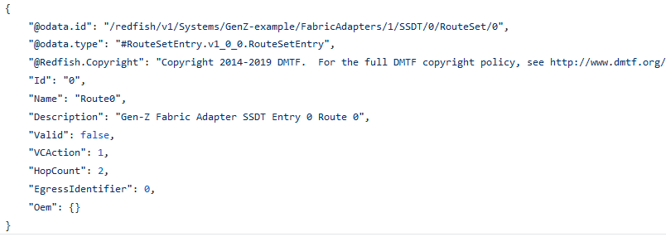
Model of a Fabric Adapter Routing
Fabric Adapter with multiple ports has route tables
  Single Subnet Destination Table(SSDT)
  Multi-subnet Destination Table(MSDT)
  Describes which egress port to get to each destination
  Describes which virtual channel to use on a particular egress port
  Each Entry can have a set of possible egress routes

Slide 32
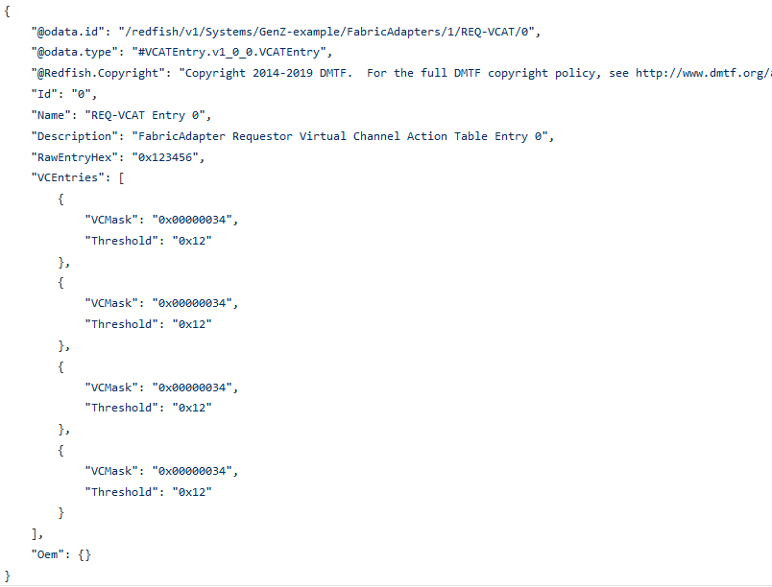
Model of a Fabric Adapter Virtual Channels
Fabric Adapter has Virtual Channel Action Tables
  For Requestor and Responder (REQ-VCAT, RSP-VCAT)
  Describes which virtual channels to use

Slide 33
Address Pools
Notes:
Describe Address Pools

Slide 34
Address Pools to provide constraints
Service
Root
Provides constraints on the values in Endpoints
  Ex. Limiting CID values for a Gen-Z Address
Typical constraints are minimum/maximum
All endpoints within that pool would adhere to the pool constraints
Address Pool would be specific to a particular fabric type
Fabrics
GenZ
AddressPools
Zones
Switches
AP1
Zone1
Switch1
Endpoints
Ports
Initiator Endpoint
Target Endpoint
1

Slide 35
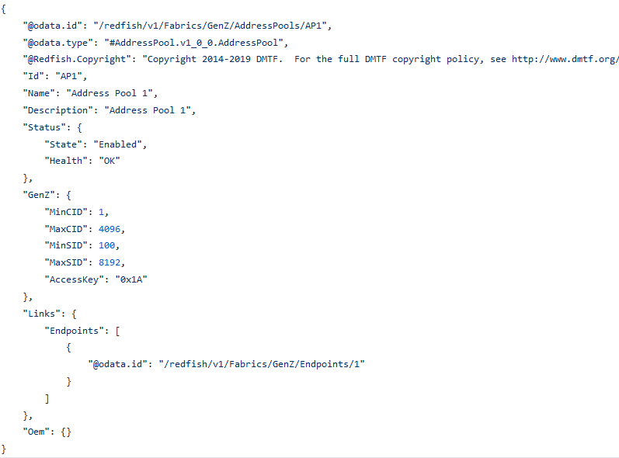
Address Pools for Endpoints
Elements Within an Address Pool
  Endpoints
  Zones
Allows for constraints for a group of endpoints

Slide 36
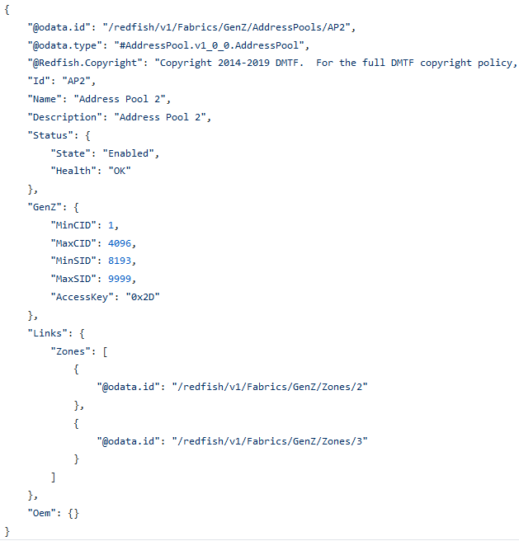
Address Pools for Zones
Elements Within an Address Pool
  Endpoints
  Zones
Allows constraining all endpoints within a specific zone
Provides scalability for managing address ranges

Slide 37
Zones
Notes:
Describe Zone of Zones

Slide 38
Zones need scalability
Zones represent connections
  Which resources are allowed to communicate with other resources
Large scale fabrics can have thousands of zones with thousands of endpoints within those zones
Allowing one zone to start communicating with another group would require another zone
Not scalable, would have to create another zone with all the previous zone endpoints within that zone
Hard to manage
  Removing a single endpoint would require DELETEing from all zones containing that endpoint

Slide 39
Zone of Zones
Created a new Zone of Zones
Allow for endpoints in one zone to communicate within another zone
Reduces number of required IOs from a client
Scalable for large fabrics
Uses ZoneType to differentiate Zone of Zones from Zone of Endpoints
AddressPool2
Zone1
AddressPool3
Zone2
Zone3
1
Endpoint
5
Endpoint
2
Endpoint
6
Endpoint
3
Endpoint
7
Endpoint
4
Endpoint
8
Endpoint
Route

Slide 40
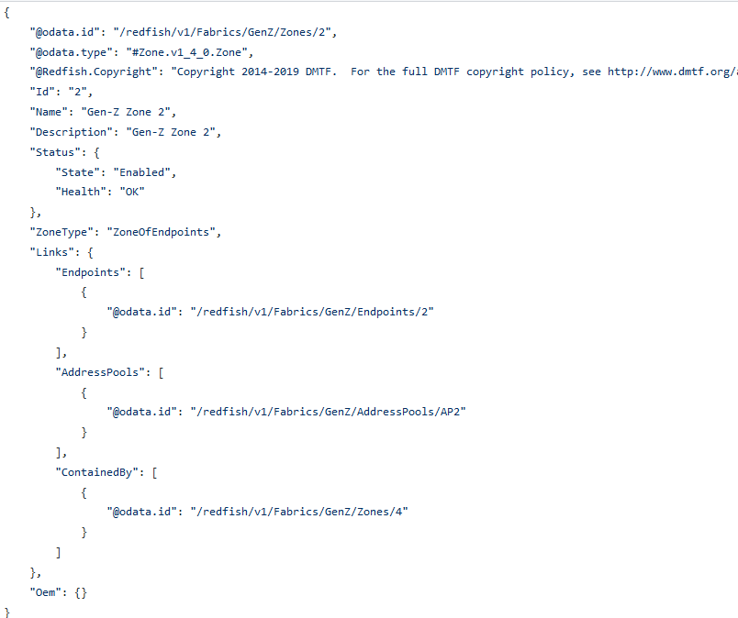
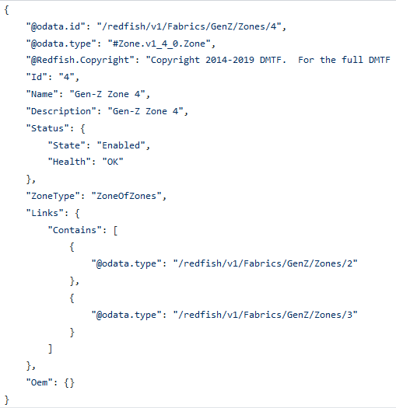
Example Zones

Slide 41
Events and Notifications

Slide 42
Unsolicited Event Packets
Gen-Z UEPs have a table of descriptions for each Unsolicited Event
Need to generate a Message Registry based on the UEP table defined in the Gen-Z Core Specification to describe each event type
  Table 6-40 in the Gen-Z Core Spec. has the list of events to turn into individual messages
  Take the UEP format to provide parameters for the messages

Slide 43
Questions/
Comments?

Slide 44

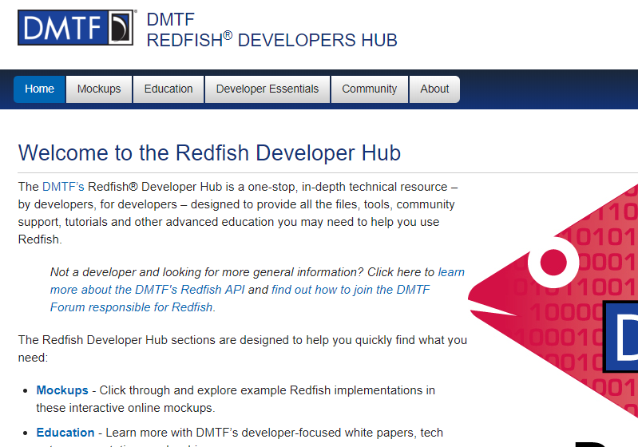
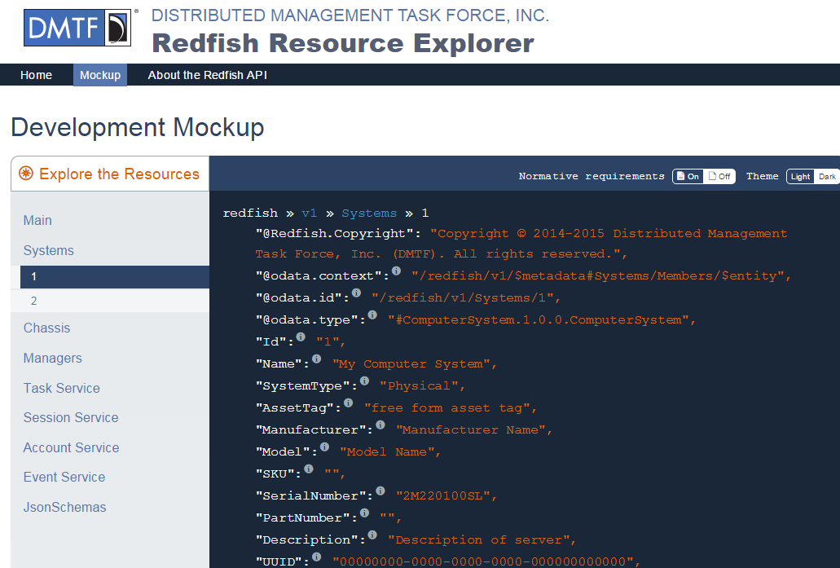
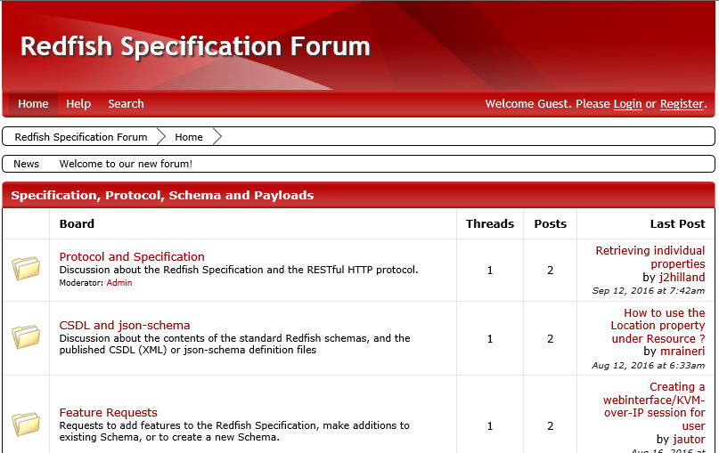
Redfish Developer Hub: redfish.dmtf.org
Resources
  Schema Index
  Specifications
  GitHub for Redfish Tools
  Registries
  Other Documentation
Mockups
  Simple Rack-mounted Server
  Bladed System
  Proposed OCP Redfish Profile
  More being added
Education/Community
  Redfish User Forum
  Whitepapers, Presentations
  YouTube shorts & Webinars

Slide 45
Thank you!

