Slide 1
Kubernetes Connections
Russ Herrell HPE
9/18/2020

Slide 2
Kubernetes Architecture and services
Worker nodes
Kubelet service
Master Node
K8s services
Kube-api-service
Kube-scheduler
Kube-controller-mgr
Load balancing
Replication mgr
Worker nodes
Kubelet service
Kubectl →
Worker nodes
Kubelet service
Container runtime (Docker, rkt, runc)
Kube-proxy
etcd
etcd →
Storage

Slide 3
Kubernetes Architecture and services
Worker nodes
Kubelet service
YAML conf
files
Worker nodes
Kubelet service
Master Node
K8s services
Kube-api-service
Kube-scheduler
Kube-controller-mgr
Load balancing
Replication mgr
etcd is a key-value store containing the globally available configuration information
Cluster status kept here
Kubectl →
Worker nodes
Kubelet service
Container runtime (Docker, rkt, runc)
Kube-proxy
etcd
etcd →
Api service supplies kubectl to clients.
Client submits YAML config files via kubectl
Also converses with worker nodes
Storage

Slide 4
Kubernetes Architecture and services
Worker nodes
Kubelet service
YAML conf
files
Worker nodes
Kubelet service
Master Node
K8s services
Kube-api-service
Kube-scheduler
Kube-controller-mgr
Load balancing
Replication mgr
Scheduler assigns workloads, reads in the configuration files, binds container execution to appropriate worker nodes, updates the etcd config files
Kubectl →
Worker nodes
Kubelet service
Container runtime (Docker, rkt, runc)
Kube-proxy
etcd
etcd →
Operations manager that listens to api-service, monitors etcd data base and invokes appropriate actions
Storage

Slide 5
Kubernetes Architecture and services
Worker nodes
Kubelet service
YAML conf
files
Worker nodes
Kubelet service
Master Node
K8s services
Kube-api-service
Kube-scheduler
Kube-controller-mgr
Load balancing
Replication mgr
All workers execute the Kubelet service to communicate with the Master Node
All workers have a container execution environment
Kubectl →
Worker nodes
Kubelet service
Container runtime (Docker, rkt, runc)
Kube-proxy
etcd
etcd →
Kube-proxy: worker node subnet proxies each host node to other workers … isolates subnet as a cluster of co-app servers
Storage

Slide 6
Kubernetes Architecture and services
YAML conf
Files
Typical “application” is one or more micro-service, each of which is in its own container….
Metadata
Name
Labels (to make connections with)
Deployment
POD 1
Container image 1
Container image 2
Container image 3
TCP port connection info
Replications 6
POD 2
Container image 4
Container image 5
Container image 6
TCP port connection info
Replications: 2
Status
<what actually is running>
Many ‘cloud native applications’ are clusters of identical micro-services, so a POD implements the number of instances
Kubernetes “controllers” monitor the etcd data base and make adjustments to the running configs so that status matches the deployment description

Slide 7
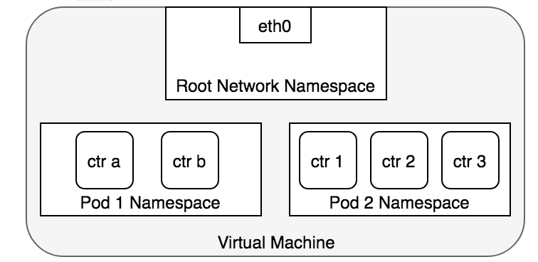
Kubernetes Networking Basics
A Pod is the smallest unit of work that can be deployed to a Kubernetes worker node
A Pod may have one or more containers
A Pod has a single IP address and network namespace
Containers within a Pod have port numbers pre-assigned by the user in the YAML deployment file
A worker node (a VM in this case) has its own Root Network Namespace and a logical (or physical Ethernet port)
A worker node may execute one or more Pods

Slide 8
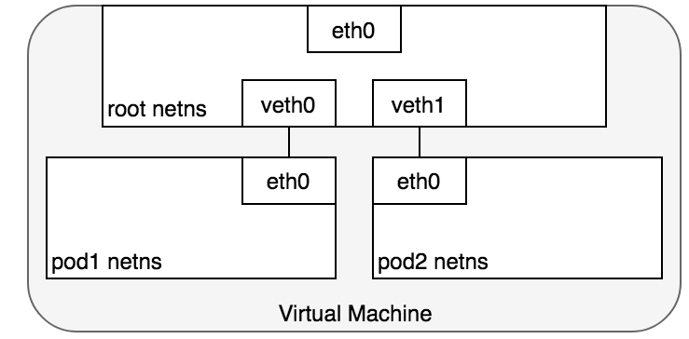
Kubernetes Networking Basics
Standard Linux OS implement Virtual Ethernet Devices, or veth pairs that can straddle different network namespaces.
Each Pod in a node is connected to the root namespace via a veth pair
Each Pod can thus converse with the root network

Slide 9
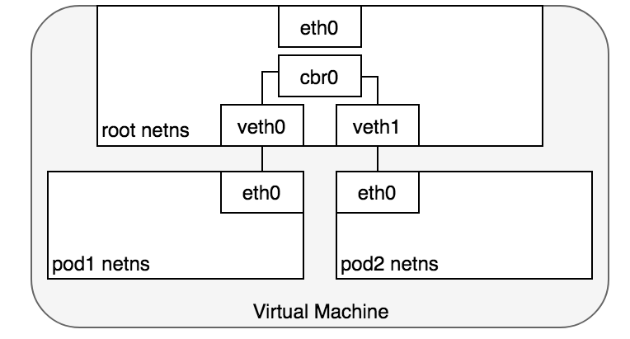
Kubernetes Networking Basics
Inside a node, the Pod’s network namespaces are connected with virtual bridges.
Pod 1 and Pod 2 have different IP addresses
Pod 1 and Pod 2 are connected to the root namespace by respective veth pairs
Traffic between the two pods is bridged in the host name space by a virtual bridge
Pod 1 and Pod 2 communicate with each other without going through a physical fabric
The virtual bridge is a feature of the standard Linux networking services
The IP address for a Pod is translated to a MAC address
The MAC address determines that the packet does not leave the node
Pod 1: IP 1
Pod 2: IP 2

Slide 10
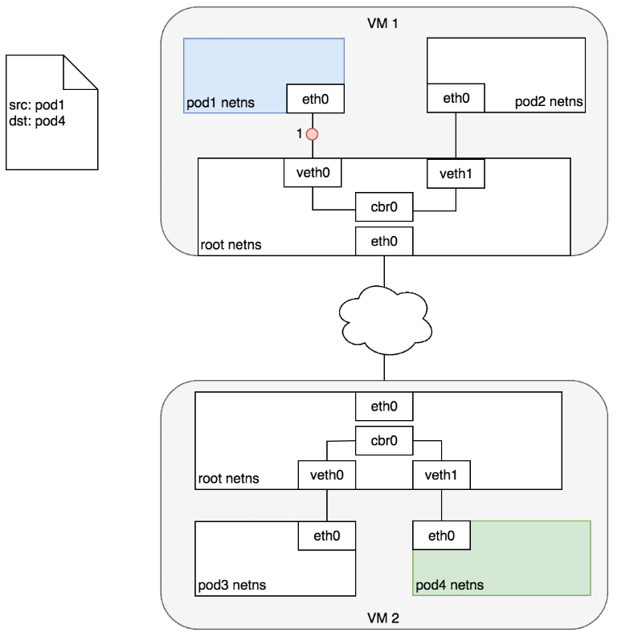
Kubernetes Networking Basics
Pod 1: IP 1
Pod 2: IP 2
Packets between Pods on different nodes are sent across a logical or virtual fabric external to the nodes
Kubernetes expects Pods are able to communicate with each other on different worker nodes. Essentially, the Master Node for the cluster assumes all its worker nodes can communicate
This external fabric must enable a route between the IP addresses of the two Pods (and the two nodes)
Pod 3: IP 3
Pod 4: IP 4

Slide 11
Kubernetes Networking Management
Two Issues (so far):
How does Kubernetes create clusters of worker and master nodes that have the correct connectivity?
How do Kubernetes Pods get assigned appropriate IP addresses on this cluster network?
IP 1
IP 2
IP 3
IP 4

Slide 12
Kubernetes Networking Management
Pod 1: IP 1
Pod 2: IP 2
Fabric Manager
CIDR1
IP 1
IP 2
Issue: how to assign the actual IP addresses to each Pod?
IP 1 & IP 2 come from CIDR block (subnet) assigned to VM 1.
IP 3 & IP 4 come from CIDR block (subnet) assigned to VM 2.
Solution: The Container Networking Interface (CNI) provides a common API for connecting containers to the outside network.
Each fabric environment supplies a CNI Plugin which handles the fabric specific details of choosing the IP addresses from the CIDR blocks and communicating them to the calling client.
CNI
CIDR2
IP 3
IP 4
Pod 3: IP 3
Pod 4: IP 4

Slide 13
AWS CNI Example
Pod 1: IP 1
Pod 2: IP 2
When Kubernetes creates a cluster, it needs to create a corresponding VPC.
Not part of the CNI plugin – (other issue)
Each VPC has many Elastic Network Interfaces (ENI) associated with it, all of which may communicate with each other (subnet)
When the AWS CNI plugin is deployed to the cluster, each node creates multiple ENI with associated IP addresses
Creates the CIDR block for the node
The AWS CNI plugin (via DaemonSet) creates a new ENI for each Pod deployed to a node
Effectively assigns the new Pod an IP
AWS CNI plugin launched when node placed in K8s cluster
Amazon Virtual Private Cloud (VPC)
AWS CNI plugin calls FM daemon when Pod is created to obtain an IP address
Pod 3: IP 3
Pod 4: IP 4
Notes:
Not sure yet exactly where the plugins and daemons run
But the general behavior is as illustrated

